Slide 1
UCAT
By Ben Joseph

Slide 2
What is the ucat?
The ucat is a 2 hour, multiple choice, computer based test sat in a test centre
admissions test is used by the majority of uk universites for entry to medical and dental schools
No curriculum content – think like an IQ test
Sit the test between July and September
Can only sit the test once per year

Slide 3
Key dates
Registration and booking:
24th May – account registration opens
20th June – booking opens
22nd September – booking deadline
Testing:
11th July – testing starts
29th September – testing ends

Slide 4
Test format

Slide 5
Verbal reasoning
Given a passage and need to answer questions based on the information
2 types of questions
1. Can be given 4 statements based on the passage and have to work out the correct one
2. Can be given one statement and need to work out if a statement is true, false or can’t tell

Slide 6
Verbal reasoning tips
2 approaches that you need to practice to decide which one you prefer
You can either read the text first and then answer the questions, or read the questions first and then look in the text to find the answer
Time pressure is very difficult with this section – need to get used to guess, flag and move on, to give yourself time to answer all the questions
Don’t use any external knowledge – you may think you know the answer but if the answer is not given in the text, it will be can’t tell

Slide 7
Decision making
Few different questions types including syllogisms, venn diagrams, arguments, probability and puzzles
Syllogisms is the main type of question
Slightly less time pressured than verbal reasoning – get just over a minute per question

Slide 8
Decision making tips
Practise following a logical thought process (use whiteboard if necessary)
Take time to read the statement properly first and then answer the statements referring back if you are stuck
Learn how to evaluate strong vs weak arguments – Do not pick the argument you like the most
Learn venn diagrams
Learn probability (GCSE level)

Slide 10
The key words or phrases are ‘driver-less cars and lorries’ in order to ‘improve road safety and encourage technological development’.
A - This answer doesn’t refer to technology at all or directly to road safety.
B- This refers well to safety but not to technology.
C - This statement talks about the driver’s confidence but has no reference to any of the key words.
D – This statement refers to safety and technology, so it is the strongest argument.

Slide 11
Quantitative reasoning
Tests maths at GCSE level
Common topics include: percentage changes, area, currency conversions and interest
Questions vary in difficulty a lot

Slide 12
Quantitative reasoning tips
use a keyboard with a number pad on the side – need to practice typing numbers into the on screen calculator very quickly
Use the whiteboard to write key numbers down
Learn to triage – harder questions include time zones and calculating tax brackets so skip and then come back to them at the end if you have time
Practice mental maths but know when to use the calculator
Learn the equations (speed distance time etc)
Learn the unit converstions

Slide 13
Abstract reasoning
In most questions, you are presented with set A and set B, and then a test shape
Set A and B have a different ‘rule’ and you need to try to work out the rule
For each set there are usually 5 test shapes

Slide 14
Abstract reasoning tips
Remember SCANS:
S – shape
C – colour
A – arrangement
N – number
S – symmetry
- eventually, you want to get to the stage where you don’t have to go through the whole of scans – you can already narrow it down

Slide 15
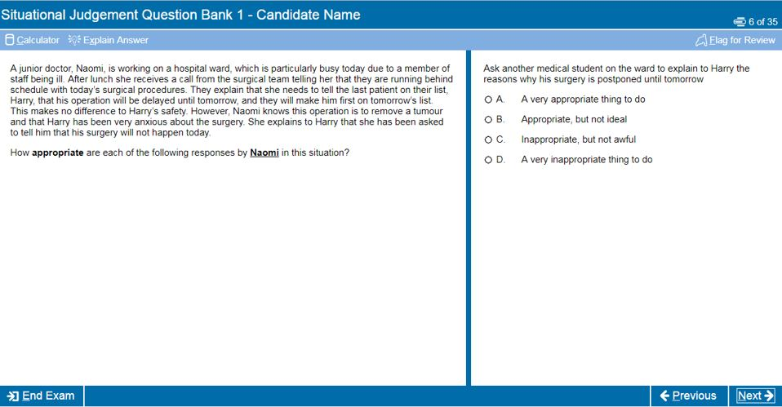
Situational judgement
Key themes include honesty, professionalism, patient confidentiality, patient safety
Almost no time pressure so do not rush
Tips:
Read GMC good medical practice
If unsure, pick either B or C, as you get half marks if you are one away

Slide 16
How to revise
Allow enough time before your exam to revise - start early (but not too early)
Medify – expensive but worth it
Start with untimed practice questions to get used to the style of how to answer the questions
2 weeks before the exams, move on to timed practice
Do as many mock tests as you can face – they are really helpful!
Youtube videos are great - you can pause the video, have a go yourself and then see how they approach the question if you get stuck
Use kharma medic, especially for abstract reasoning

Slide 17
What score do I need?
Scored between 300 and 900 on every section apart from situational judgement
These 4 sections are then added up for a total score out of 3600 and divided by 4 to get a mean score out of 900
Different universities require different scores – once you have your score check their website to see if your score is competitive
Over 650 is seen as competitive, over 680 is good enough for most places, and over 700 is good pretty much anywhere
For situational judgement, you are placed in a band. Band 1 is highest band 4 is lowest. Band 3 is ok, but you want a band 2.

