Slide 1
UCAT
The University Clinical Aptitude Test

Slide 2
What is the UCAT
The UCAT is hard.
It is a test of how well you can do mindless revision for hours on end.
It’s made up of 5 sections used to test every aspect of boringness and academic confusion

Slide 3
The five sections
Each section has a different number of questions in a different amount of time
They are all (except SJT) scaled up to be scored between 300-900 so the max score you can get is 3600
Situational judgement is banded with band 1 being the best and band 4 being the worst
Verbal reasoning
Decision making
Quantitative reasoning
Abstract reasoning
Situational judgement

Slide 4
Verbal reasoning
44 questions in 21 minutes
11 question sets with 4 questions per set
28 seconds per question or just under 2 minutes per set
A verbal reasoning set has a large piece of text that you will have to pick information out of to answer the question
There are 3 different main question types that you will learn when you come to practice it
Helpful tip – read the first few words of each paragraph before you answer the questions, so you know where in the passage the content is

Slide 5
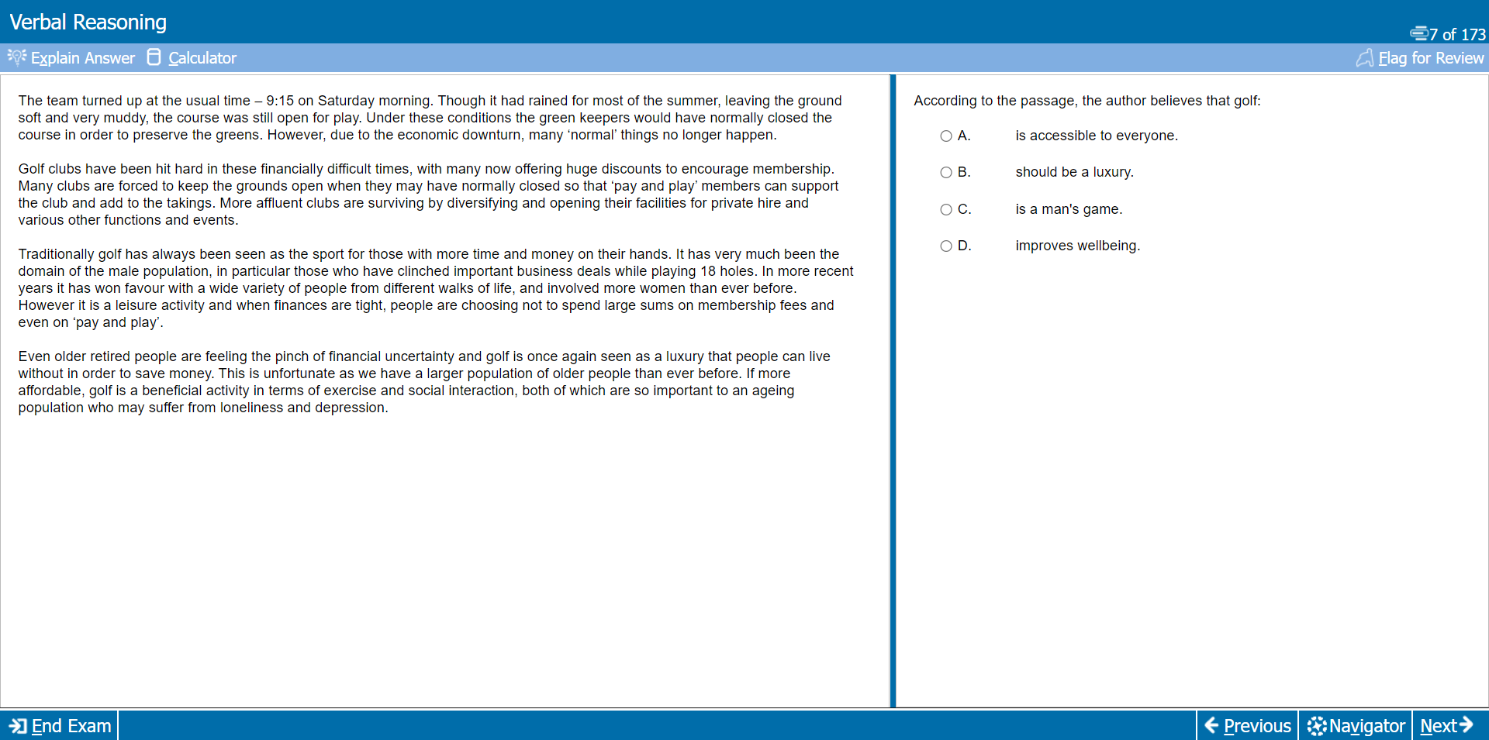

Slide 6
Decision Making
29 questions in 31 minutes
No question sets, 29 totally separate questions
1 (and a bit) minutes per question
The ‘DM’ section is made up of a few different types of questions – always with 4 questions about probability at the end
These questions are used to tell your logical thinking skills by working through word problems
Helpful tip – read the prompting question twice before answering is syllogisms

Slide 7
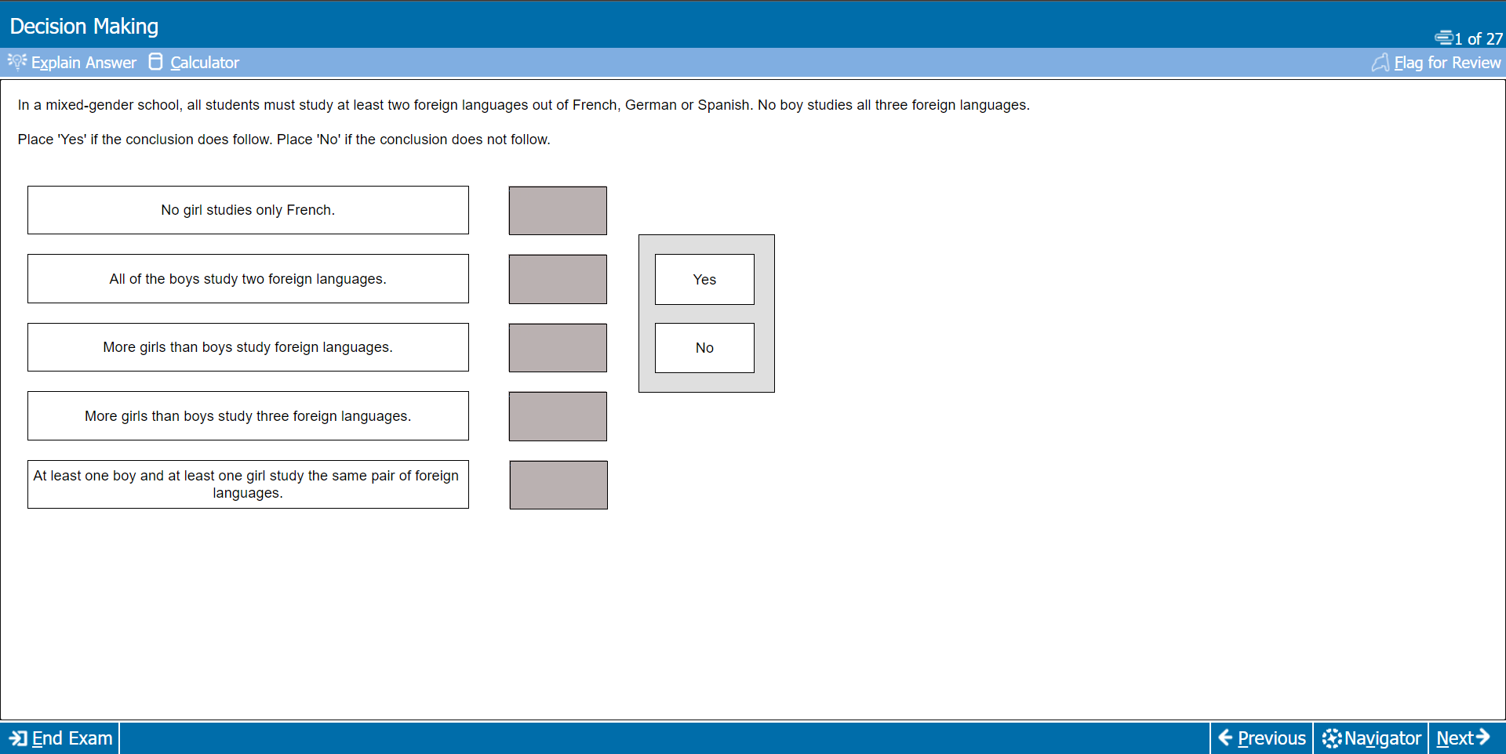
Yes
Yes
No
No
No

Slide 8
Quantitative Reasoning
36 questions in 25 minutes
Can be a mix of several questions sets and sole questions
40 (Ish) seconds per question
The maths in this section is very simple, but often there are a lot of steps wasting time
It can also take a lot of time to search through data tables if they give you a lot for data to use in your calculations
Helpful tip – be ruthless with the flag button, you can always come back to the longer questions, but you will lose marks on the easier questions at the end if you don’t

Slide 10
Abstract Reasoning
50 questions in 12 minutes
1 question every 14 seconds
An even mixture of sole questions and question sets with either 3 or 4 questions
All about pattern recognition
There are three main types of questions
Question sets can have a minute or a minute and a half each depending on the number of questions in the set
Helpful tip – again, use flag button wisely. If you can’t tell pattern after about 30 seconds skip and come back

Slide 12
Situational Judgement (SJT)
The SJT looks incredibly time dependent, but it isn’t
There are 69 questions in 26 minutes
Almost all questions are part of a set of 3 – 5 except for the three separate questions at the end
There are three different types of questions
It is scored off the model results from a panel of medical and ethical experts
For the 4-option multiple choice, you will get 1 mark for a correct answer and 0.5 marks for an adjacent answer
Helpful tip – don’t forget to revise this. It seems easy at first and as it doesn’t go to your numerical score it can be easily forgotten about and you don’t want a good score with a band 3 or 4 as that would be a shame

Slide 14
Overlook
While the UCAT is very tough lots of preparation will stand you in very good stead
Make sure to start heavily working about 8 weeks before your test
Book your test whenever suits you in the summer to maximize revision time
Most people get a revision platform
I used Medify but there are many other good ones available
For now, focus on school and I can give anyone revision methods closer to the time but the one and only thing that works is endless amounts of practice
Good Luck!!!

