Slide 1
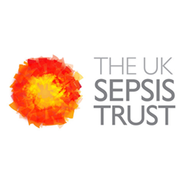

Slide 2
What is Sepsis?
SEPSIS, also known as blood poisoning, is the reaction to an infection in which the body attacks its own organs and tissues.
Sepsis is a potentially life-threatening condition, however it can be easily treated if caught early.
Symptoms of sepsis will present differently between adults and children. The information below is to help you identify the symptoms.

Slide 3
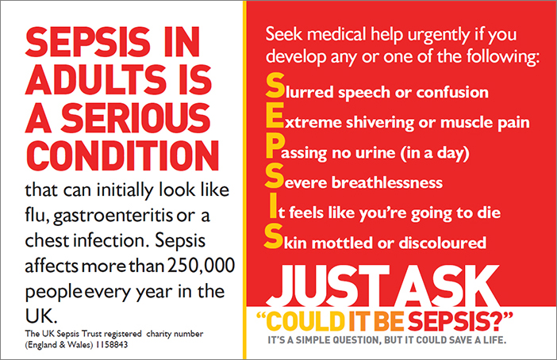

Slide 4
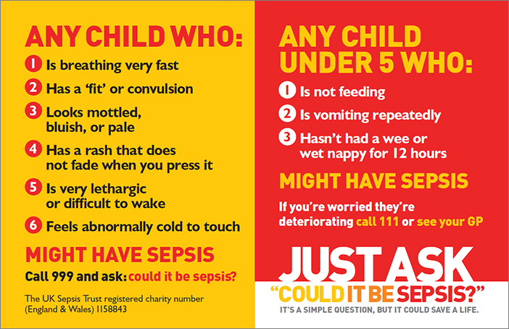

Slide 5
Videos
https://youtu.be/bvMPiy2hfcc
https://youtu.be/Vxxr6sJ9P3s

Slide 6
Facts and Figures
The Uk’s 2nd biggest Killer
There are 100,000 more people suffering from sepsis each year than initial estimates suggested.
The 44,000 lives claimed by sepsis each year in the UK and long term complications due to delayed diagnosis were found to be costing the UK as much as £15.6 billion annually.
The good news is that improving sepsis care across the NHS could save thousands of lives and reduce the economic burden by £2.8 billion..
It’s imperative that the government acts decisively to develop a national ‘sepsis registry’ and introduces coding practices for sepsis in all NHS trusts. A precise understanding of how the NHS handles sepsis is urgently required to prevent avoidable deaths, improve outcomes for survivors and save billions of pounds for the UK as a whole.”
There is a tick box service on NHS 111 service
If you go to a hospital or GP and say “it could be sepsis your treatment will be urgent”
Sepsis can be detected from a simple blood test
Ask for the blood test
Last year sepsis claimed more lives than; breast, bowl and prostate cancer combined
More people die of sepsis each year in the UK than in car accidents
Sepsis can come from any infection; eg. A cut gum, a cut hand, a peircing that has gotten infected

Slide 7
44,000
People lose their lives to sepsis every year.
EVERY 3.5 SECONDS
Someone dies from sepsis.
THE BIGGEST
Direct cause of death in UK pregnancies.

Slide 8
Tests to diagnose sepsis
Sepsis is often diagnosed based on simple measurements such as your temperature, heart rate and breathing rate. You may need to give a blood test.
Other tests can help determine the type of infection, where it's located and which body functions have been affected. These include:
urine or stool samples
a wound culture – where a small sample of tissue, skin or fluid is taken from the affected area for testing
respiratory secretion testing – taking a sample of saliva, phlegm or mucus
blood pressure tests
imaging studies – such as an X-ray, ultrasound scan or computerised tomography (CT) scan
Treatments for sepsis
If sepsis is detected early and hasn't affected vital organs yet, it may be possible to treat the infection at home with antibiotics. Most people who have sepsis detected at this stage make a full recovery.
Almost all people with severe sepsis and septic shock require admission to hospital. Some people may require admission to an intensive care unit (ICU).
Because of problems with vital organs, people with severe sepsis are likely to be very ill and the condition can be fatal.
However, sepsis is treatable if it is identified and treated quickly, and in most cases leads to a full recovery with no lasting problems.

Slide 9
Who's at risk?
There are around 123,000 cases of sepsis a year in England. Around 37,000 people die every year as a result of the condition.
Anyone can develop sepsis after an injury or minor infection, although some people are more vulnerable.
People most at risk of sepsis include those:
who are already in hospital with a serious illness
who are very young or very old
who have just had surgery or who have wounds or injuries as a result of an accident
have a medical condition that weakens their immune system – such as HIV or leukaemia
are receiving medical treatment that weakens their immune system – such as chemotherapy or long-term steroids
are pregnant
have a long-term health condition – such as diabetes
are on mechanical ventilation – where a machine is used to help you breathe
have drips or catheters attached to their skin
are genetically prone to infections

