Slide 1
The anterior cruciate ligament (acl)
By libby elias

Slide 2
What is a ligament?
A ligament is a fibrous connective tissue made from collagen, that helps connect bones,joints and organs, and usually serves to hold structures together and keep them stable.
There are over 900 ligaments in the human body but most are located in your arms and legs.

Slide 3
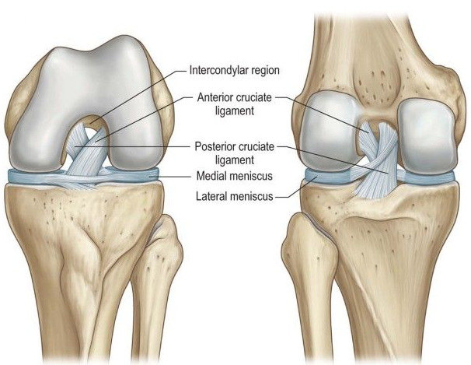
The cruciate ligaments
These are found inside your knee joint.
They cross each other to form an "X" with the anterior cruciate ligament in front and the posterior cruciate ligament in back.
The cruciate ligaments control and restrict the back and forth motion of your knee.

Slide 4
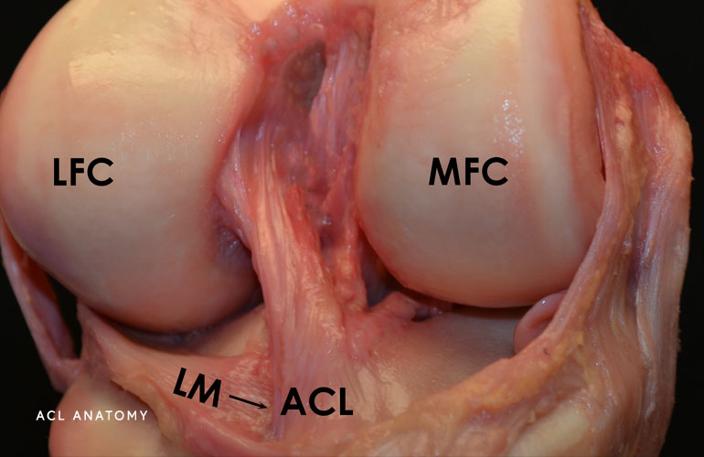
What actually is the acl?
The anterior cruciate ligament (ACL), is a band of dense connective tissue which courses from the femur to the tibia.
It is the most commonly injured ligament in the body.
The ACL is a key structure in the knee joint as:
It prevents the tibia from sliding out in front of the femur
Provides rotational stability
Prevents knee dislocation

Slide 5
How can the acl be torn?
As a result of cutting or pivoting maneuvers, when an athlete plants a foot and suddenly shifts direction
When a person lands on one leg, such as when jumping in volleyball or basketball
When the knee is hit directly, especially when it is hyper-extended or bent slightly inward
During a sudden slowing or stopping from running, which can cause the ligament to hyper-extend
Through repeated stress to the knee, which can cause the ligament to lose elasticity (like a stretched out rubber band)
When the knee is bent backward or twisted, which can occur during a fall or landing a jump awkwardly

Slide 6
Risk factors for acl tears
Age
Previously torn ACL
Being female
Participation in certain sports

Slide 7
Why do women have a higher risk than men?
Differences in physical conditioning, muscular strength, and neuromuscular control.
Differences in pelvis and lower extremity (leg) alignment, increased looseness in ligaments (more lax), and the effects of estrogen on ligament properties.

Slide 8
symptoms
A loud pop or a "popping" sensation in the knee
Severe pain and inability to continue activity
Rapid swelling
Loss of range of motion
A feeling of instability or "giving way" with weight bearing

Slide 9
How can you tell?
People with ruptured ACL’s have a loss of feedback from mechanoreceptors in the ACL,this leads to quadriceps femoris weakness.
Increase in hyperextension, anterior translation (extended knee), increase in external and internal rotation (knee extended).
There are 2 orthopaedic tests that can be done:
Lachmans Test-with the knee extended, resistance to anterior translation of the tibia
Anterior Drawer Test-with the knee flexed, resistance to anterior translation of the tibia.
If the doctor suspects a torn ACL from these tests, they will then do an MRI scan

Slide 10
Non-invasive treatments
In some cases, a torn ACL is treatable without surgery.
Initial treatment consists of controlling pain and swelling through rest, ice, compression, and elevation (RICE protocol).
Physical therapy is often recommended to improve knee motion and strength.
For a short period, a knee brace may be needed to help immobilise the knee.
Some patients may be able to regain a functionally stable knee without surgery by improving their reflexes and strengthening their thigh and calf muscles.

Slide 11
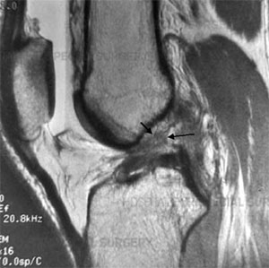
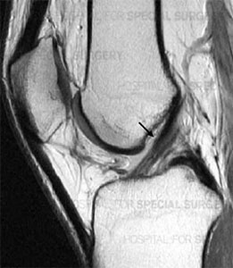
Invasive treatments
In ACL reconstruction surgery, a new ACL is made from a graft of replacement tissue
This is usually sourced from a portion of the patient's own hamstring, quadriceps or patellar tendon
Side view MRI showing intact ACL after reconstruction
Side view MRI showing completely torn ACL

Slide 12
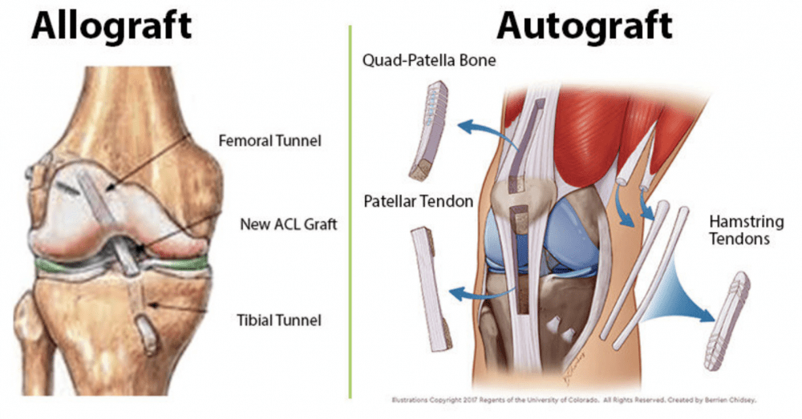
Graft options

Slide 13
How ACL reconstruction works
The orthopedic surgeon makes small incisions around the knee joint, creating portals of entry for the arthroscope and surgical instruments.
The surgeon then evaluates structures that surround the torn ACL, including the left and right meniscus and the articular cartilage. If either of these soft tissues have any lesions, the surgeon repairs them.
Next the graft will be harvested (unless a donor allograft is used). A section of tendon from another part of the patient's body is cut to create a graft, which is then attached at each end to plugs of bone taken from the patella and tibia. These plugs help to anchor the graft that will become the new ACL.
The surgeon inserts the new ACL into the femur and tibia using a flexible guide wire.
Screws are used to secure the plugs of bone. Over time, these plugs will grow into the surrounding bone.

Slide 14
Post-op
It usually takes six to nine months for a patient to return to participating in sports after an ACL reconstruction, depending on the level of competition and the type of activity.
Very soon after surgery, the patient enters a rehabilitation program to restore strength, stability and range of motion to the knee.
This includes, strengthening,stabilising,pivoting, running and eventually return to sport.

Slide 15
Thanks for listening!!!

Slide 16
references
https://medlineplus.gov/ency/imagepages/19089.htm#:~:text=A%20ligament%20is%20a%20fibrous,together%20and%20keep%20them%20stable.
https://my.clevelandclinic.org/health/body/21604-ligament
https://orthoinfo.aaos.org/en/diseases--conditions/anterior-cruciate-ligament-acl-injuries/
https://www.researchgate.net/figure/Cruciate-ligaments-121_fig8_294291791
https://www.physio-pedia.com/Anterior_Cruciate_Ligament_(ACL)
https://www.hopkinsmedicine.org/health/conditions-and-diseases/ligament-injuries-to-the-knee#:~:text=The%20anterior%20cruciate%20ligament%20(ACL,common%20ligaments%20to%20be%20injured.
https://www.jorgechahlamd.com/knee/acl-injuries-chicago-il/
https://www.sports-health.com/sports-injuries/knee-injuries/acl-tear-causes-and-risk-factors
https://www.topdoctors.co.uk/medical-articles/acl-injury-non-surgical-vs-surgical-treatment?amp=1

