Slide 1
Magnetoencephalography (MEG)
The Brain Scanner You Can Move Around in
Josh Suppree

Slide 2
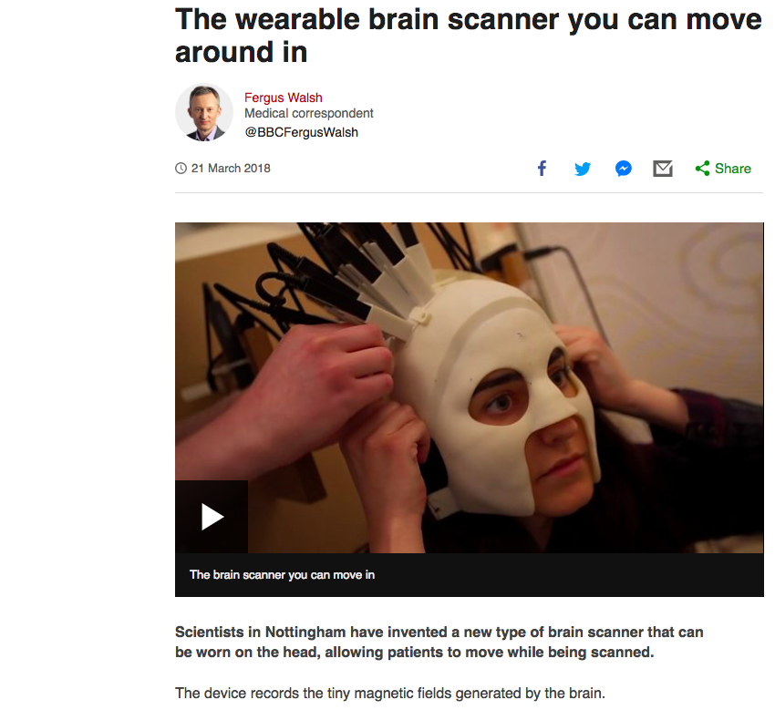
MEG

Slide 3
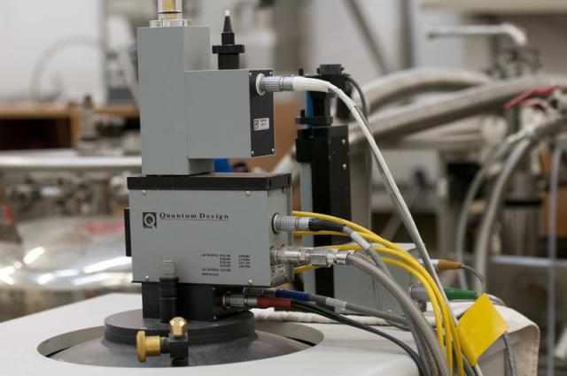
Traditional MEG Scanning Techniques
Magnetoencephalography (MEG) is a technique, which allows us to measure the magnetic fields produced by the brain at a millisecond time resolution
MEG starts with the recordings of magnetic fields naturally generated by neuronal sources in the brain
Tiny fluctuations in these magnetic fields can be detected using an array of extremely sensitive Superconducting Quantum Interference Devices (SQUIDs) which detect subtle changes in the bodies electromagnetic energy field and where they are coming from
These locations can then be superimposed onto an MRI image for surgical planning

Slide 4
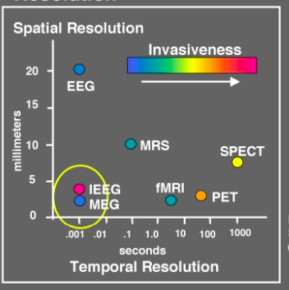
MEG has extremely high temporal and spatial resolution without being invasive
MEG is very different to fMRI which measures blood flow changes occurring on a much slower time-scale
http://web.mit.edu/kitmitmeg/whatis.html

Slide 5
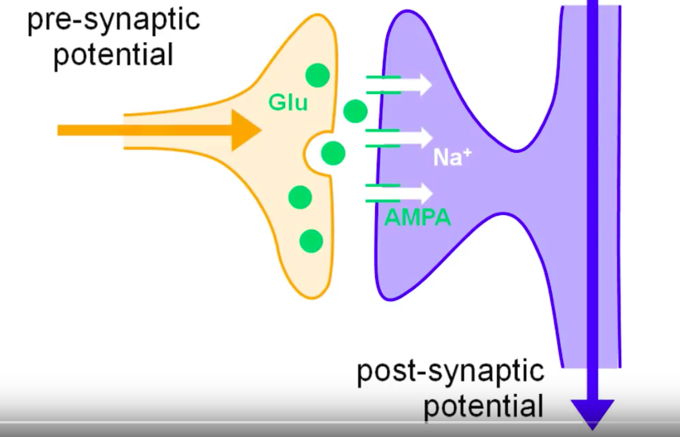
Role of Synapses
The movement of molecules from one neuron to the next generates a small post-synaptic potential - This is associated with a very small magnetic field

Slide 6
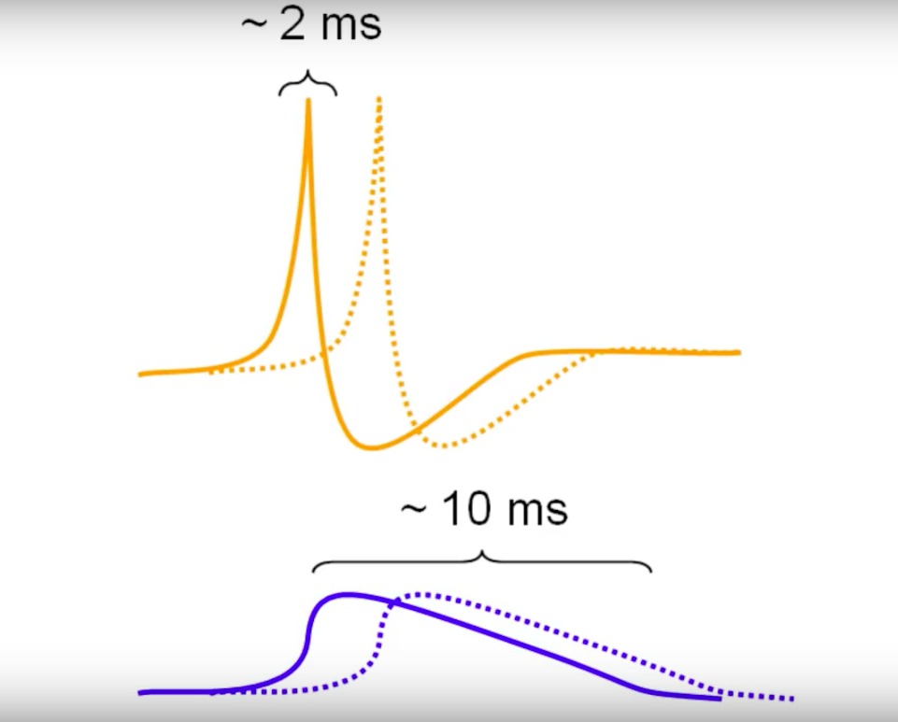
Notes:
Add Biphasic – Positive and negative spikes aren’t perfectly synchronized and will cancel each other out making it impossible to measure potential
When a sufficiently large population of neurons receives synaptic inputs within a short time-window, the dendritic currents will sum up, producing a field which is large enough to be detected outside the head

Slide 7
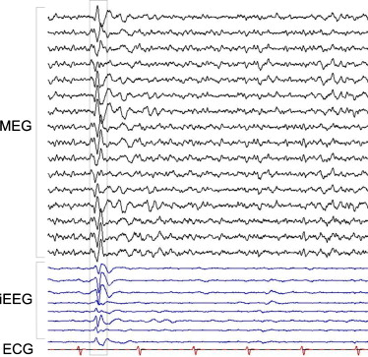
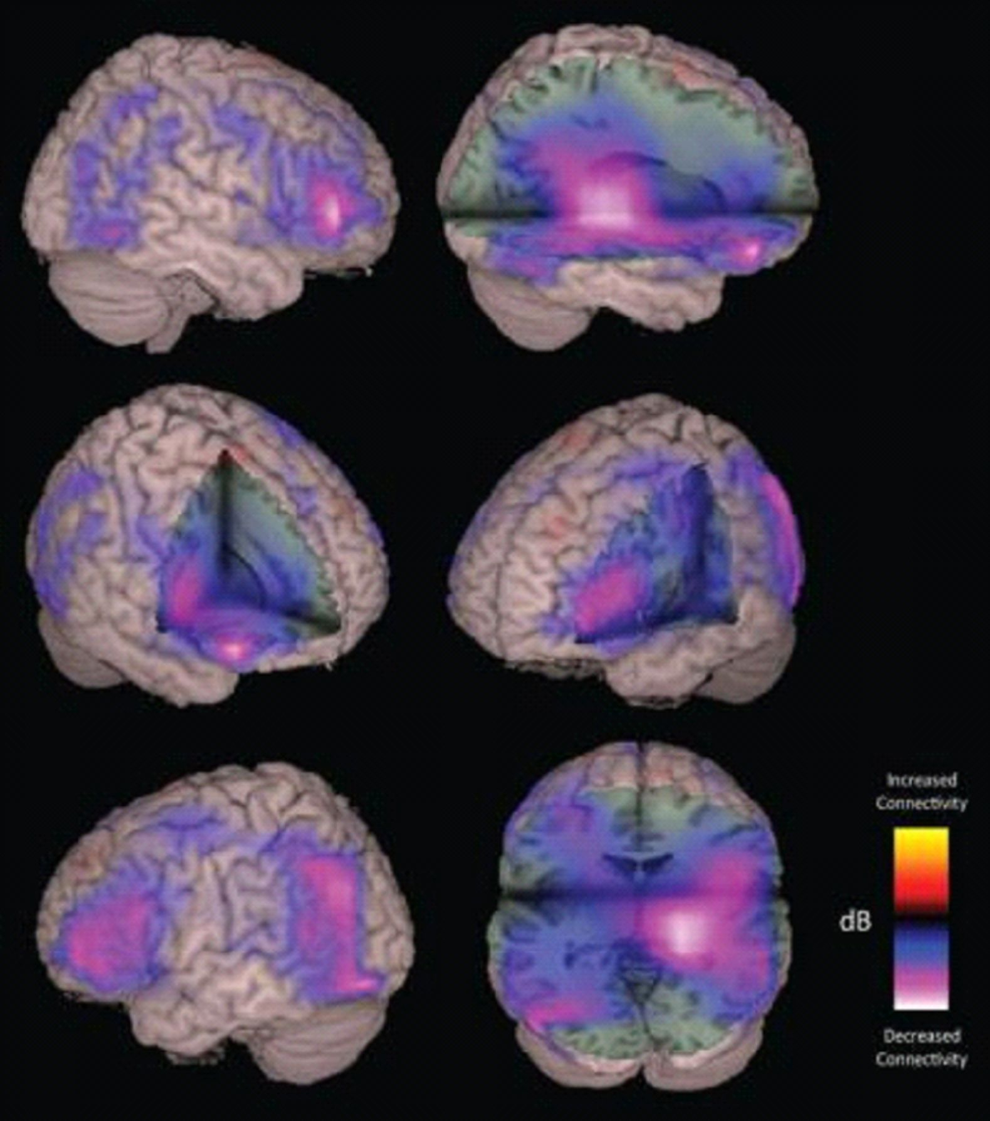
Notes:
Reason EEG is used more frequently is MEG takes an extremely long time and cannot just be done in a doctors office like EEG so instead the main applications of MEG are clinical investigations and cognitive neuroscience research. This makes MEG fundamentally different from imaging technologies like functional magnetic resonance imaging (fMRI), which measures blood flow changes occurring on a much slower time-scale. The only major advantage of MEG compared to EEG is Magnetic fields are less distorted by tissues of different conductivity compared to the electric potentials measured with electroencephalography (EEG). In addition, MEG does not require a reference electrode that is needed for EEG recordings. Another important difference between MEG and EEG is that MEG is insensitive to current flows oriented perpendicularly to the scalp. Only the tangential component of a current flow will produce a measurable field. This in fact makes EEG and MEG complementary techniques, and MEG and EEG signals are often recorded simultaneously

Slide 8
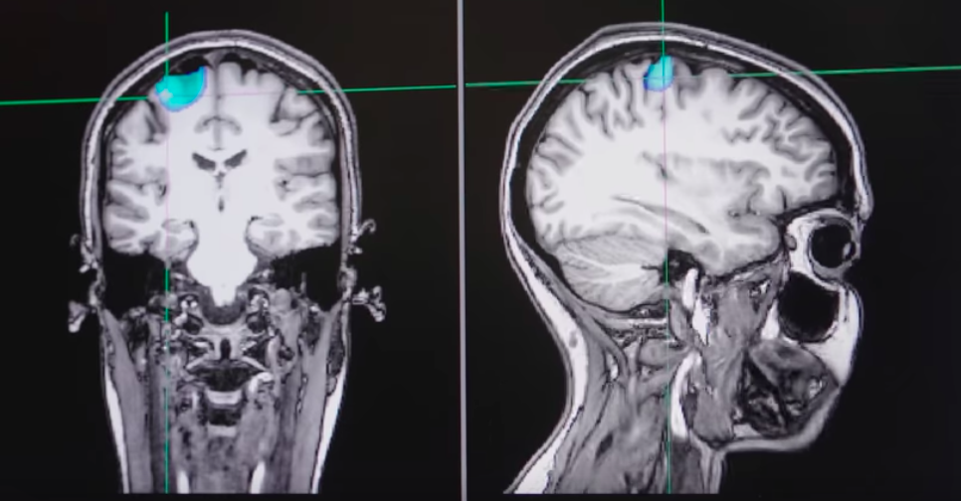
Area highlighted in blue shows the area in the brain used when playing bat and ball

Slide 9
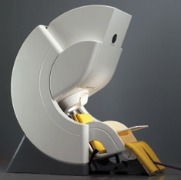
The Device
The device is situated in a magnetically shielded room which consists of three layers made of pure aluminum
This eliminates outside radiation mainly radio waves which could decrease the accuracy of the SQUIDs
Notes:
Even small signals like telephones can distort results

Slide 10
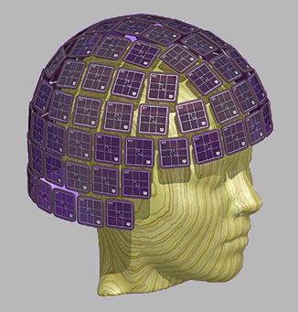
Role of Sensors
Over 300 sensors distributed over the head which makes it possible to identify where in the brain the activity is produced with great accuracy
This makes MEG suited for studying the human brain as a network of interacting brain areas during performance of various tasks
Notes:
300 sensors distributed over the head, it is possible to identify where in the brain the activity is produced with reasonable accuracy. This makes MEG suited for studying the human brain as a network of interacting brain areas during performance of various tasks

Slide 11
MEG in Action
https://youtu.be/pYJW-J_IcC4

Slide 12
Advantages of MEG Compared to Other Scanning Techniques
MEG directly measures neuronal electrical activity compared to fMRI which reflect brain activity indirectly, by measuring the oxygenation of blood flowing near active neurons so the results may be less accurate
MEG scanning is very straightforward compared to EEG as it doesn’t require electrodes to be attached to the skin and the person can simply sit in a chair and rest their head in the scanner
MEG does not emit radiation meaning even people with pacemakers and medical implants can be scanned safely
MEG tells us where in brain specific activity is happening - By combining this with a image from an MRI activity can be found in specific regions of a person’s brain – This is useful in understanding disorders
Notes:
Unless implant is in the head which is an exception

Slide 13
Disadvantages of MEG Compared to Other Scanning Techniques
Due to very accurate signals being used MEG scans can take anywhere from 30 minutes to 3 hours to complete which isn’t very effective in emergency situations
The findings of MEG scans are based on a number of assumptions and algorithms which all haven’t been proved true themselves
MEG scans aren’t catered for use on children as many are unable to sit for such long periods of time in a magnetically shielded room alone
As MEG scans are usually done in conjunction with EEG and fMRI scans they are very expensive to use and require skilled professionals
Notes:
Inverse problems

Slide 14
Portable MEG Scanning Techniques
“On the 21st March 2018 Richard Bowtell from the University of Nottingham, and his colleagues have designed a portable MEG device that is worn like a helmet, allowing people to move freely during scanning. They tested the device on four people while they moved their fingers, and got results similar to those achieved using a traditional MEG scanner” – BBC News

Slide 15
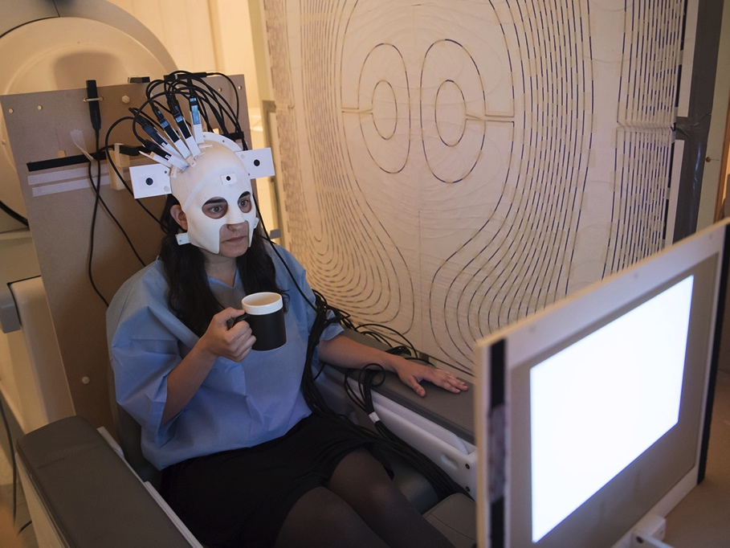

Slide 16
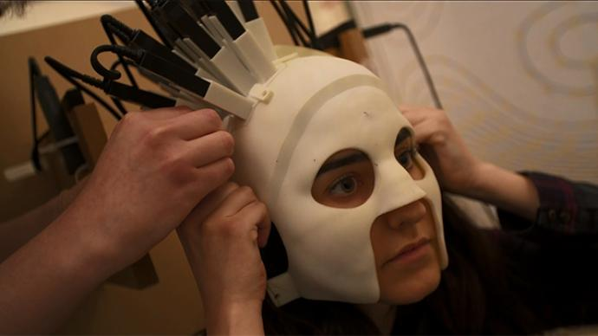

Slide 17
Portable System
Compared to conventional MEG systems people can now move freely (within limits) and do activities which they could never previously do
The device is now suitable for babies, children and people with movement disabilities
Instead of having to sit in a large machine in a magnetically sealed room quantum sensors have been developed into a head cast and can now be paired with a system for cancelling out background magnetic fields
Each scanner is 3D printed to fit a persons head comfortably and the sensors can be attached above the target area

Slide 18
Portable System
In order to test their new machine on volunteers scientists recorded the volunteers brain activity while they performed different tasks that involve head movement, such as bouncing a ball on a paddle or drinking from a mug
This brain response is measured the same way conventional MEG scans are measured

Slide 19
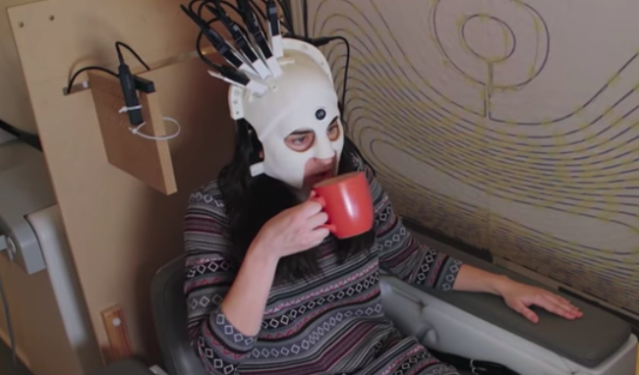
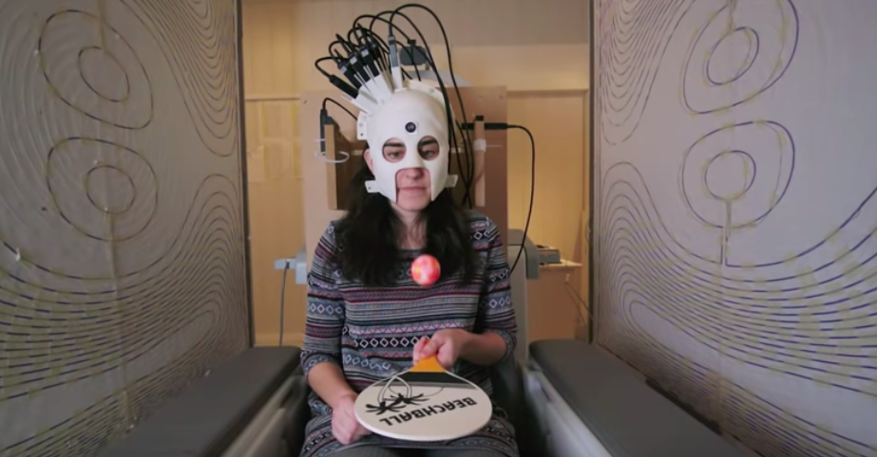

Slide 20
Limitations of the Scanner
At this point in development outside radiation can still have an effect on the accuracy of results so volunteers can only move their heads 20-40cm at a time – In the next stage of development the researchers aim is for subjects to be able to stand up and move around whilst their brain is being scanned
The way the aim to do this is by integrating background-cancelling coils into the walls of the room which will allow the subject to walk around

Slide 21
Comparison to Portable EEG
Scientist’s have already developed a portable EEG scanner however MEG scans can pinpoint the precise location of activity in the brain whereas EEG reflects voltages in the brain which aren’t as useful in measuring on-going brain activity

Slide 22
Applications – Epilepsy
MEG generates a accurate representation of the magnetic fields produced by neurons in the brain
Using a portable MEG in convention with fMRI will allow researchers to analyse areas of the brain that could generate seizures and even test different actions performed by volunteers to see the effect they have on the magnetic fields produced outside the brain
This can improve the detection of potential sources of seizures by revealing the exact location of the problem
MEG may be able to confirm that the epileptiform discharges (the brain waves typical of epilepsy) are indeed arising from the lesion identified using MRI scans and decide what the best course of treatment would be and whether that includes surgery
In patients who have brain tumours or other lesions MEG may be able to map the exact location of the normally functioning areas near the lesion and surgery to remove the tumour can be planned to lessen postoperative weakness or loss of brain function
Notes:
Using a portable MEG in convention with fMRI will allow researchers to analyse areas of the brain that could generate seizures and even test different actions performed by volunteers to see the effect they have on the magnetic fields produced by the brain

Slide 23
Application – Parkinson’s
Parkinson's disease is a condition in which parts of the brain become progressively damaged over many years
The three main symptoms of Parkinson's disease are:
involuntary shaking of particular parts of the body
slow movement
stiff and inflexible
Portable MEG is extremely useful for Parkinson’s patients as it allows them to move around during being scanned without affecting the accuracy of results
Every time an involuntary movement occurs it will be picked up by the quantum scanners and again when combined with MRI scans researchers will be able to see exactly what part of the brain is being used and if brain surgery is an option for treatment

Slide 24
Application – OCD and Other Mental Disorders
OCD is an anxiety disorder where obsessive thoughts leads to compulsive behaviors
Right now there is a number of explanations for OCD
OCD patients could wear a portable MEG and see the changes in brain activity that occur when obsessions and compulsions are active
e.g. Obsession – holding a cloth which is dirty
Compulsion – Washing hands to remove germs
This could allow researchers to provide evidence for explanations to OCD and other disorders

Slide 25
MEG
http://www.wcax.com/content/news/British-scientists-develop-wearable-MRI-scanner-477763643.html
https://youtu.be/Hx7_SlvWmEs

