Slide 1
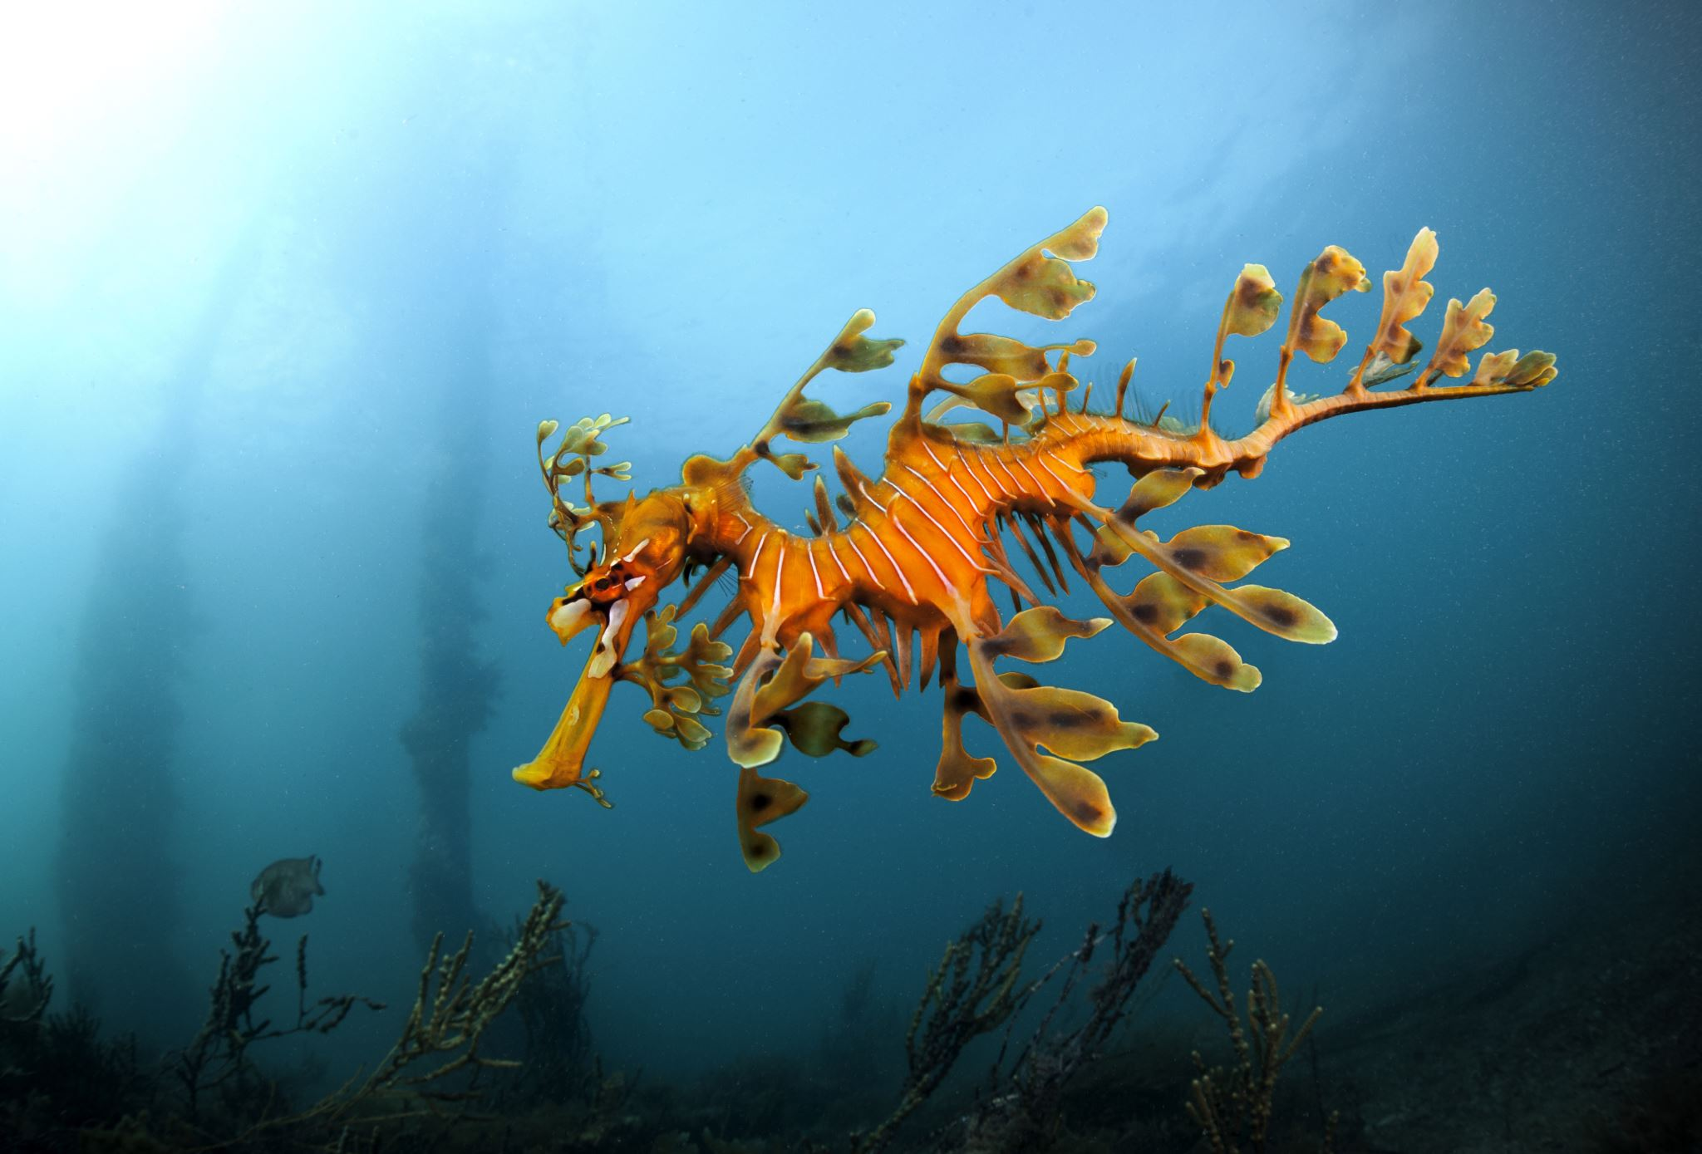
Toby’s totally awesome presentation on the physiology of SCUBA diving
By Toby

Slide 2
Sinus system
When diving the water on top of you increases the pressure exerted on your body dramatically
This pressure increases by 1 ATA for every 10 meters you descend
This is like having another whole atmosphere on top of you every 10 meter
The thing that allows you to descend in depth and increase in pressure is your sinus systems.
You have to equalize yourself. In other words, you have to pop your ears at intervals of no more than 2 meters in order to make the pressure inside your sinuses and inner ear the same as the pressure in the atmosphere directly outside of them.
This is just like popping our ears on the plane

Slide 3
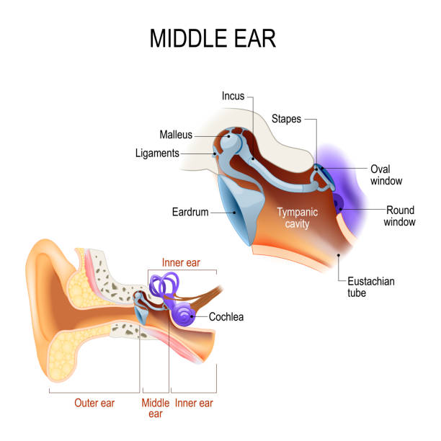
Physiology of equalization
The way that the ears are equalized is through popping them.
Since our ears don’t actually pop, here’s what happens.
Eustachian tube
The ear is made up out of 3 sections. In equalization the aim is to push air through the eustachian tube, through the outer and middle ear, into the inner ear.
Through doing this the pressure is equalized to the current atmosphere
However, not equalizing enough or correctly can cause health issues.

Slide 4
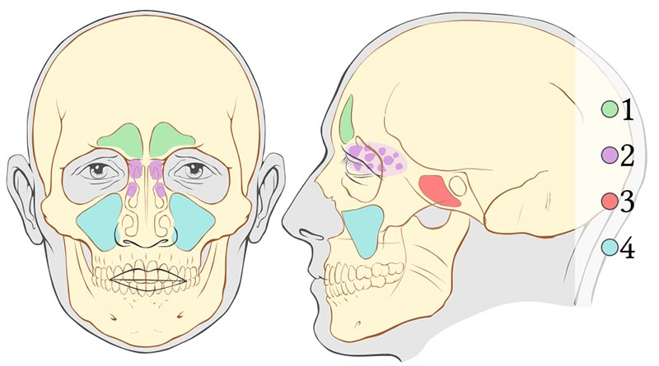
Sinus barotrauma
Popping your ears not only equalizes the pressure on your inner ear, it also equalizes the pressure in your sinuses.
Sinus barotrauma is ‘a tissue injury caused by a rapid change in barometric pressure difference between the intrasinusal air and the surrounding atmosphere’
Sinus barotrauma can and does cause
Significant facial pain particularly on the bridge of the nose
Bleeding from the nose on ascent
Decompression sickness
It is apparent from this diagram that all of the sinuses are close in proximity so are therefore connected. When one sinus is obstructed or having trouble equalizing it can cause a much larger blockage and lead to sinus barotrauma.

Slide 5
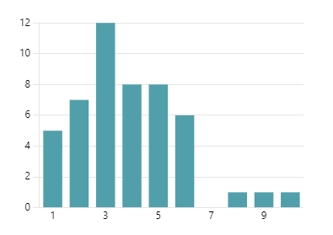
Frequency of equalization problems
From a survey I conducted of 118 SCUBA divers 49 said that they experience or have experienced problems equalizing their ears on descent
This means that while a large proportion of people experienced trouble equalizing, overall, it was not so severe
No problems
Problems
About 75% of people who reported having trouble also reported having ear and sinus pain when trying to equalize
This is because the pressure difference in the sinus systems causes pain as it is compressing the gas inside the inner ear and sinus
From the 49 people who claimed equalization problems, they rated the severity of their problems relatively lowly with an average rating of 3.88/10
Frequency
Severity of problems

Slide 6
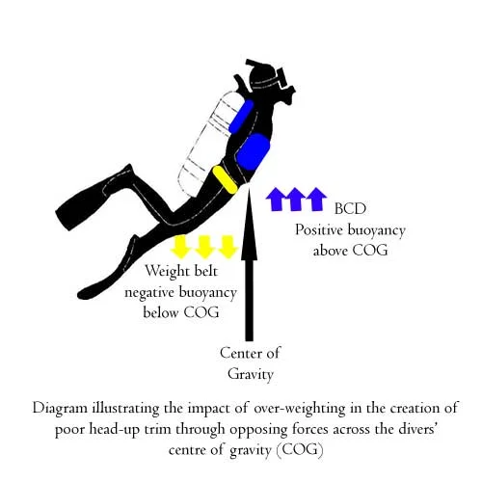
Effects of scuba diving on dexterity
Balance is needed underwater as when you are neutrally buoyant you are essentially weightless.
Because of this it is easy to tip over due to the oxygen tank weighing up to 30kg. This shifts the center of gravity upwards making your body want to invert
Dexterity is affected in different ways by SCUBA diving.
Fine motor skills worsen a little bit when underwater because of muscle fatigue and a change in vision and depth perception
SCUBA diving does however improve balance, muscle strength and endurance since there is a lot of skill required to stay upright while operating complicated equipment

Slide 7
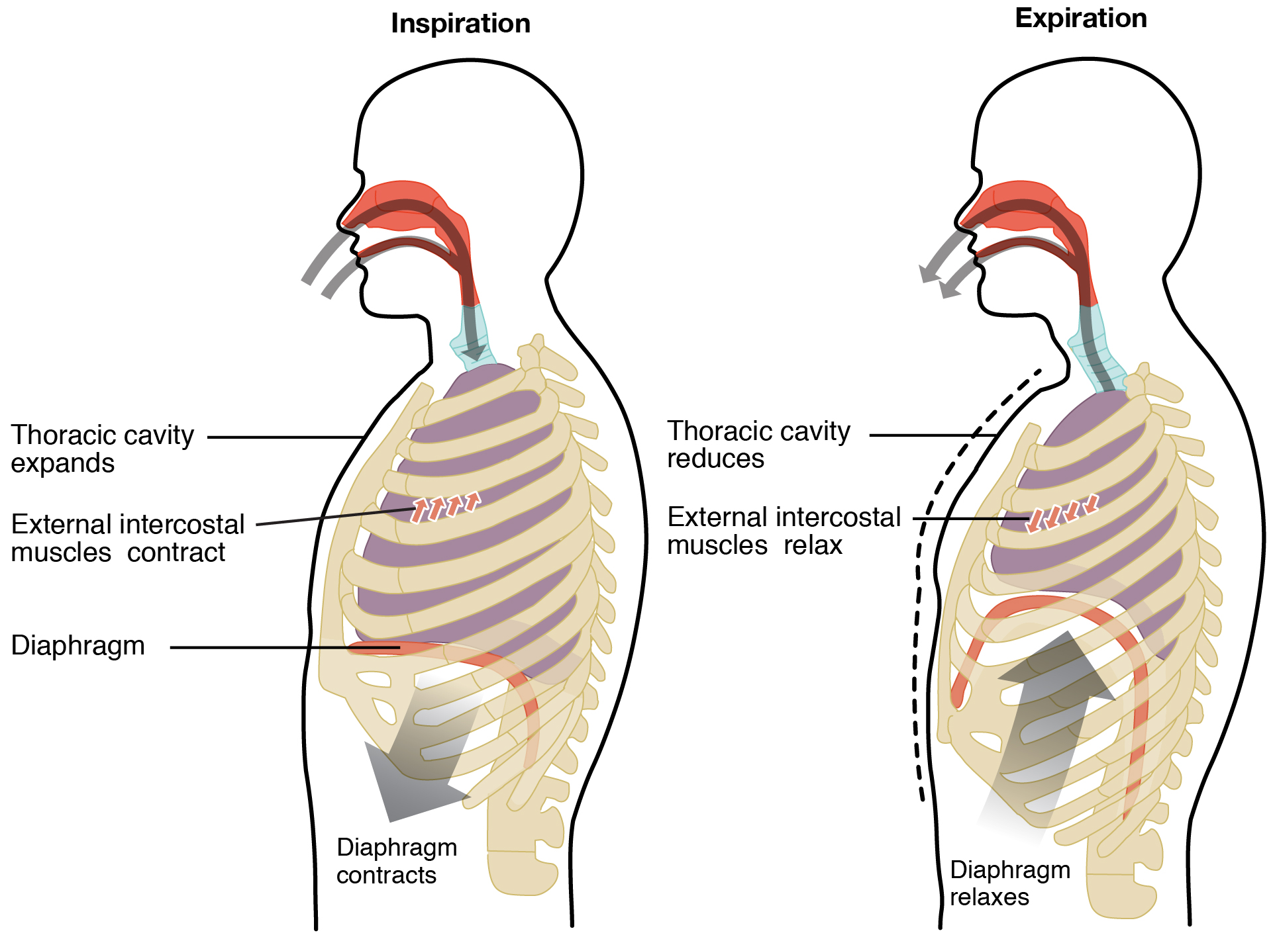
Breathing while underwater
Breathing regularly while underwater
Because of the higher pressure air it is naturally tougher to breathe as the intercostal muscles and diaphragm have to work harder to expand the chest cavity
In the research I conducted just over 42% of divers reported noticeably heavier breathing while underwater

Slide 8
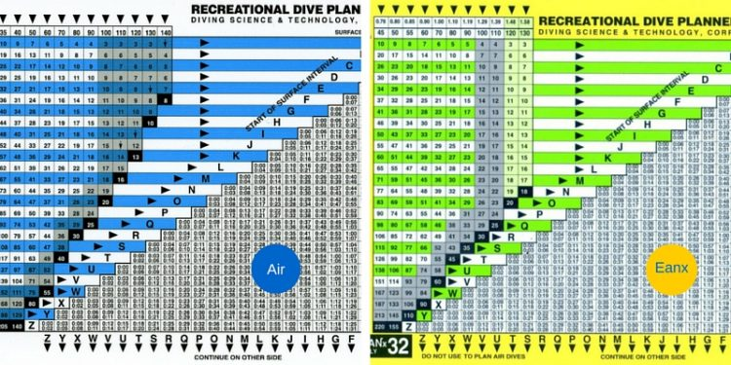
Using different gas mixes underwater
It is possible to use a gas mixture when diving with different percentages of the regular gas mix in normal air
This is called nitrox diving
It is done so one `can spend longer at a certain depth without having to make a recompression stop
When diving with nitrox the gas exchange system inside the lung is thrown off a bit due to the different ratios of oxygen/carbon dioxide and nitrogen
This causes heavier breathing subconsciously as people try to get a regular amount of air to their brain even though they are getting a surplus of oxygen

Slide 9
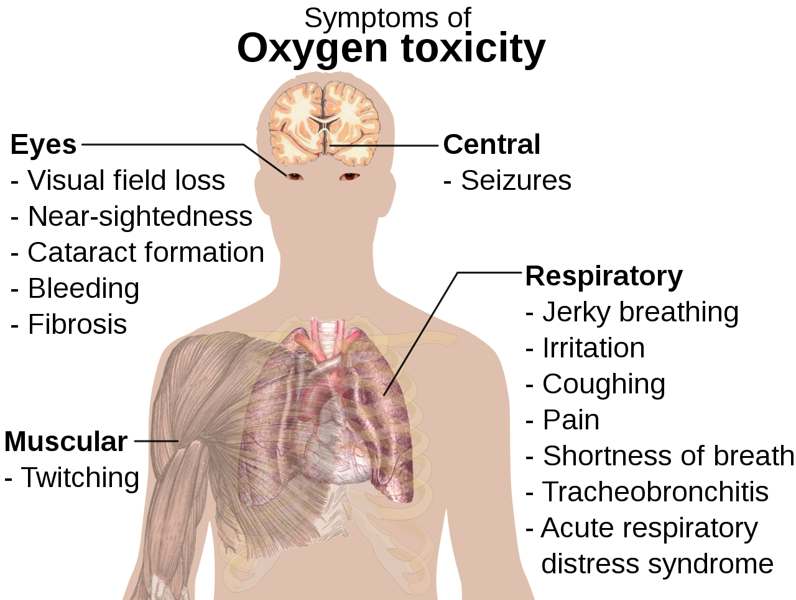
Oxygen toxicity in nitrox
Because you are diving with an increased amount of oxygen than you would normally breathe in and you are doing this at greater pressure there is a small risk of oxygen toxicity
Oxygen toxicity is when alveoli fill with fluid due to a different concentration gradient of oxygen.
Oxygen toxicity causes many bad things and can be identified because the afflicted will start convulsing, which, under water, can cause drowning.
It also causes:
Coughing
Chest pain
Nausea
Psychosis
Blurred vision

Slide 10
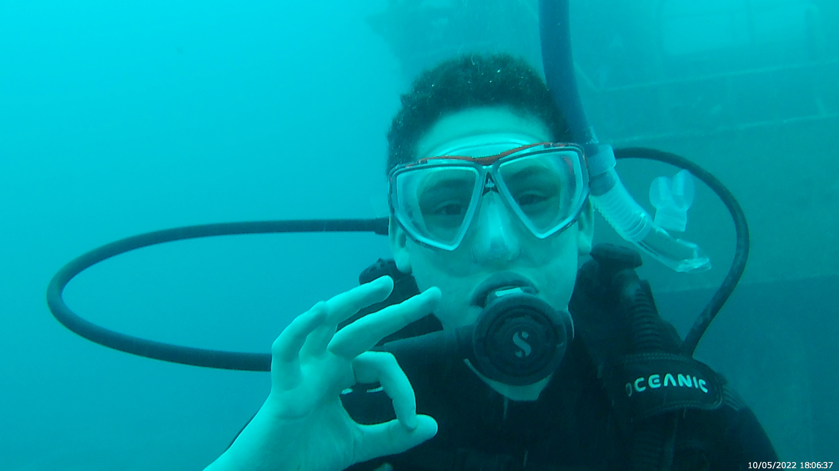
Thank you very much for watching
Please ask me easy questions
Stay safe!!

