Slide 1
Life of a Junior Doctor
Dr Chaya Fligg

Slide 2
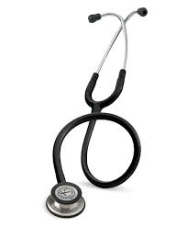
Why do you want to study Medicine and become a doctor?

Slide 3
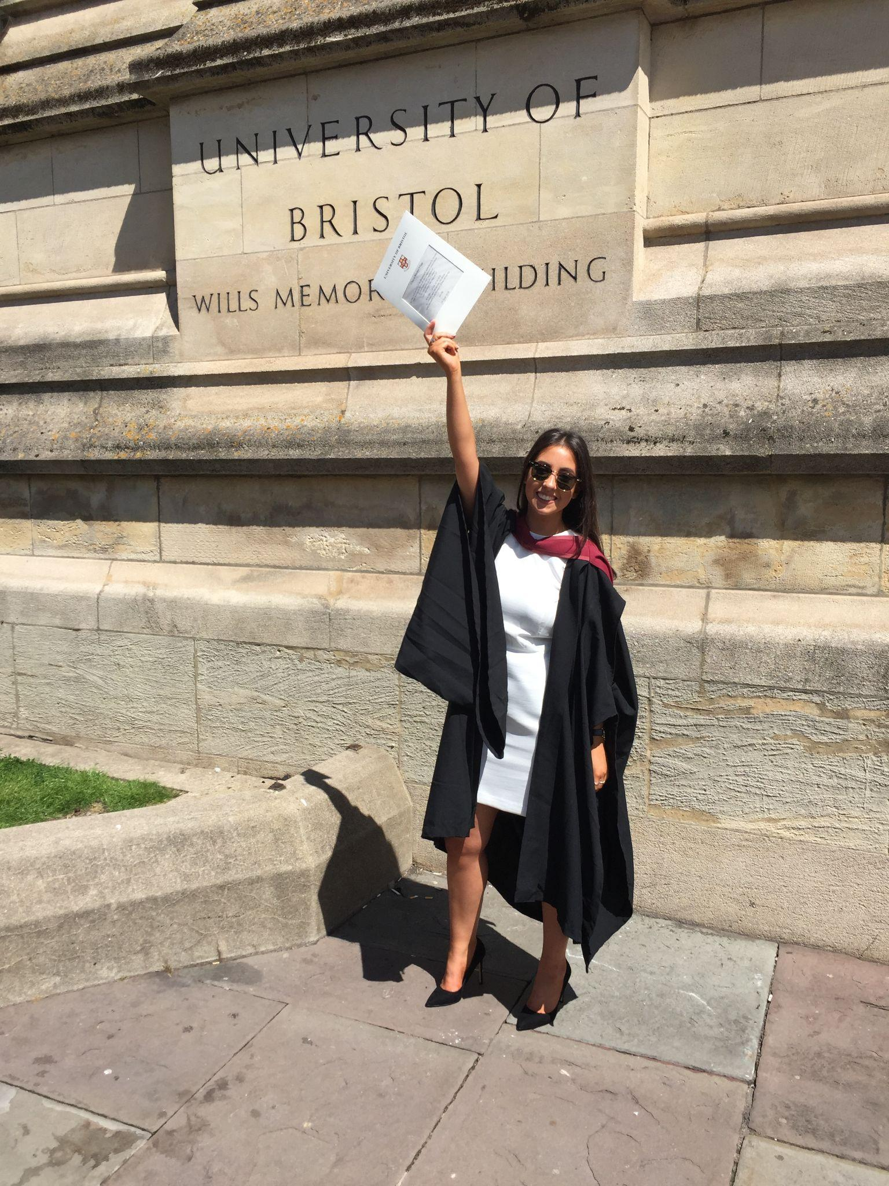
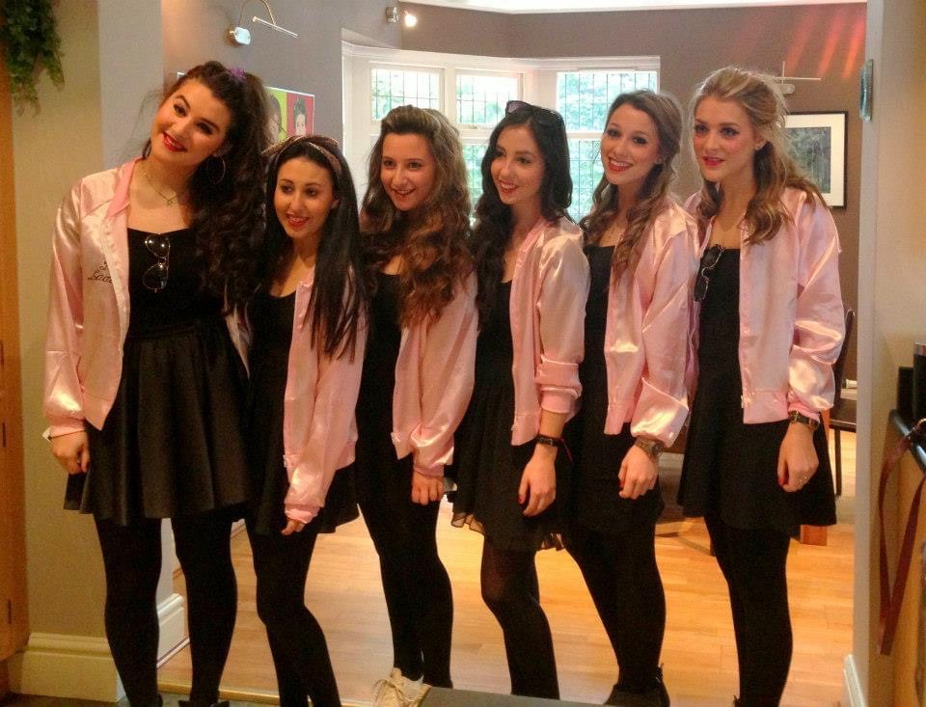
My Journey
King David High School
GSCEs 4 A*s, 6As
AS Levels AAAA
A-Levels ABB
University of Bristol
Cellular and Molecular Medicine BSc Hons 2:1

Slide 4
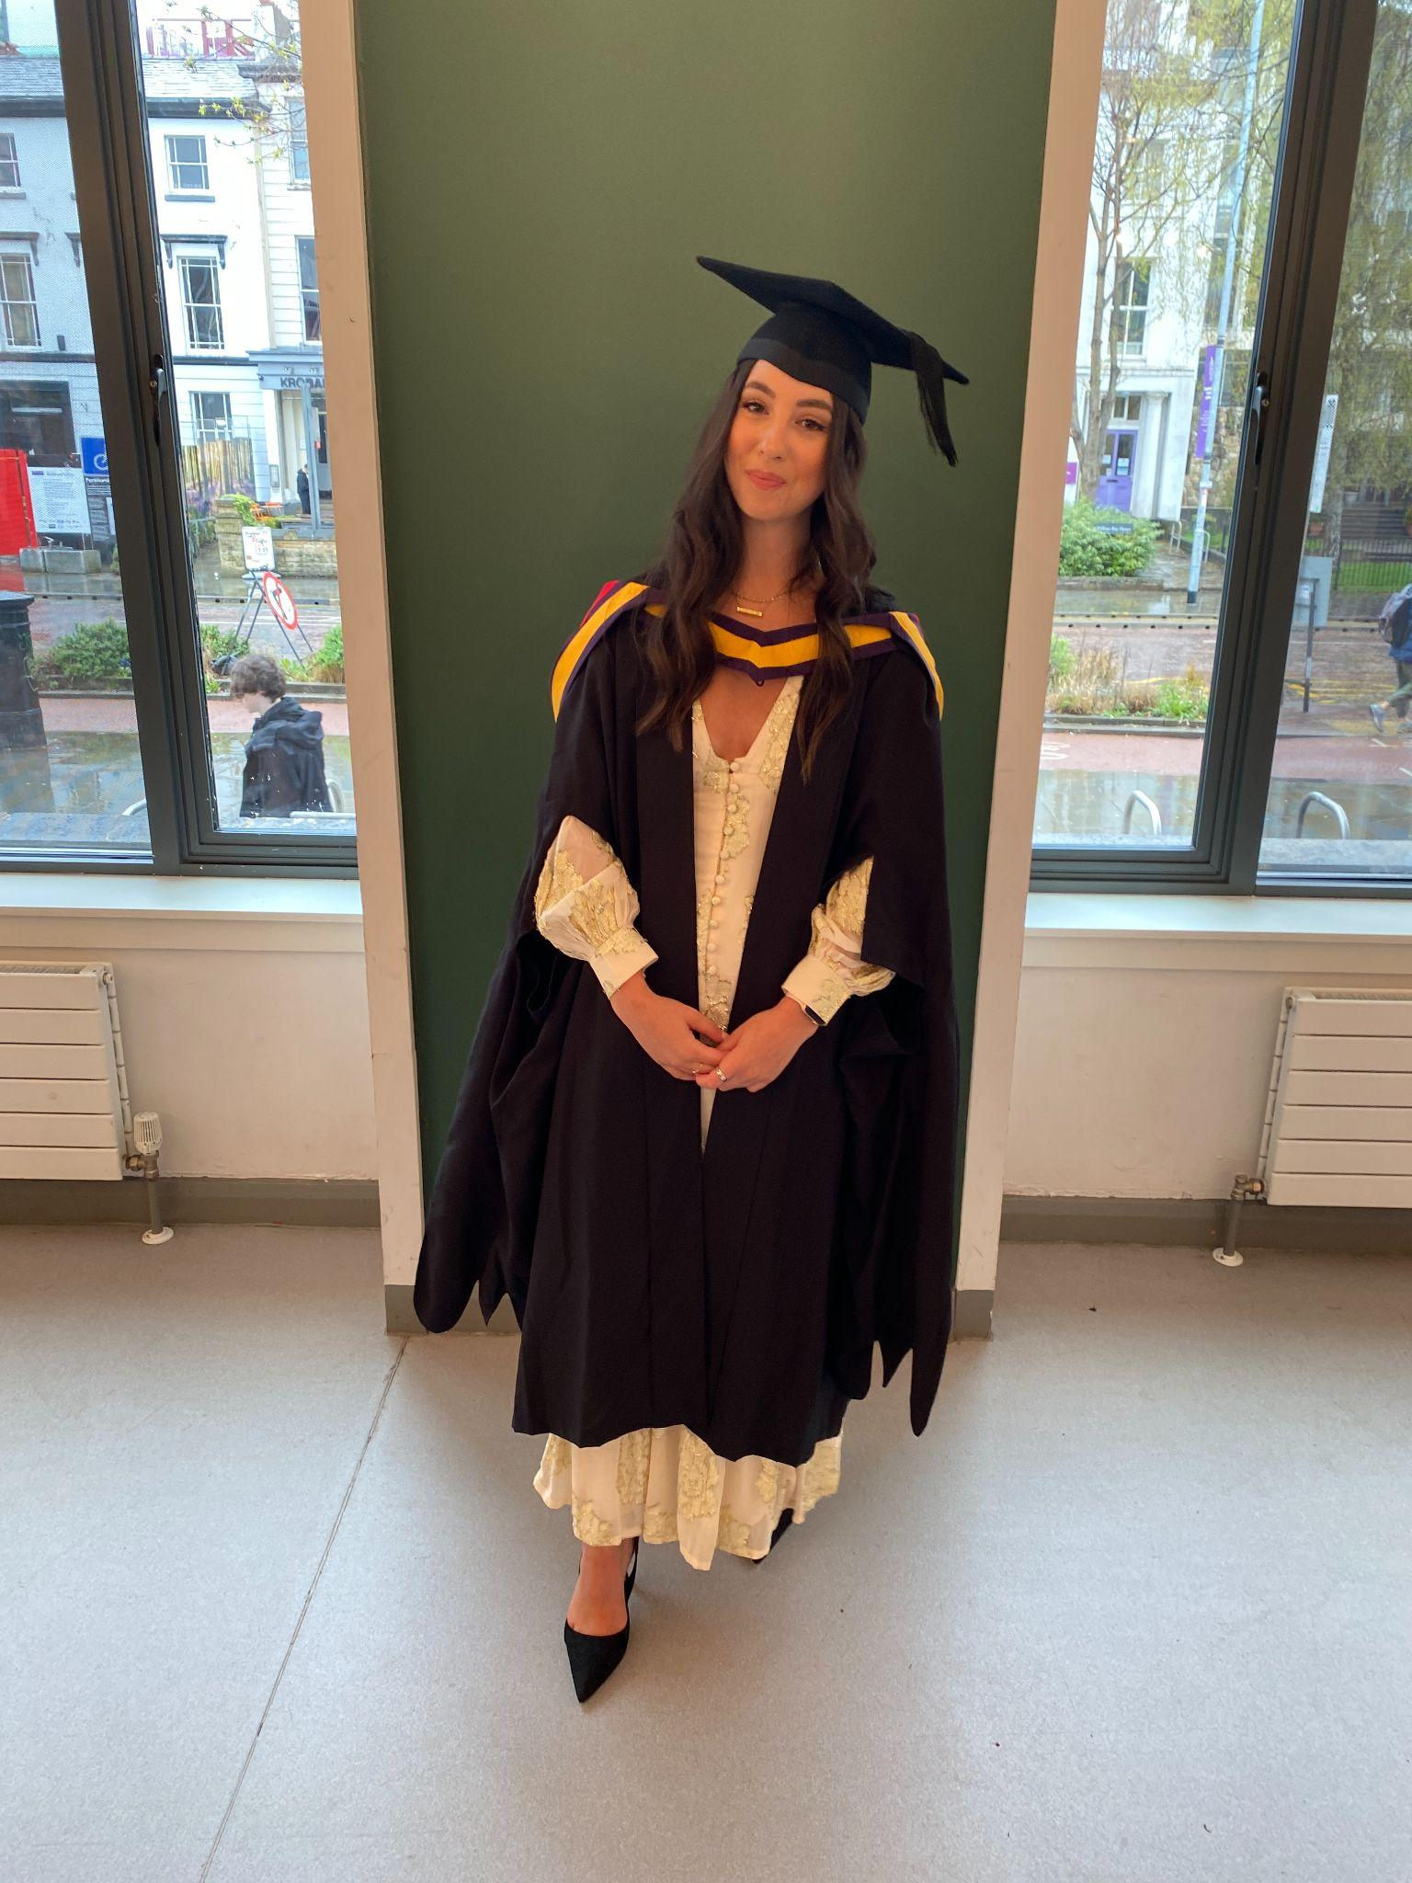
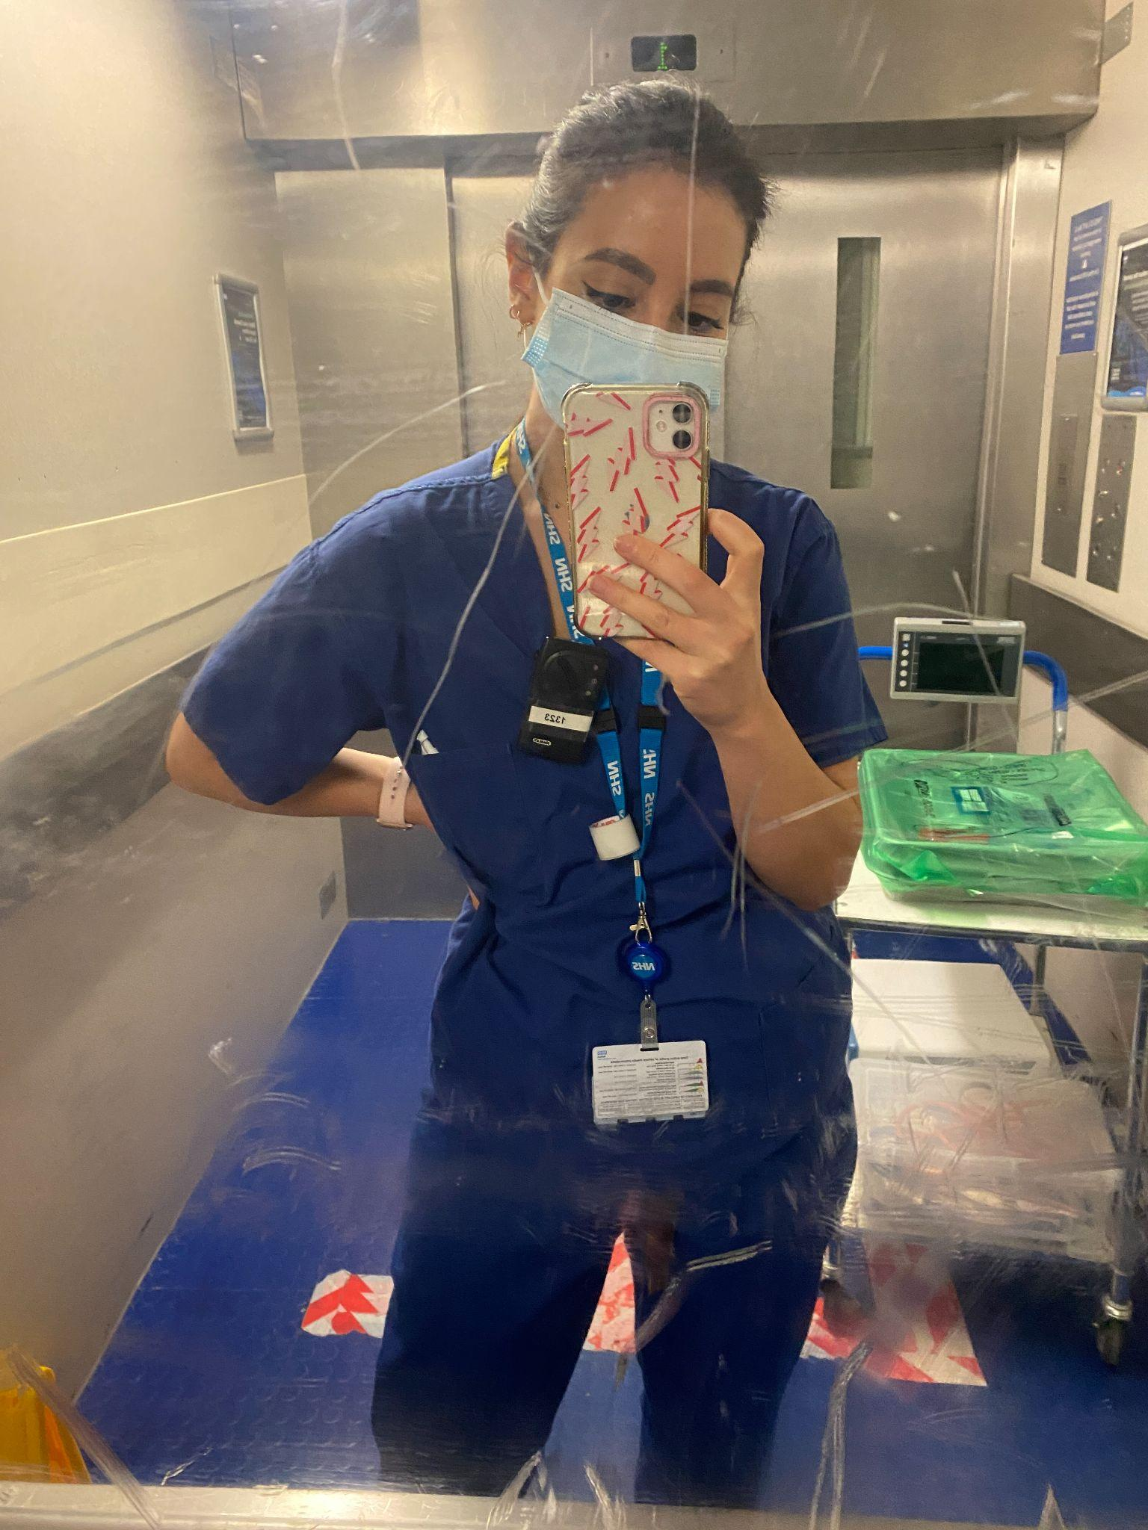
University of Manchester
Medicine MBChB Honours with Distinction in Final Exams
Bolton Hospital
FY1/2 Training post

Slide 5
What is a “Junior Doctor”?

Slide 7
What does an average day on the wards look like?
Senior ward rounds
Junior ward rounds
Bloods
Jobs for the rest of the day
On-call shifts
Night shifts
Weekend cover

Slide 8
Pros/Cons of being a doctor
Pros:
Get to do what you love each day
Very hands-on career
Not stuck behind a desk all day
So many different avenues you can take
Job security
Team bonding
Cons:
Takes time to qualify
Different career stages to many friends
Not very lucrative
Have to spend more money on exams post-university
Stress and burnout
The current state of the NHS

Slide 9
Contact Information:
chaya.fligg@doctors.org.uk

