Slide 1
How cooking methods can impact our health

Slide 2
Common electric devices used for cooking
The microwave oven which was made in 1967
Deep fryer made in 1918
Air fryer made in 2005 which has become more popular in recent years
These devices may be convenient but how do they effect the food we are fuelling our bodies with?

Slide 3
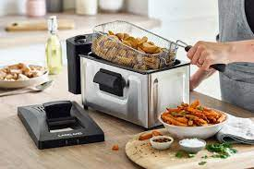
Deep Fryer
How do they work?
Deep fryers use a heating element to heat oil to around 400 Fahrenheit , the food is then placed into this hot oil which vaporises the food and simultaneously cooks it. As oil and water don't mix, the product doesn't lose moisture, but rather, is steamed from the inside out.

Slide 4
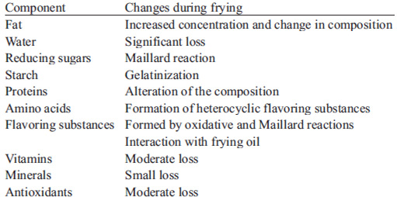
Does it change the composition of food?
The fat content of food increases due to absorption and retention of oil, which implies an increase in energy intake on average 42% in chips.
It can produce trans fatty acids which are unsaturated fatty acids linked to increased risk of cardiovascular disease.
In general, the content of protein is increased by the frying process due the effect of concentration, because frying is also a process of dehydration.
Loss of vitamins is caused by high temperatures or enzymatic oxidation when investigated the effect on vegetables, an average loss of 14 % and 24 % for vitamin A activity in frying was indicated.
Frying food in oil can cause dangerous compounds to develop, such as acrylamide. This compound forms in certain foods during high-heat cooking methods, acrylamide may have links to the development of some cancers,

Slide 5
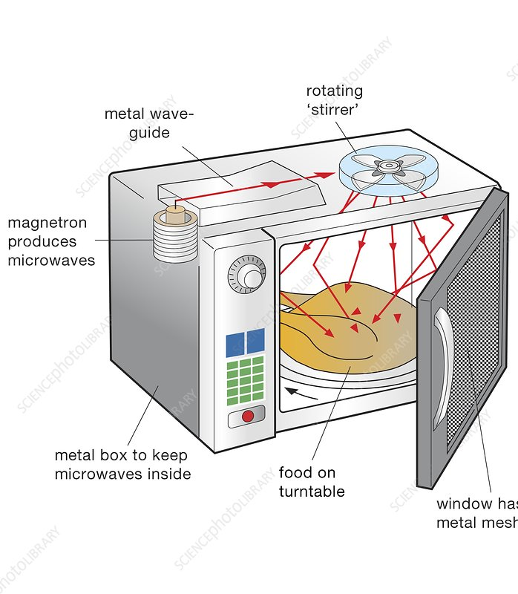
Microwave
How do they work?
magnetron inside the oven produces microwaves. The microwaves reflect off the metal interior of the oven and cause the water molecules in food to vibrate. This vibration results in friction between molecules, which produces heat that cooks the food.

Slide 6
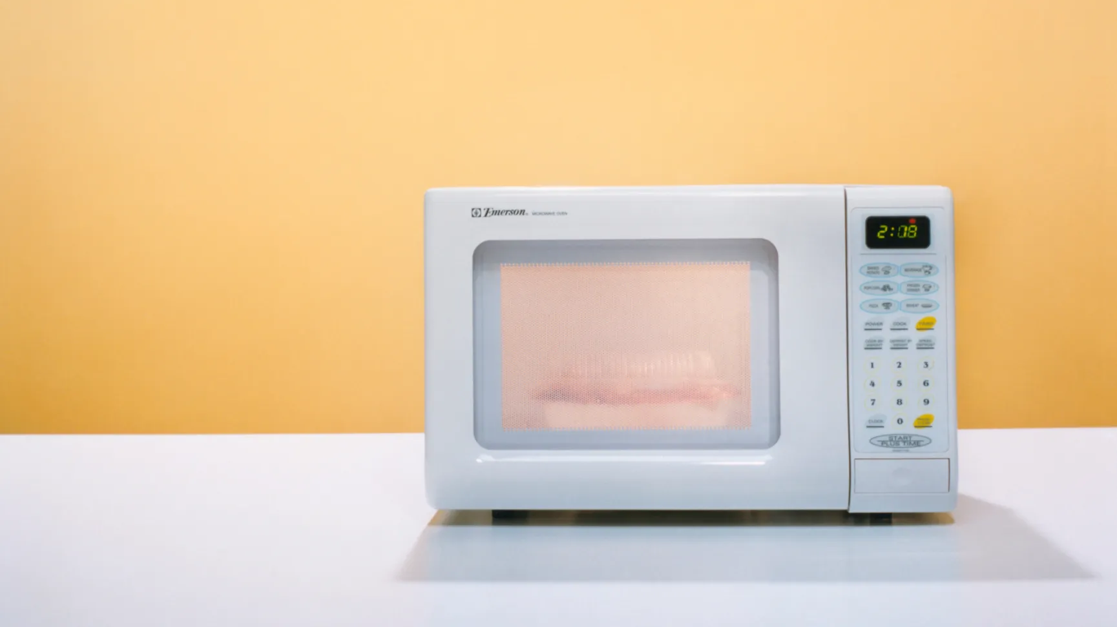
Does it change the composition of food?
When you microwave a piece of chicken, energy from the microwaves causes the protein molecules to vibrate faster. This can break the hydrogen bonds and sulphur bridges that give the protein chains their specific 3d shape. With a piece of bread, a high enough dose of microwaves will cause the starch and protein molecules to break down and react with each other to create complex organic molecules.
However, microwave cooking is actually one of the least likely forms of cooking to damage nutrients. That's because the longer food cooks, the more nutrients tend to break down, and microwave cooking takes less time.
It is a common misconception that microwaves are linked to an increased risk of cancer, microwaves are an example of non-ionising radiation.

Slide 7
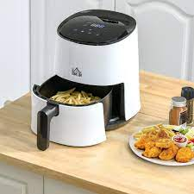
Air Fryers
How do they work?
Air fryers work by using super heated air to cook the food. A fan at the top of the fryer blows air down through a heating element. The air passes through and around the food cooking it.
An air fryer is basically a hybrid between a deep fryer and a convection oven.
instead of being placed in hot oil, the food is exposed to very hot, circulating air

Slide 8
Does it change the composition of food?
There is some evidence that using an air fryer reduces a compound known as acrylamide by up to 90%, compared to deep fat frying. Acrylamide is a chemical substance that is formed when starchy foods, like potatoes, are cooked at high temperatures

Slide 9
In Conclusion
Unless you eat a clean diet of raw foods, there is no way to preserve all the nutrients in your food .
The bottom line? Heat and water alter the nutrients in the foods we eat. That means the cooking process is bound to deplete at least some of the nutritional value in your food.
However by choosing to use a deep fryer you will be increasing your fat intake and putting your health at a higher risk then by using other methods of cooking such as the air fryer or an oven.

