Slide 1

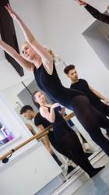


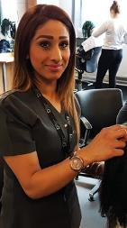




Notes:
JM

Slide 2

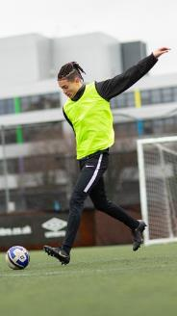



OBJECTIVES
To recognise what a CV is and to understand why we need one.
To recognise what is essential and what is not essential on a CV.
To identify the skills that you hold and where you develop them.
Notes:
CR

Slide 3



WHAT DO YOU KNOW?
What is a CV?
Why do you need one?
Notes:
CR

Slide 4






PROGRAMMES OF STUDY
Core Programme Choices:
T Levels
(Starting 2021)
Industry Excellence Academy
Vocational Study Programmes
Centre of Excellence
Apprenticeships
Degree Level Study (18+)
Notes:
JM

Slide 5





















EMPLOYER PARTNERS
Some of our employer partners
Notes:
JM

Slide 6

TRUE OR FALSE
The average time spent by employers looking at a CV is 5 to 7 seconds
76% of CVs are discarded for an unprofessional email address
There is an 88% rejection rate when you include a photo on your CV
Employers can not look you up and find you on social media using the information you provide on your CV or application form
A CV should be written on a computer and never hand written
Employers need to know your age, sex, religion and marital status
Only 35% of applicants are actually qualified for the job they apply for.
TRUE
TRUE
TRUE
FALSE
TRUE
FALSE
TRUE
Notes:
CR

Slide 7


WHAT DO I Include?
ESSENTIAL | NON-ESSENTIAL
Personal Details e.g Your name | Age/DOB
Contact details | Gender
Qualifications | Sexuality
Skills | Religion or Faith
Achievements (these can be out of school) | Primary School details
Work experience | A Photograph
Hobbies & Interests | References (can be available upon request)
Notes:
JM

Slide 8

Video
https://www.youtube.com/watch?v=1EgOHOscyCE
Notes:
JM

Slide 9

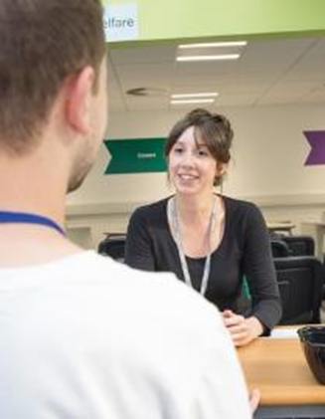
Employability skills
Employability skills are qualities that can be developed through
work and experiences. They make you a well-rounded person.
These skills are what set you apart from others and let you use
your qualifications practically.
CAN YOU COME UP WITH THE TOP 10?
Notes:
CR

Slide 10
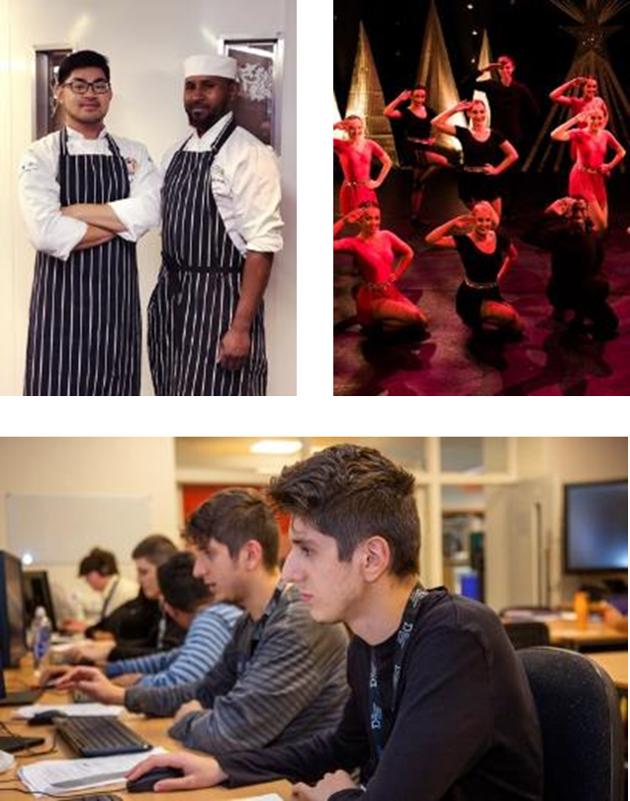
Employability skills
Communication.
Teamwork.
Problem-solving.
Initiative.
Leadership.
Managing, organising and time management.
Negotiating and persuading.
Lifelong learning.
Decision-making.
Creativity and innovation
Notes:
CR

Slide 11




SAY WHAT YOU SEE..
1
Team Work
2
Leadership

Slide 12






SAY WHAT YOU SEE..
3
Lifelong learning
4
Decision Making

Slide 13

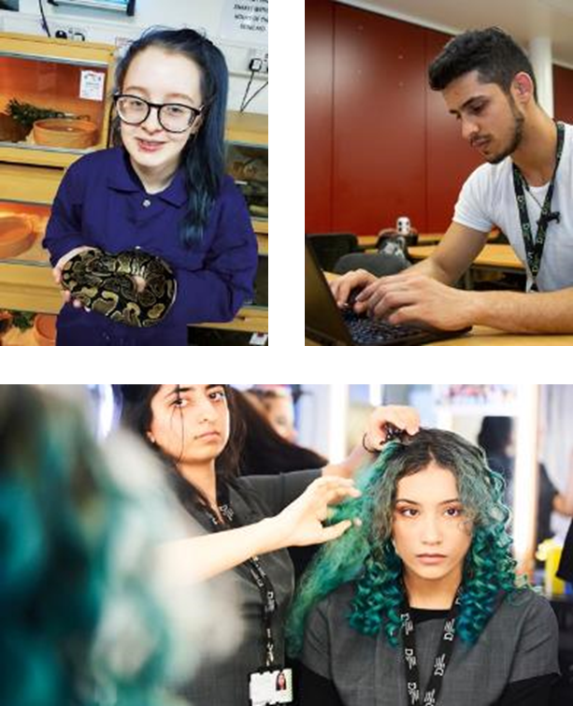
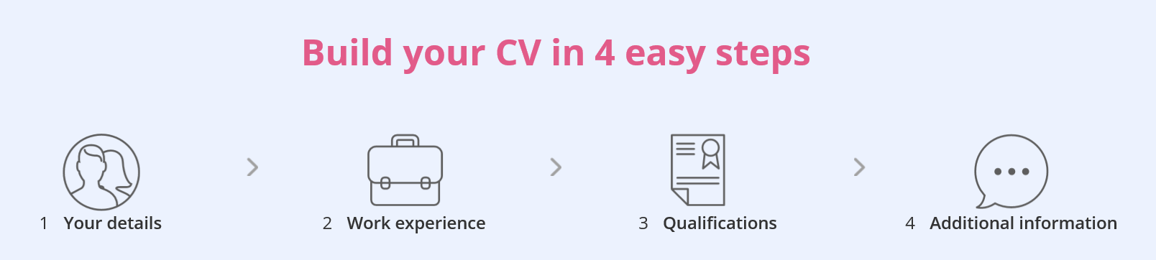
STRUCTURE
Name
Contact details
Short personal statement
Work experience
Qualifications
Key Skills
Interests & Hobbies
References
Notes:
Ensure that presenter talks about each point so that examples can be given
JM

Slide 14


Support online
If you would like to take a look at some good CV’s or would like to find a good place to start, check out some CV builder websites such as Reed.
https://www.reed.co.uk/cvbuilder

Slide 15


Top Tips
Be passionate about your studies
Be prepared to develop new skills away from the school – experiment!
Engage with ANY work-based opportunities
Get related work experience – or create it!
Get to grips with professional social media
Start creating your CV now!
Notes:
CR

Slide 16





Thank you
tmc.ac.uk
@SchoolsTeamTMC
@SchoolLiaisonTMC
slt@tmc.ac.uk
Notes:
CR

