Slide 1
Brain Tumours
By Melissa Bickerdike

Slide 2
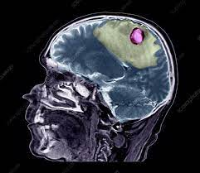
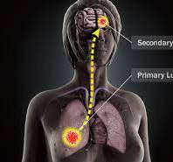
How are brain tumours formed?
The brain tumour will first develop into a primary tumour. There are two types of brain tumours -malignant tumours which can spread to other parts of the body to form secondary tumours and is 30% of all brain tumours. Benign tumours which make up 70% of brain tumours and do not spread. Malignant tumours if not treated straight away can spread and form secondary tumours, making treatment harder.

Slide 3
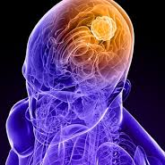
The grading system for tumours.
There are various types of primary malignant brain tumours. The different types develop through different types of cells in the brain. The graded scale is 1-4, as the grading system increases due to the tumour becomes more aggressive, treatment therefore varies on the grade of the tumour.
The NHS has a grading system for types of brain tumours. Brain Tumours are graded on how fast they grow and how likely they are to grow back after treatment.

Slide 4
Risk factors for a brain tumour
There are a few risk factors for the development of a brain tumour such as age. With age most tumours occur during older ages such as 85-89, although some types of brain tumours are more common in children.
Exposure to radiation, which only accounts for a small scale of brain tumours ; some types of brain tumours are more common in people who have had radiotherapy, CT scans or an x ray of the head. In addition, genetic conditions can also increase the risk of getting a brain tumour.

Slide 5
Brain tumours by gender
Brain tumours are the leading cause of death within males of 20-39 and the forth leading death for females within this age group.
Overall, the rates of getting a primary brain and CNS tumours are higher in females (58% of diagnoses) than in males (42%)
Non-malignant brain tumours occur significantly more often in females (64%) than in males (36%)
Malignant brain tumours occur slightly more often in males (56%) than in females (44%)
Incidence rates for specific brain tumour types vary, for example, glioblastoma diagnosis are more common in males, while meningioma diagnosis are more common in females.

Slide 6
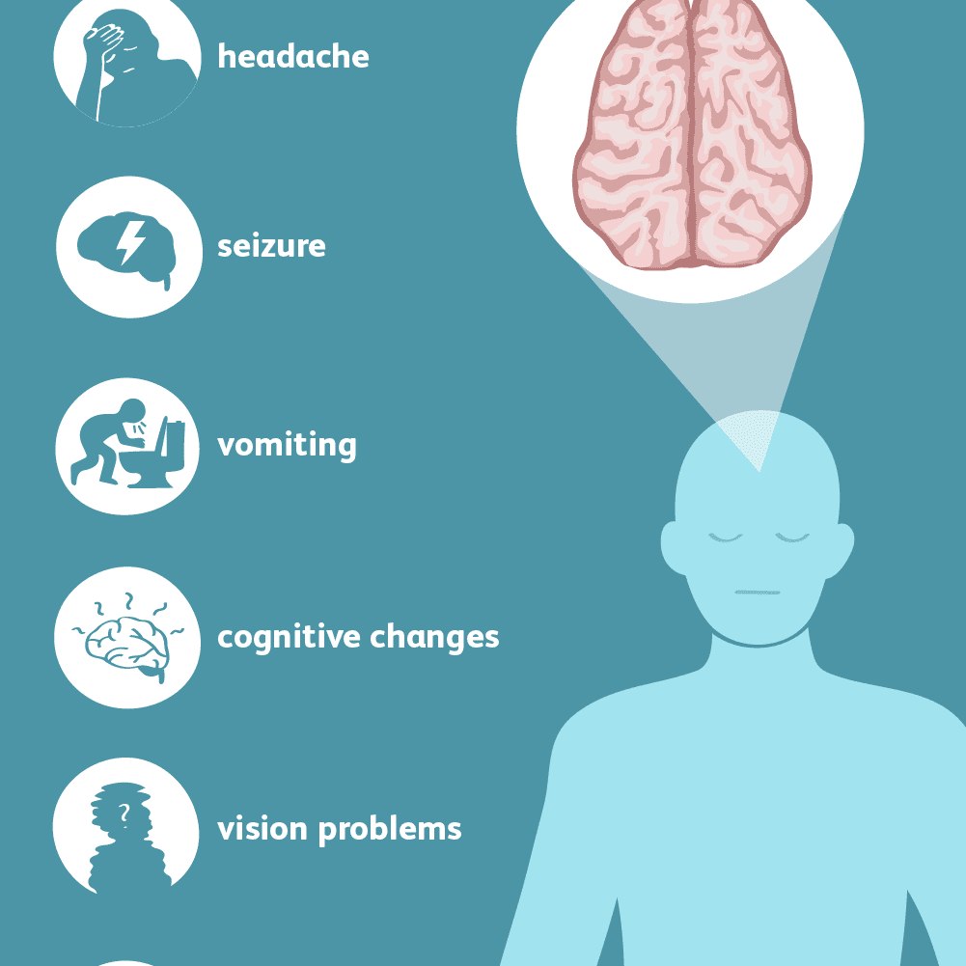
The symptoms of brain tumours.
The first signs of a brain tumour is irritability, drowsiness, numbness and dizziness. Interestingly the tumour does not just affect you physically but also mentally. Common symptoms are hallucinations, depression, personality changes, abnormal behaviour and memory loss. The reasons for this is due to the tumour disrupting the brains functions and different symptoms can be seen in different patients due to which hemisphere the tumour effects of the brain such as the right side being the logic side of your brain, whereas the left is the creative side.

Slide 7
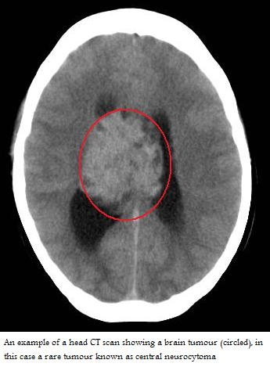
When should you go to a GP?
You should go to a GP if you experience the type of symptoms mentioned on the previous slides. Especially, if you have a headache that feels different from the types of usual headaches you experience.
If a GP cannot identify a more likely reason for why you are experiencing these symptoms
,they would refer you to a neurologist who would do further assessments and tests such as a brain scan.

Slide 8
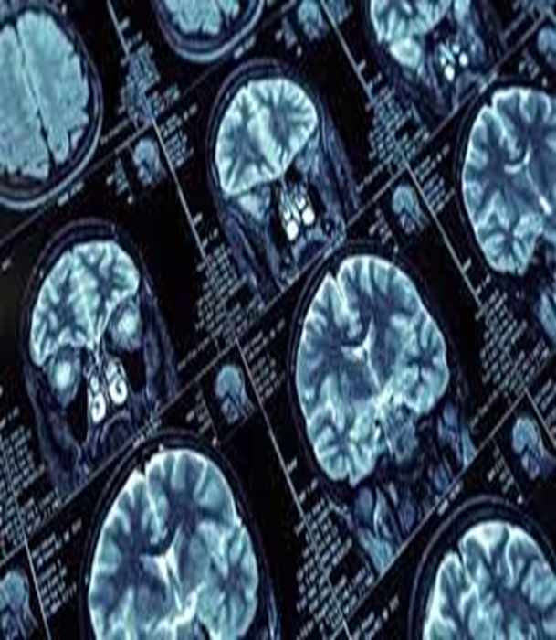
Treatment for brain tumours
The treatment depends on the type of tumour- where it is in the brain? How big it is? And how far it has spread and the abnormality in cells.
Treatment for a brain tumour includes: Steroid, medication to reduce current symptoms, surgery, radiotherapy and chemotherapy.
The risks that face a surgeon when removing a tumour, further treatment will be needed such as chemotherapy or radiotherapy may be needed to treat abnormal cells left behind. However, chemotherapy and radiotherapy have their own risks due to them killing healthy cells too.
Treatment for non-cancerous tumours is often successful and a full recovery is possible.

Slide 9
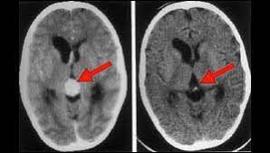
Thank you for listening!

