Slide 1
Oxbridge

Slide 2
Is Oxbridge right for you?
1. You’re on track for top A-level grades
2. You work obsessively
3. You like a good academic debate
4. You don’t crumble under pressure
5. You don’t mind self-directed study
6. You adore your subject
7. You like quirky traditions

Slide 3
What students need to do
Subscribe to journals/magazines/newsletters e.g. National Geographic, The Economist, New Scientist etc.
Read beyond the syllabus
Get onto one of the many outreach days run by individual colleges
Summer schools and master classes

Slide 4
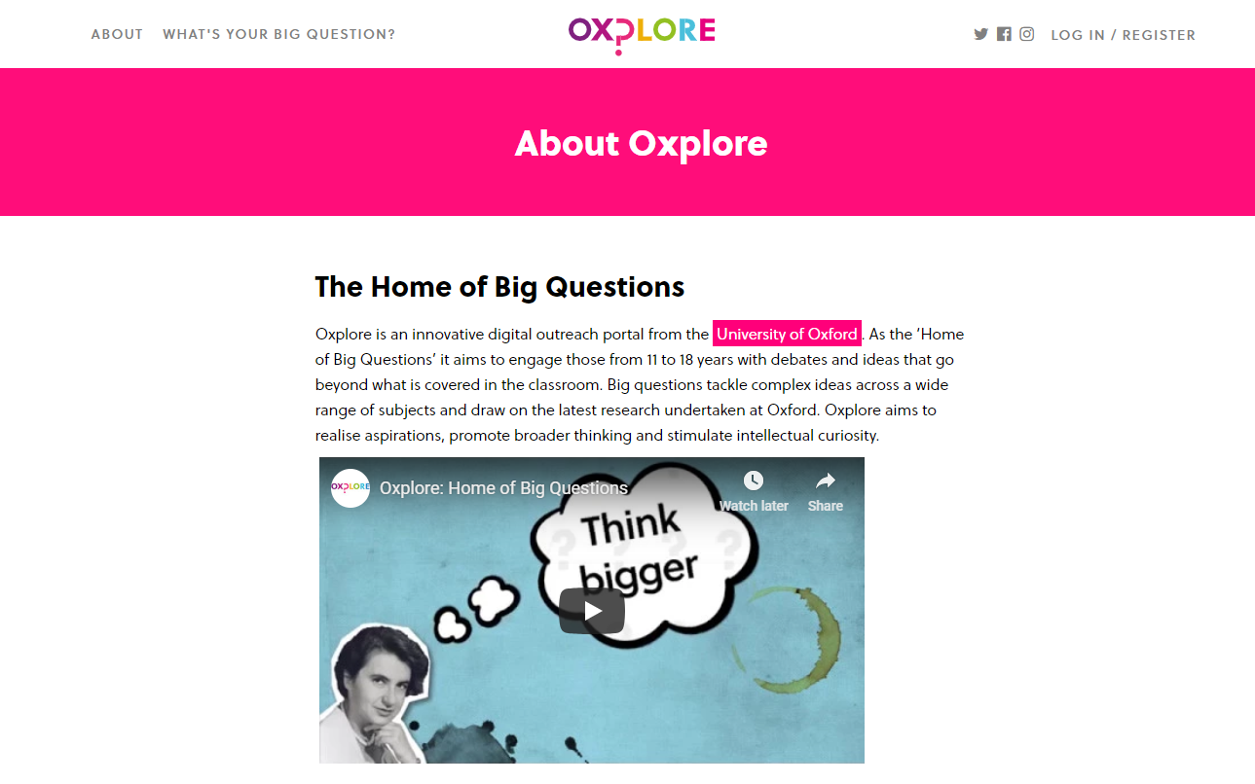
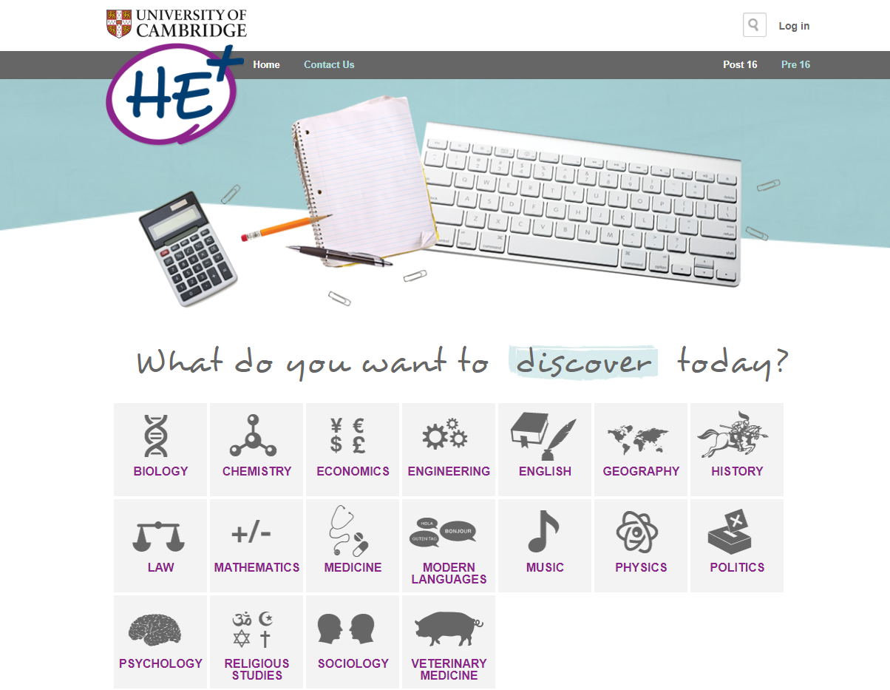
Resources
www.oxplore.org
www.myheplus.com

Slide 5
And now for something completely different
Oxbridge application process goes beyond the UCAS form
Information taken from a variety of sources (including GCSEs, supplementary questions, reference etc.)
Aptitude tests for both universities
Some colleges require submissions of work
Interviews

Slide 6
The timetable
In school meetings January 2023 onwards
March 2023 : Outreach days
September 2023: Mock aptitude tests
End of September: Registration for tests
15 October: Mock interviews and deadline for applications
November: Testing
December: Interviews

