Slide 1
Organ
Donation
Should it be mandatory?

Slide 2
What is organ donation?
When a person passes away, their organs may be viable to be harvested for transplantation.
Many factors affect this, such as biochemical, functional and morphological viability of the organs
Donors may have some viable organs and some not
These organs can be harvested from deceased and living donors (depending on organ and situation) and transplanted into a patient
Key terms:
-morphology: structure and form of an organ without regarding function
-biochemical: characterized by, produced by, or involving chemical reactions in living organisms
-functional: how effectively the organ works in completing the required process

Slide 3
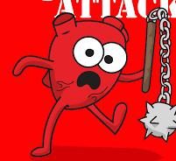
Most Commonly donated Organs:
Heart:
-these last 4-6 before needing to be transplanted
-up to 200 transplants happen a year in the uk
Kidneys
-these last 24-36 hours before being transplanted
-2868 kidneys were transplanted in the uk in the years 2021/22
Liver:
-These survive 12 hours before needing to be transplanted
-an average of 726 transplants are carried out a year in the uk

Slide 4
Key facts about transplants
In the UK there are currently around 7000 people waiting for an organ transplant
In order for a person to receive an organ they must be a “match” for the organ. This reduces the chance of the body “rejecting” the organ
Once person has received an organ, they must take immune suppressants for the rest of their life as this also helps to stop rejection. However this means the patient will be more susceptible to severe infection
Despite organ transplants being life saving, there is still a majorly increased risk of premature death of the patient
Key terms:
Match- when the donor has the same blood type, body size or even ethnicity as the patient, so organ wont be as likely to reject
Rejection: when the patient’s immune system attacks the new organ causing it to die/ fail

Slide 5
The UK’s current system: Opt out
An opt out system is if the deceased hasn’t registered their preference, their organs are still donated. However their next of kin can opt out on their behalf
This system is beneficial for many reasons such as:
Normalisation- an opt out system would make organ donation seem more normal. This will encourage people to donate and not choose to opt out
Numbers- more organs would be donated, which would aid the lack of organs needed for transplants. 421 people last year died in the UK waiting for an organ. this could have been avoidable
Prioritisation- people argue that when considering who to prioritise in this scenario, a person not yet dead with the opportunity to live should be prioritised over someone who has deceased

Slide 6
The opt in system
An opt in system is one where a person is assumed as not wanting to be an organ donor if no preference is stated
Some people are in favour of this system because of:
Autonomy: some people are not aware of the system, so may end up having their organs donated against their wishes after not having twhe opportunity to express otherwise
Respect: many argue that we should protect the dignity of the dead, particularly as some religions state that the body should stay intact after death
Alternatives: some people believe that we should encourage people to opt in rather than just assuming as it could also solve the organ shortage problem

Slide 7
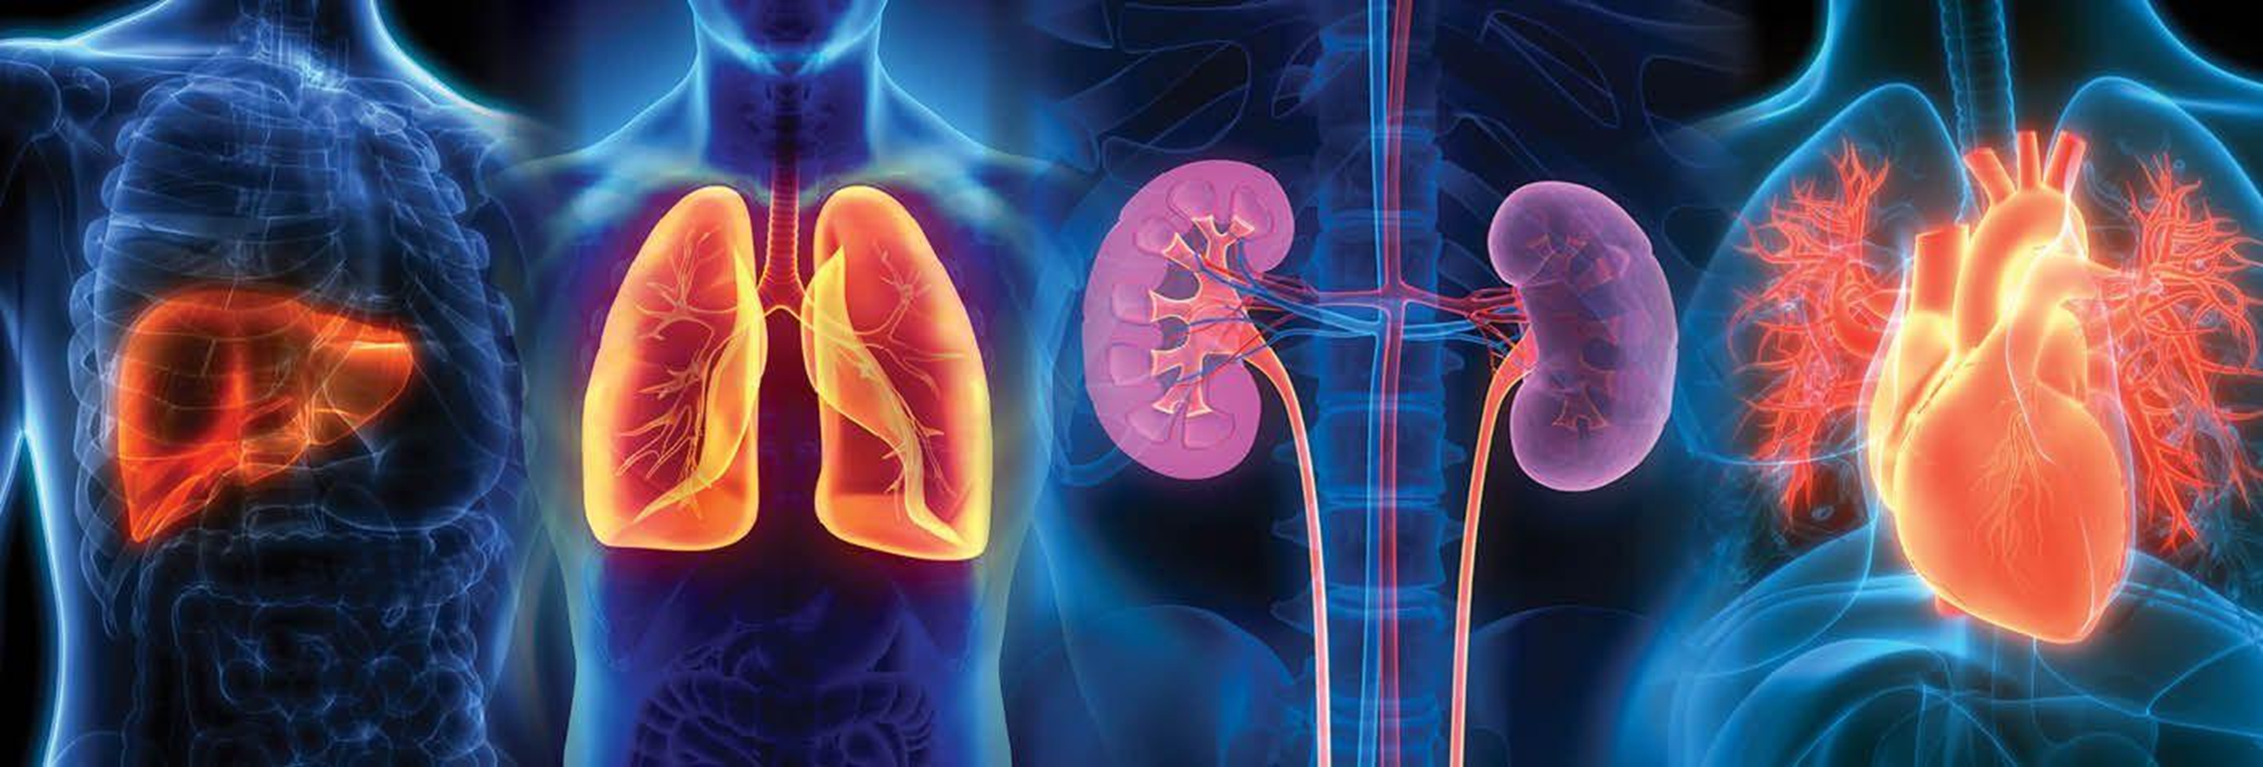
DISCUSSION…
DISCUSSION…

