Slide 1
Nutrigenetics
Maia Lurie

Slide 2
Nutrigenomics
The correlation between nutrition and genes and vice versa
How what we eat can turn on/off genes

Slide 3
DNA recap
46 chromosomes
Present in every cell in our body apart from red blood cells
1 chromosome from each parent- enables passing down of characteristics through generations
This information is sufficient to code for all living processes- DNA found in chromosomes codes for different proteins (structural, enzymes etc)
2 sets of 3 billion pairs of DNA that make up our genome

Slide 4
single nucleotide polymorphism
When one base in the amino acid sequence is substituted for another
Can change the protein coded for- protein will have a different structure and function

Slide 5
Genotype vs. phenotype
Genotype- genetic material passed from generation to generations
Phenotype- observable characteristics of an organism (humans in this case)
Genes x environment= outcome (environment and genes each contribute 50% to this idea)
We can then use this to think about how we can better our outcome of becoming healthier people
Can we change our outcome by changing our environment? How significant is this?

Slide 6
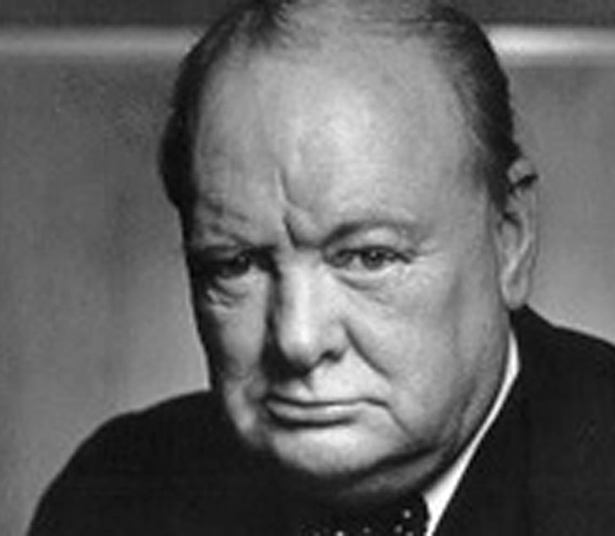
Drinker
Smoker
Little physical activity
No healthy diet
He was Prime Minister- until age of 80
Died at 90
Clearly has bad environmental choices, but must have good genetics- can be predicted

Slide 7
Hank Gathers
Professional basketball player
had undetected heart disease
Died at 23
Good environment- bad genetics
Everyone is different

Slide 8
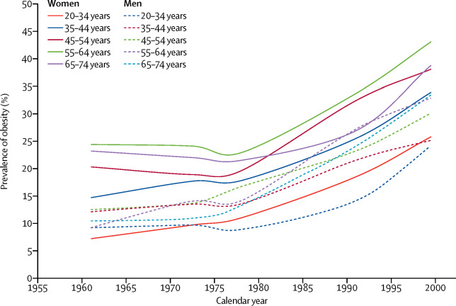
Percentage of obese people dramatically increased during the 1980’s- food pyramid introduced, peoples’ focus on ’fat free’- higher consumption of (simple) carbohydrates- increased obesity levels

Slide 9
much shorter time span but the levels are much higher and more prominent
all the things that are prevalent nowadays that provoke these statistics…
Eating in a heavy caloric surplus, smoking, heavy drinking, food advertising (and false ‘healthy’ marketing within that) etc…

Slide 10
Clear difference between the two
Celiac diease causes the lining of the small intestine to be damaged- leads to villi inflammation- villous atrophy
Granted that celiac disease limits gluten intake, peoples amount of tolerated gluten ranges from 10mg-36mg a day.
This has led to confusion about labelling gluten free products- variation in different countries over how its standardized.

Slide 11
Cancer
People often believe that the gene mutation that can cause cancer is either passed down through generations or acquired sometime in someone's life.
A study conducted shows this idea in a completely different light. It followed the progression of the early cancer in animals over the first 12 weeks, by giving some 5% protein in their caloric intake, and some 20% (sufficient amount for humans is between 8 and 10%).

Slide 13
What would happen if we continuously switched between the two diets?

Slide 14
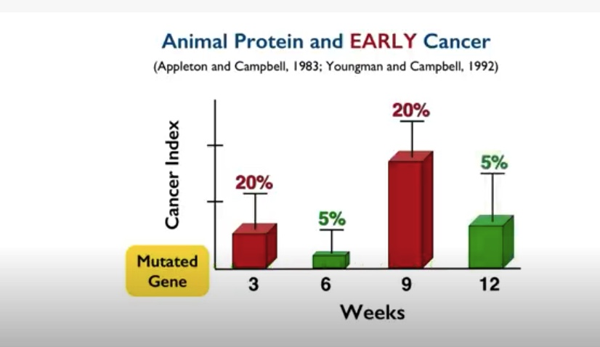
You can see how the cancer is getting switched on and off between the changes in protein percentage.
Again, this is astonishing to most people who believe that cancer stems from a mutated gene and if we have the gene then we definitely have cancer.
Here we can see how important nutrition is in this instance.
These genes are silent until they're ‘nourished’.
The process of disease relies on the many nutrients present, rather than the lack of what isn’t there.
Notes:
Eating whole foods prevsnts, treats and cures a wide range of disease and illnesses, unlike drug therapy which can cause harmful side effects

Slide 15
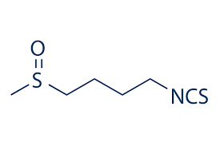
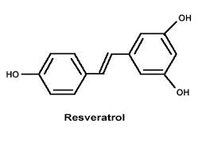
Other examples
Sulforaphane in broccoli can turn off oncogenes (cancer-initiating genes) by blocking the DNA mutations that cause cancer.
Resveratrol in grape skin can lead to changes in genes expression that cause a shift in energy production and metabolism (mimics the effects of caloric restriction by affecting proteins in the cell)
Every meal we eat is affecting our gene expression ☺

Slide 16
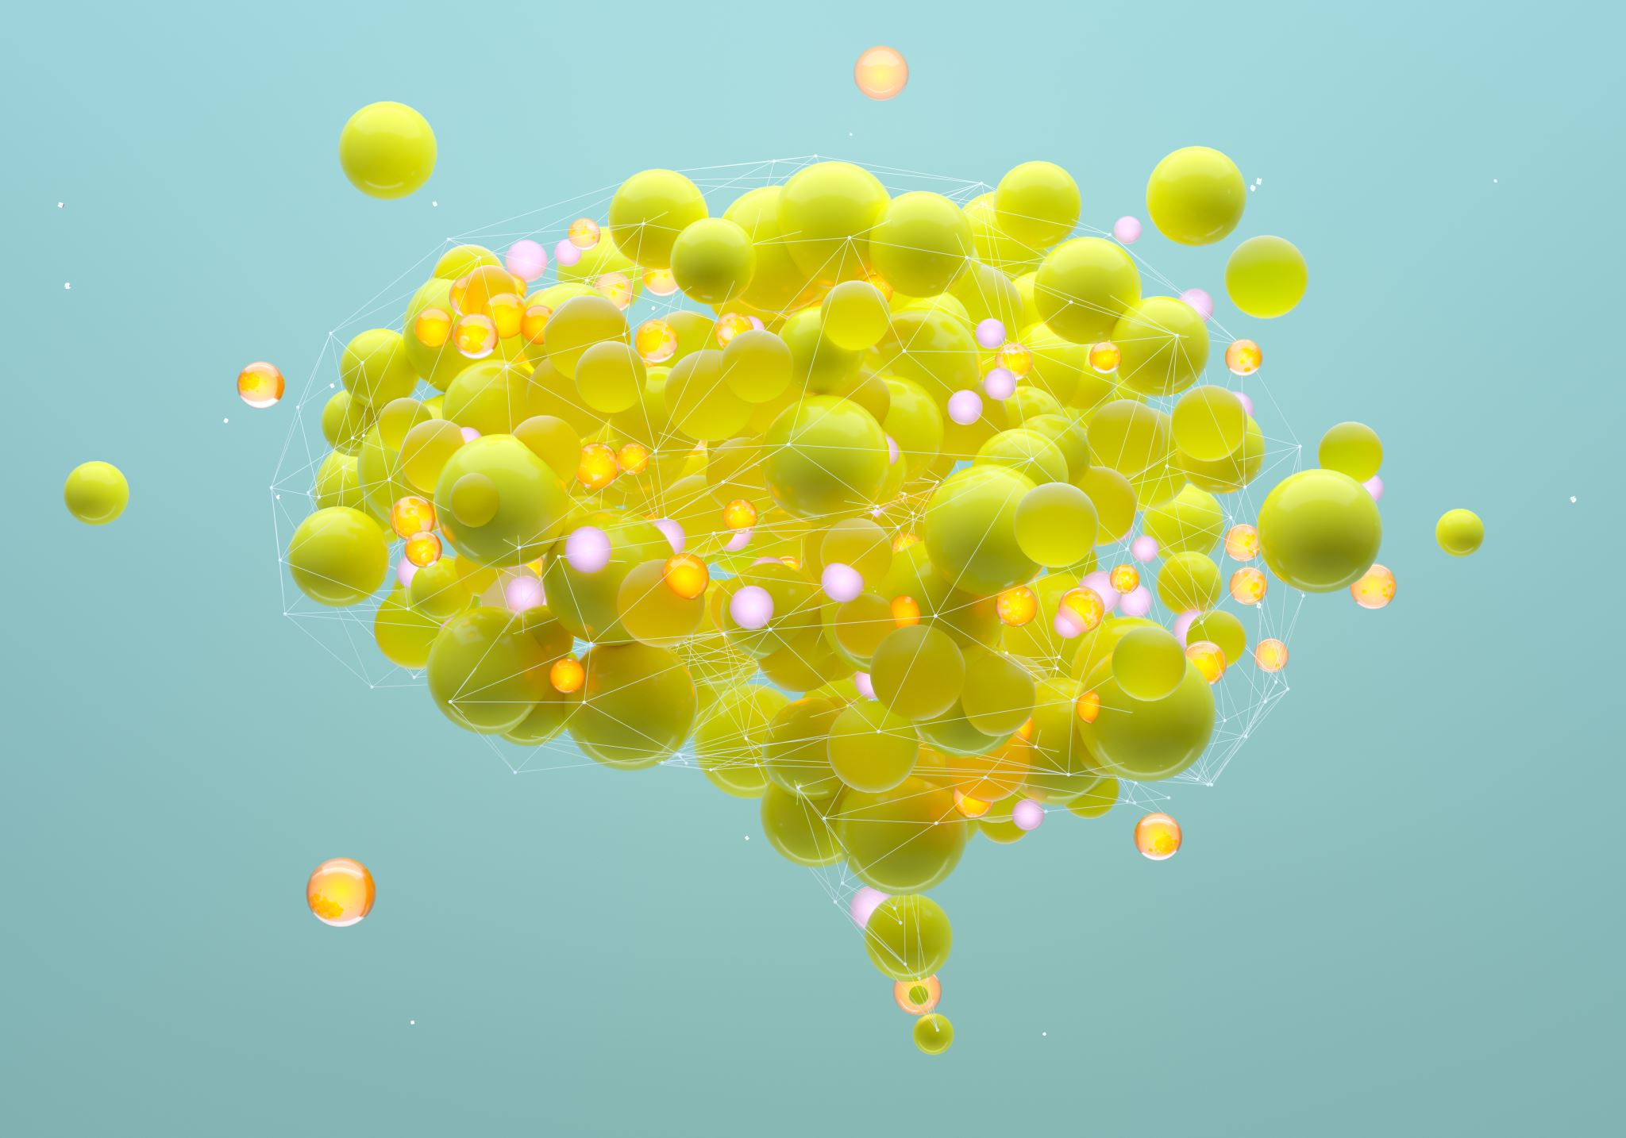
Nutrient complexity
The amount of a nutrient we consume doesn’t constitute to the amount that goes to functional parts in our body because the journey of nutrients is complex.
Individual nutrients use multiple mechanisms to cause their effects, unlike ‘targeted drug’ effects.
Nutrients work best in their whole food context (rather than isolated chemicals (supplements).

Slide 17
Nutrigenetic study
https://nutritionj.biomedcentral.com/articles/10.1186/1475-2891-6-29
2 groups of people
1 group genetically tested, 1 group not
1 group had a tailored diet based on their genes, the other group chose the Mediterranean diet
Initially not a lot of difference between the 2 groups, however, after 300 days of follow up, individuals in the nutrigenetic group were more likely to have maintained some weight loss (73%) than the comparison group (32%).
- Was this outcome because of the diet being tailored to their genes, or more the psychological impact it had on them having food tailored to their biochemistry so they must comply with it? (…can be translated to the medical sector)

Slide 18
With increasing evidence of the positive correlation between nutrition and health, why is nutrition still being largely ignored in medicine?
- Medicine is ‘reductionist’- dependent on targeted drug therapy, and so when the disease has manifested itself, we need higher amounts of those drugs (what the clinical studies teach us). This creates a focus on looking at one thing at a time rather than the numerous complex mechanisms in the body.

Slide 19
Why is nutrigenomics important in medicine?
Genes are not your destiny- lots of people nowadays think that if their parents lived until a certain age, so will they-predestined thinking.
We know that this isn’t the case due to science- although genes are critical for determining functions of proteins, nutrition impacts the extent to which different genes are expressed, so genetic background doesn’t wholly determine a particular phenotypic outcome.
Doctors with expertise in nutrition are more likely to spot diet-related issues earlier in a patients’ prognosis.
If our doctors have a better knowledge of nutrition, it can help prevent disease, improve patient outcomes and save the NHS money. In 2018, GP and clinical expert in type 2 diabetes, Dr David Unwin saved his surgery £45,000 on diabetes medications by giving simple dietary advice to his prediabetic and type 2 diabetic patients and getting them to switch to a low-carb diet. If all doctors took this approach, the national saving to the NHS would be close to £420m – money that could be redirected into important research.
Duty of candour

