Slide 1
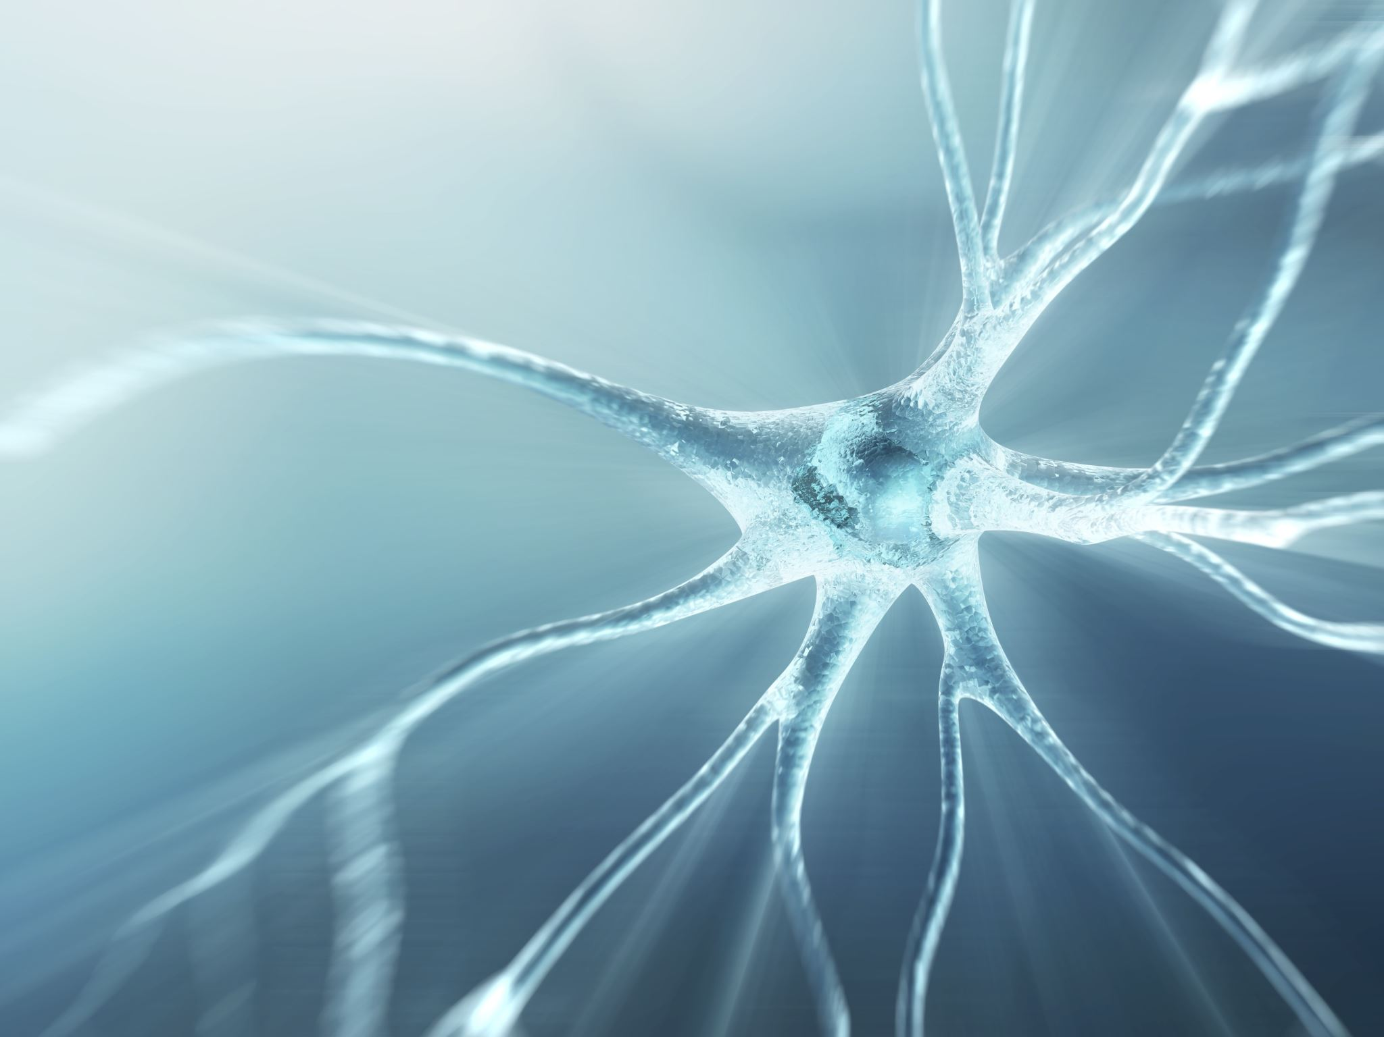
Neurosurgery
A KDHS med-soc presentation
By Nechama Giffen

Slide 2
What is a neurosurgeon?
A neurosurgeon is a doctor who specializes in diagnosing and treating conditions which are connected to the nervous system
Which consists of: brain, spinal cord, and peripheral nerves.
Neurosurgeons can also diagnose and treat conditions which are prevalent to the structures which support the nervous system.
Including: skull, spinal vertebrae, spinal disks, blood vessels, and protective membranes and tissues.

Slide 3
Although neurosurgeons ARE surgeons…
Neurosurgeons usually attempt all nonoperative treatment methods, surgery is a last case scenario situation.
Examples of non-surgical treatment which includes: medication, steroid injections and physical therapies

Slide 4
Neurologists vs Neurosurgeons
Neurologists are also medical doctors, and they treat and manage conditions which affect your nervous system.
Key difference is that neurologists don’t perform surgeries.
Neurosurgeons treat diseases or disorders which have underlying structural/anatomical causes identified.
Neurologists tend to manage patients with neurologic disorders with no surgical treatment.

Slide 5
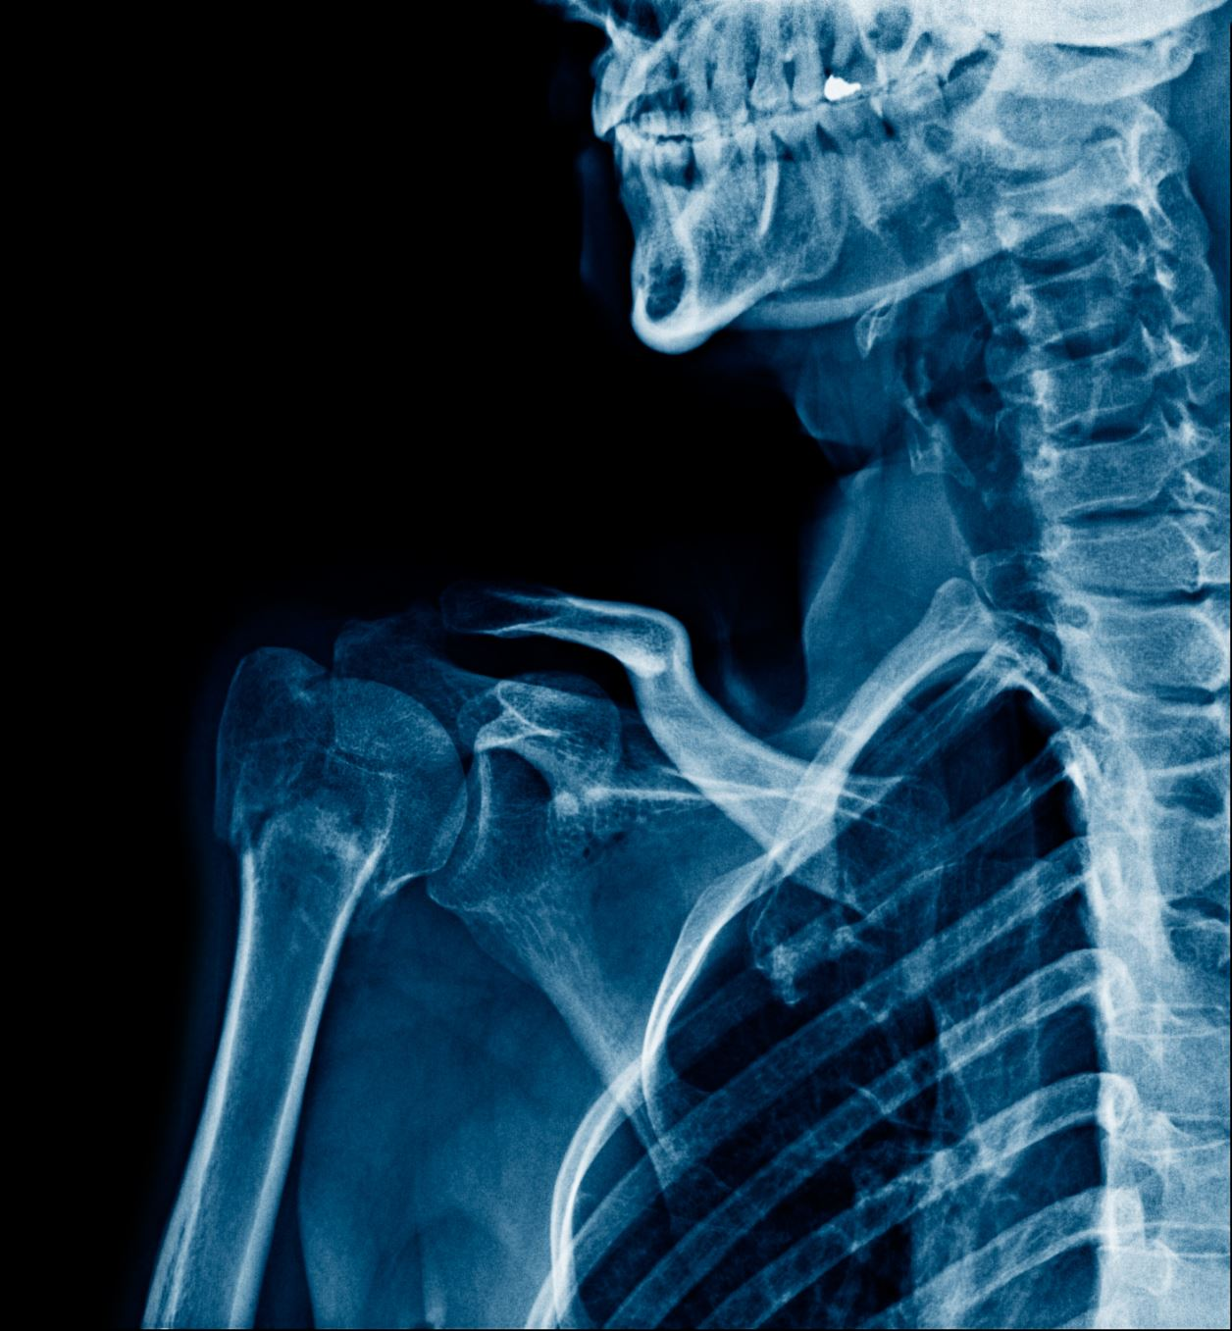
Most common neurosurgery procedures in spine
Spinal surgeries for decompression and/or fusion
Decompression surgery is a type of surgery used to treat compressed nerves in spine. Compressed nerves in the spine could cause persistent pain and numbness to areas of the body
Fusion is used to join 2 or more bones in your spine together permanently. This surgery is used when medical conditions cause vertebrae to move against each other more often than they should

Slide 6
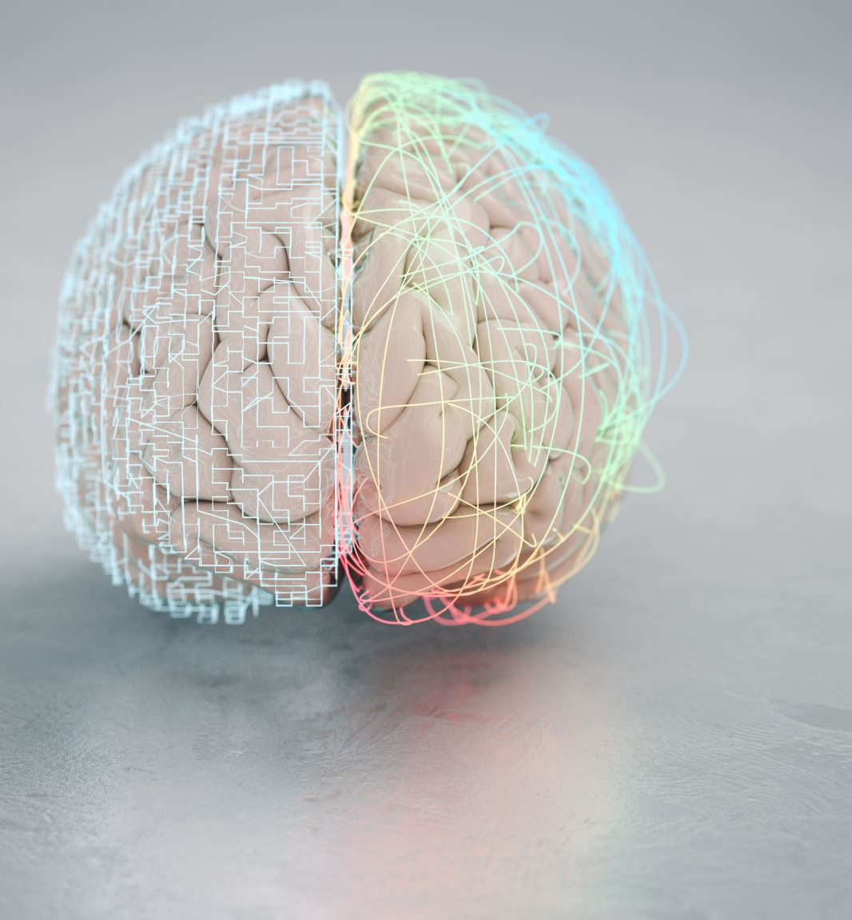
Most common neurosurgery procedures in brain
Brain tumors and blood clots.
To remove brain tumors a small section of the skull is removed, and the tumor is cut out. The piece of skull is the placed back.
Blood clots, also called unruptured brain aneurysms can be removed by neurosurgical clipping or endovascular coiling.
Notes:
A brain tumor is an abnormal mass of tissue in which cells grow and multiply uncontrollably.

Slide 7
Neurosurgical clipping and endovascular coiling
Both are carried out under general anaesthetic .
In neurosurgical clipping the neurosurgeons makes an incision into the scalp and removes a flap of bone. When aneurysm is detected the neurosurgeon will seal it shut using a tiny metal clip which remains permanently clapped on aneurysm.
In endovascular coiling a catheter is inserted into an artery in leg or groin. The tube is guided through the network of blood vessels up to your brain and into the aneurysm. The aneurysm is then filled with tiny platinum coils so blood can’t enter, meaning the aneurysm is sealed off from main artery preventing rupturing.

Slide 8
Specialisms inside neurosurgery
Although neurosurgery is a medical specialism it is still a very broad field.
Common specialization areas include: neuro-oncolic surgery, cerebrovascular neurosurgery, skull base neurosurgery, functional neurosurgery, and spine surgery.

Slide 9
Summary
A neurosurgeon is a medical doctor which treats conditions involving the nervous system.
Surgeries only occur when all other non-surgical treatment options have been exhausted.
Most common conditions which neurosurgeons face are brain tumors, brain clots, and spinal fusion and decompression surgeries.
Neurosurgery is a very broad specialism with many sub-specialism to specialise in.

Slide 10
Sources:
https://my.clevelandclinic.org/health/articles/22364-neurosurgeon
https://houseinstitute.com/neurosurgery/neurosurgery-resources/for-patients/faq-neurosurgery/
https://www.nhs.uk/conditions/lumbar-decompression-surgery/
https://www.hopkinsmedicine.org/health/treatment-tests-and-therapies/minimally-invasive-spinal-fusion
https://www.aans.org/en/Patients/Neurosurgical-Conditions-and-Treatments/Brain-Tumors
https://www.nhs.uk/conditions/malignant-brain-tumour/
https://www.nhs.uk/conditions/brain-aneurysm/treatment/

Slide 11
Thank you for watching!

