Slide 1
Orthopaedic and Hand Surgery
Mr Natan Silver
06.02.2024

Slide 2
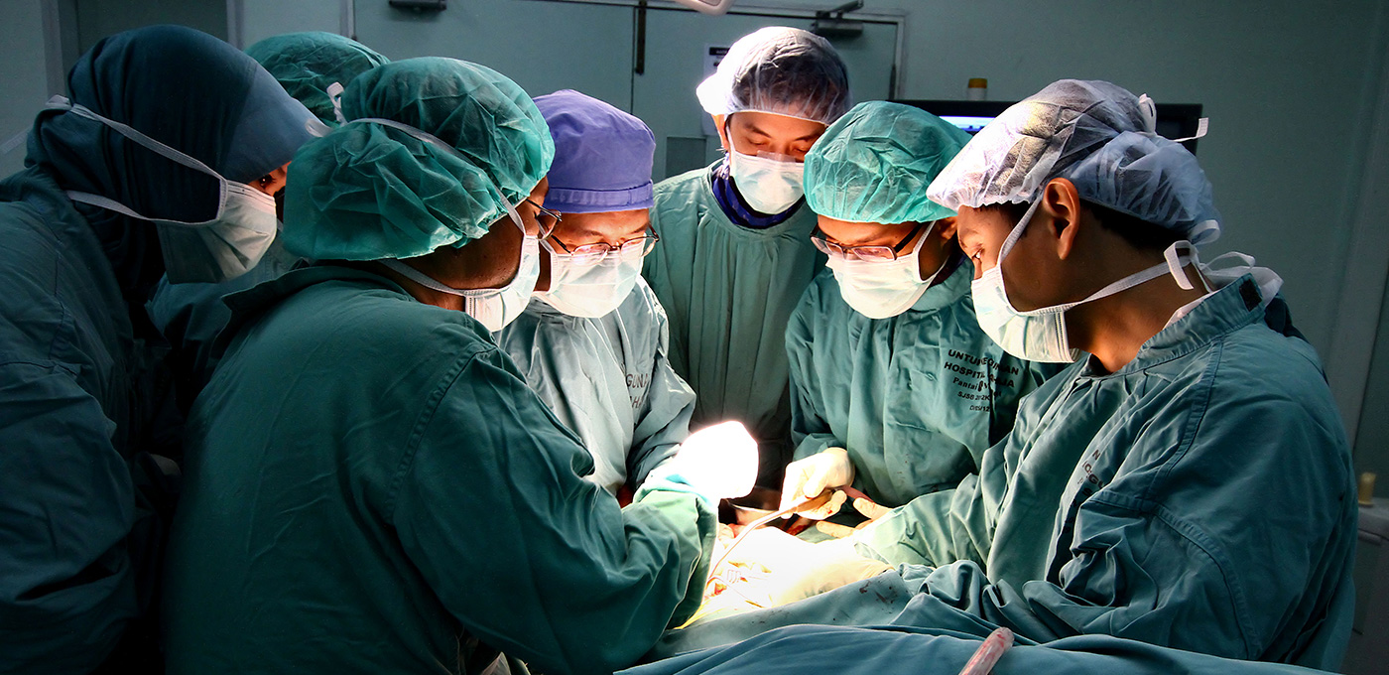
My three favourite things

Slide 3
My training Path
MBChB from University of Birmingham (5 years)
Foundation training in North West Deanery (2 years)
Emergency medicine in Israel (1 year)
Military medicine in Israeli field intelligence unit (20 months)
Orthopaedic surgery training in Jerusalem (6 years)
Hand and Wrist surgery training in Jerusalem (1 year), Liverpool (1 year), and Wrightington (1 year)
Total training time: 16 years
Professional exams (since finishing med school): 6 (and 6 more in the next 18 months)

Slide 4
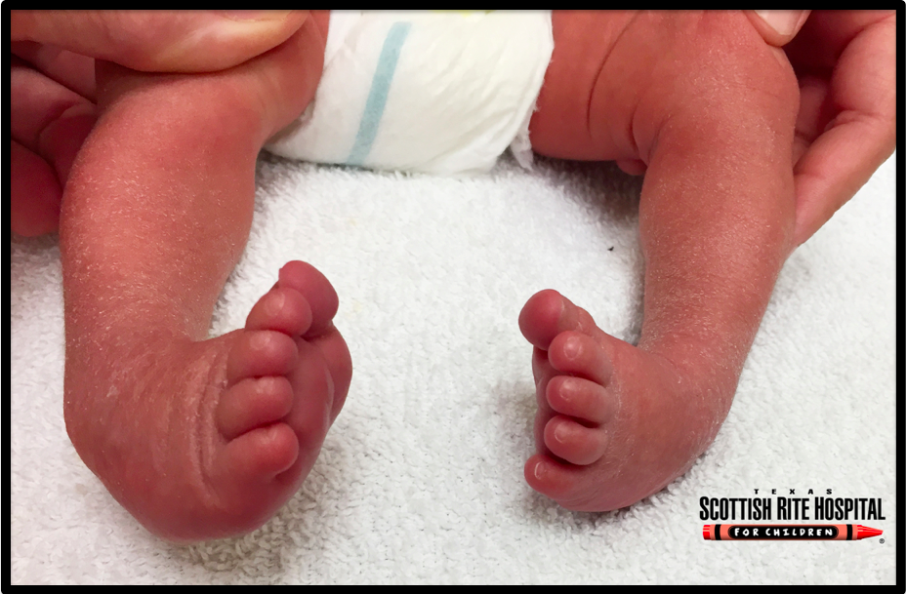
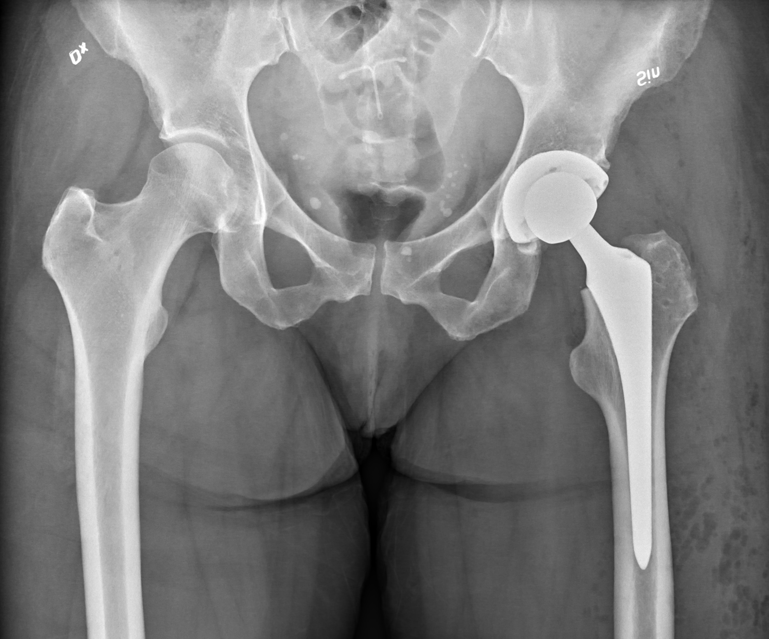
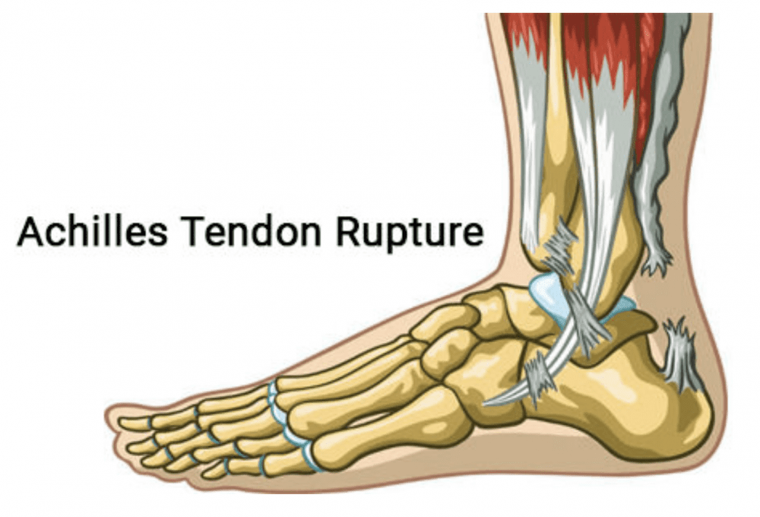
What is Orthopaedic surgery? Musculoskeletal surgery
When do we operate
What do we operate on?
Trauma (accidents) and infection – adults and children
Elective – adults and children
Arthritis
Tumours
Deformity
Lots of other things affecting the musculoskeletal system
Bones
Joints
Tendons and ligaments
Muscles
Nerves

Slide 5
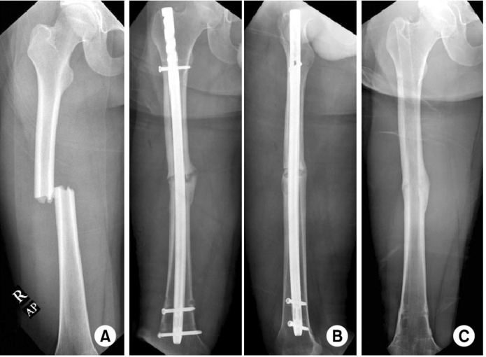
Femur fracture fixation

Slide 6
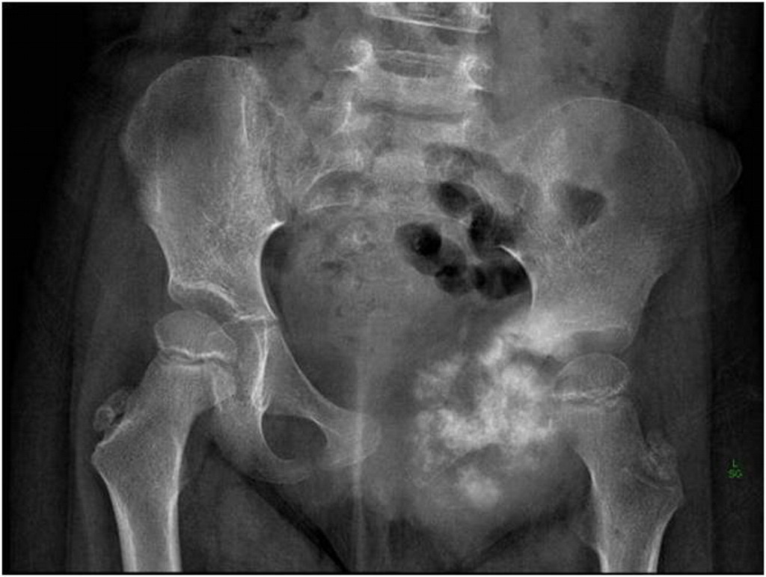
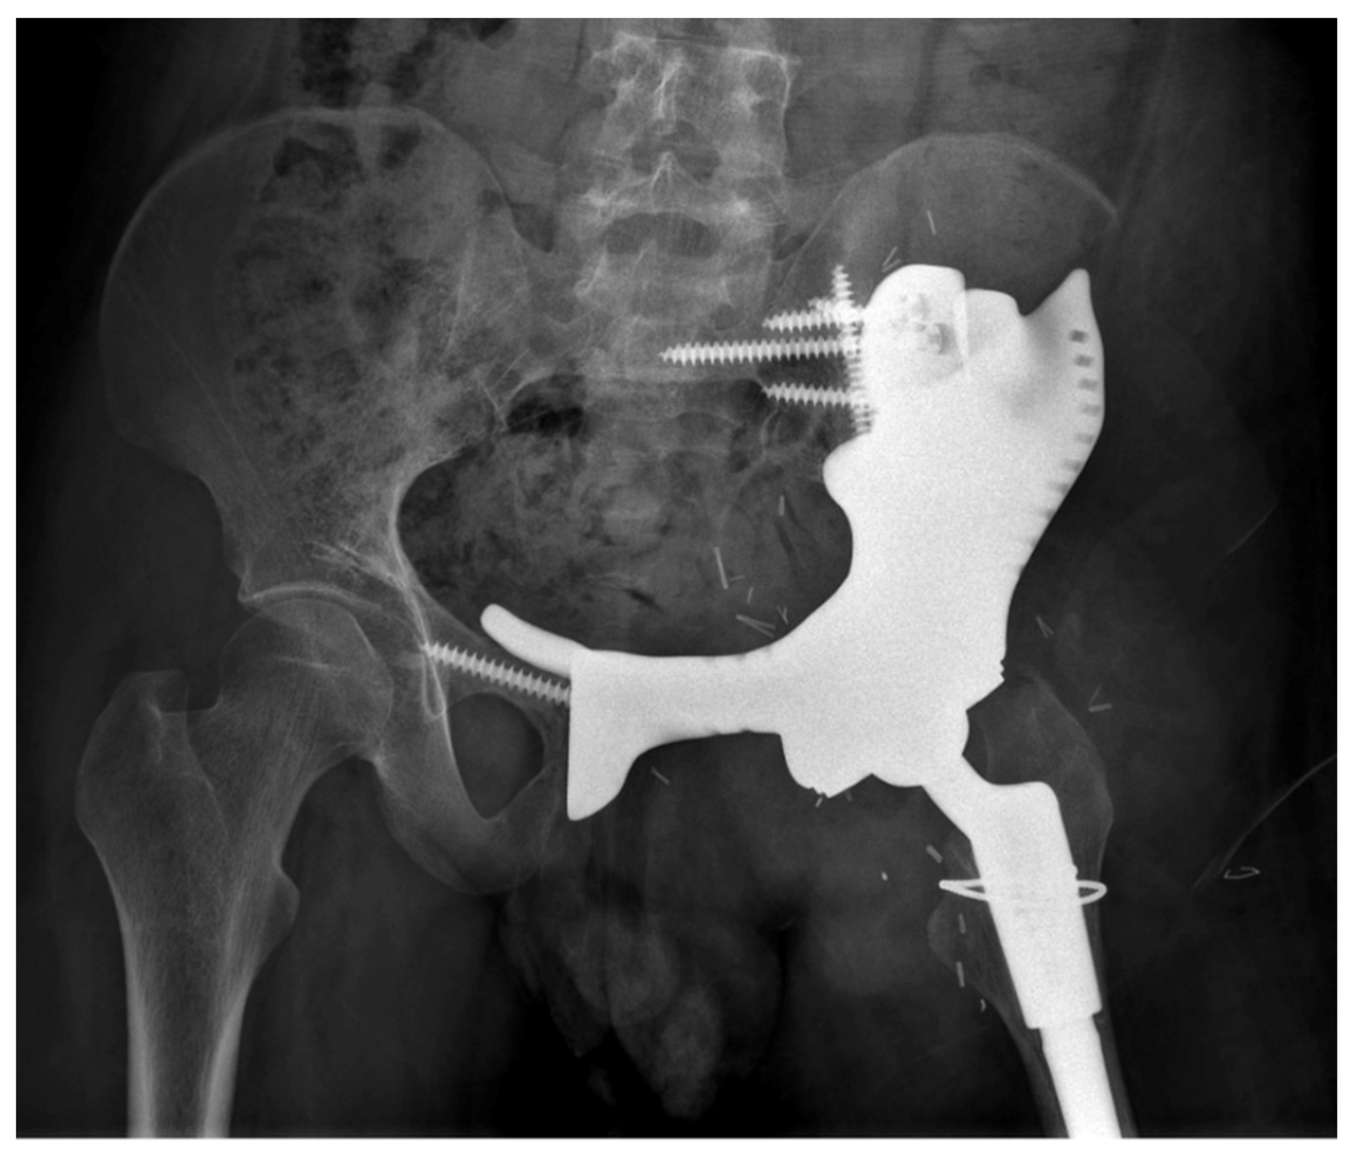
Bone tumour

Slide 7
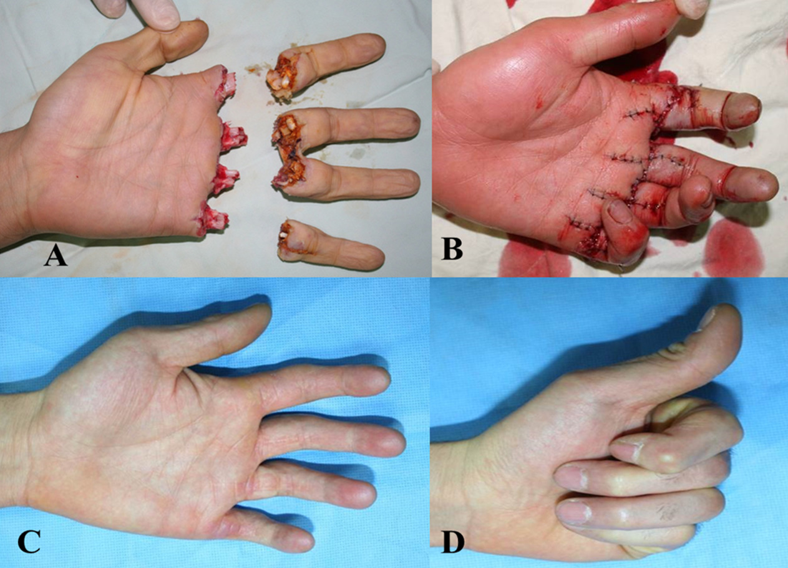
What is hand surgery?
Surgery on all elements of the hand, wrist and forearm
Combination of orthopaedic surgery and plastic surgery
Requires a varied and high-level skillset

Slide 8
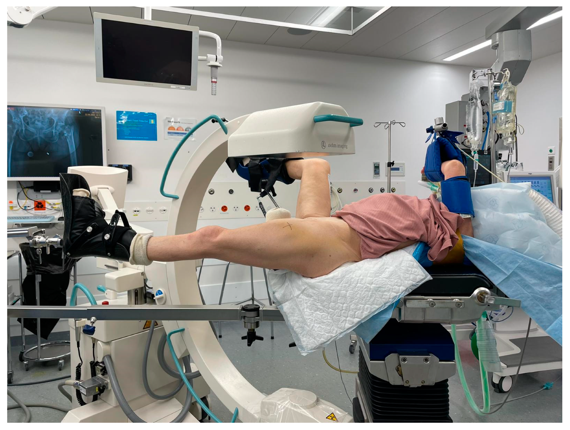
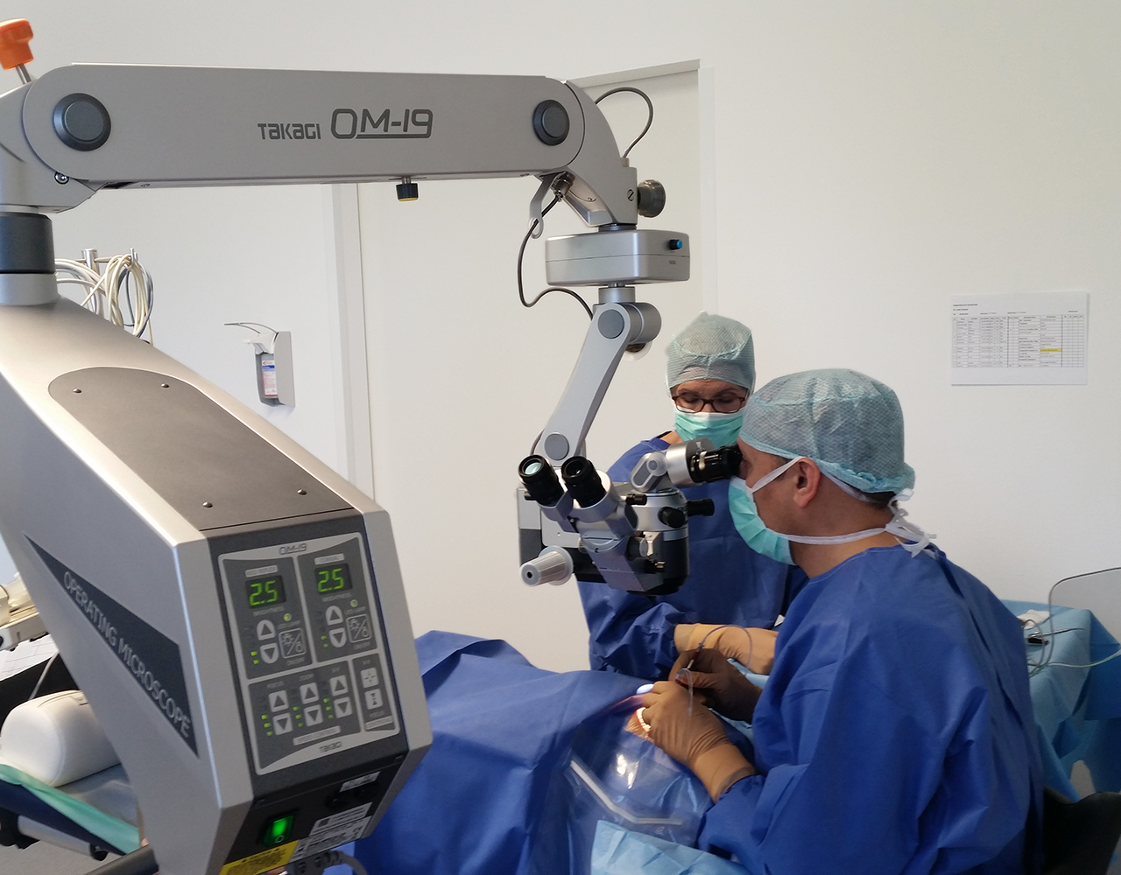
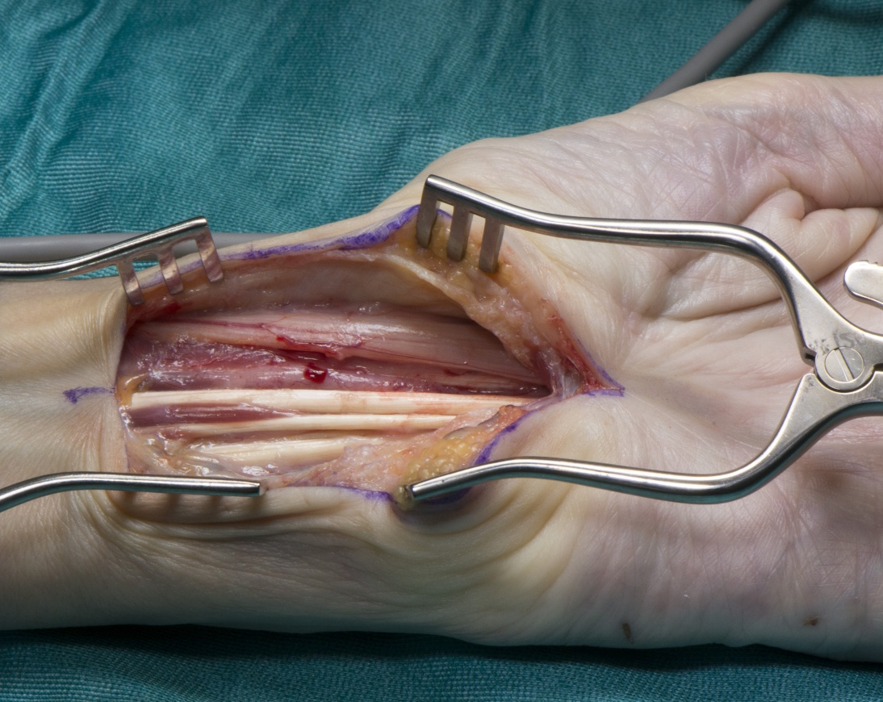
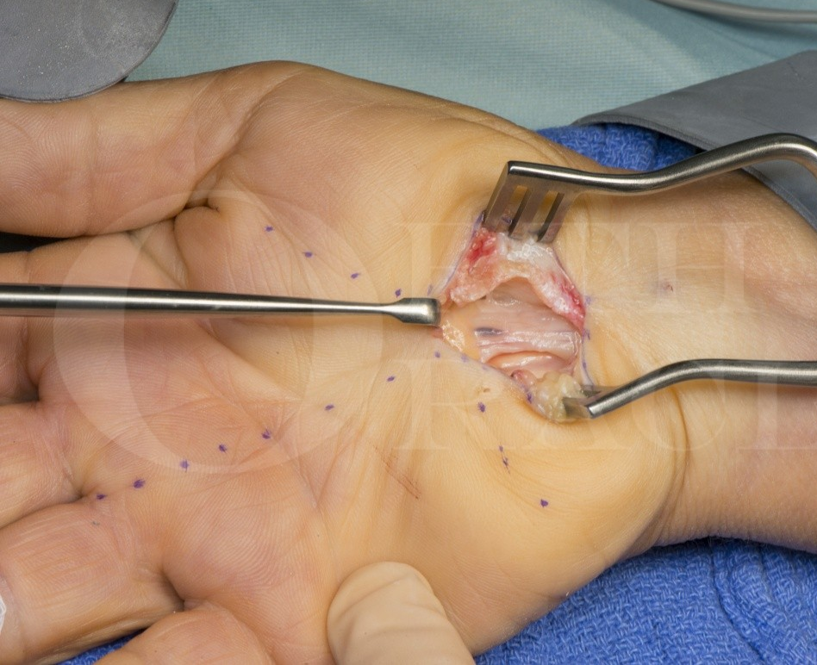
Some examples of what I do

Slide 9
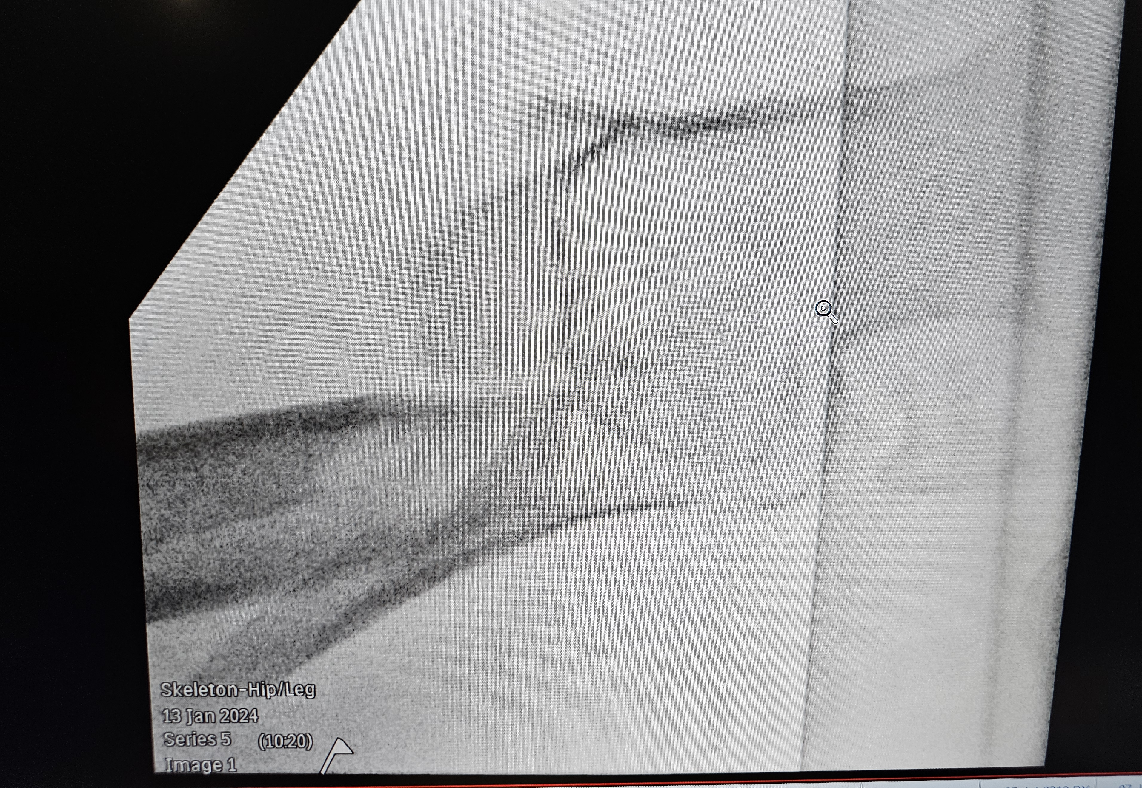
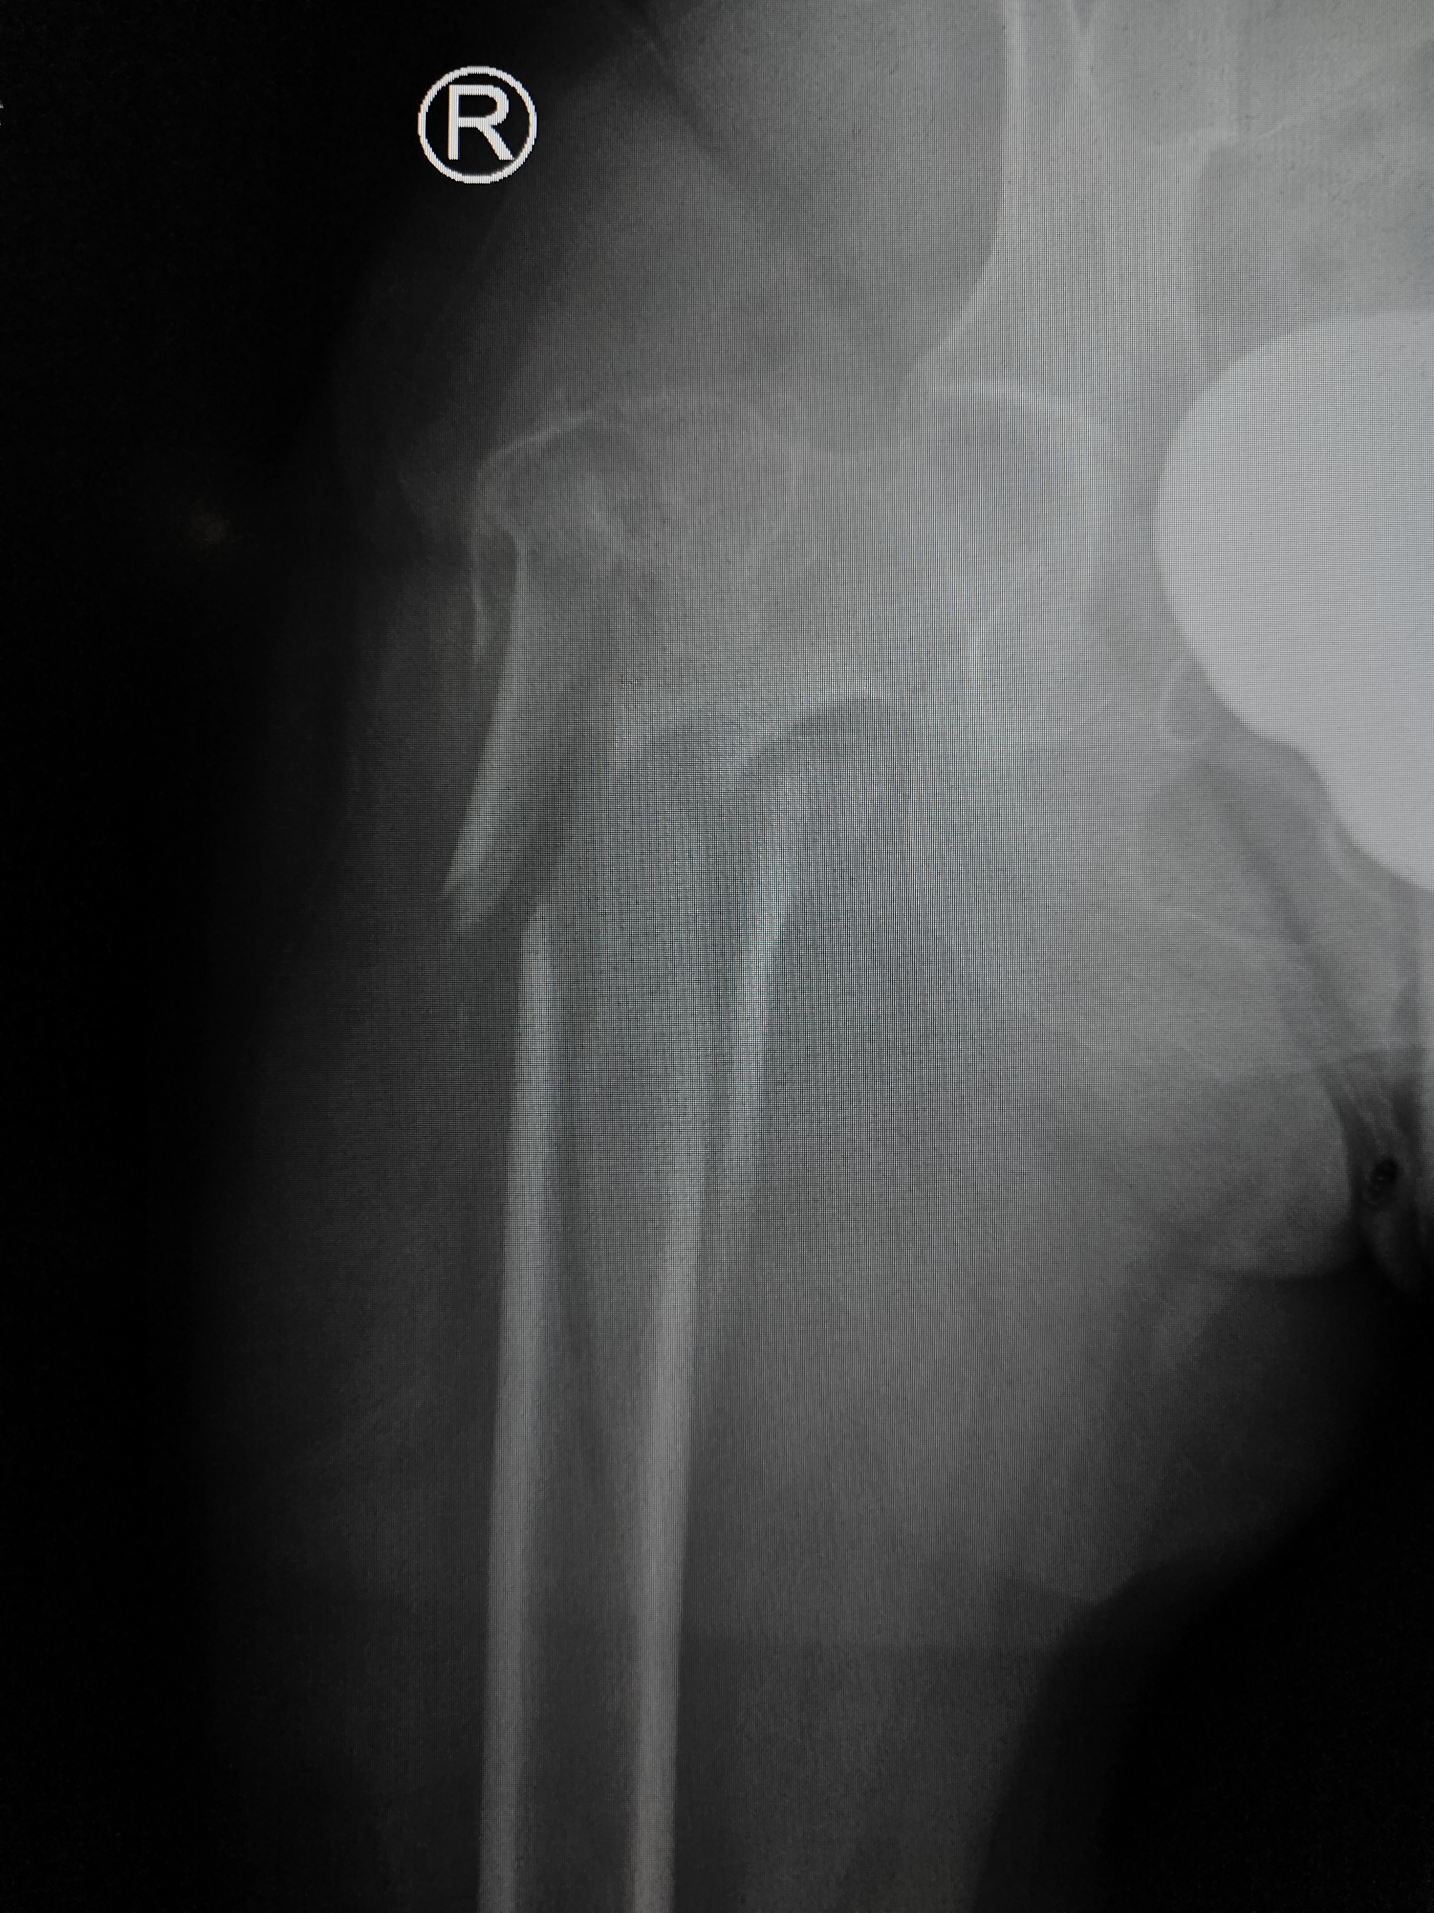
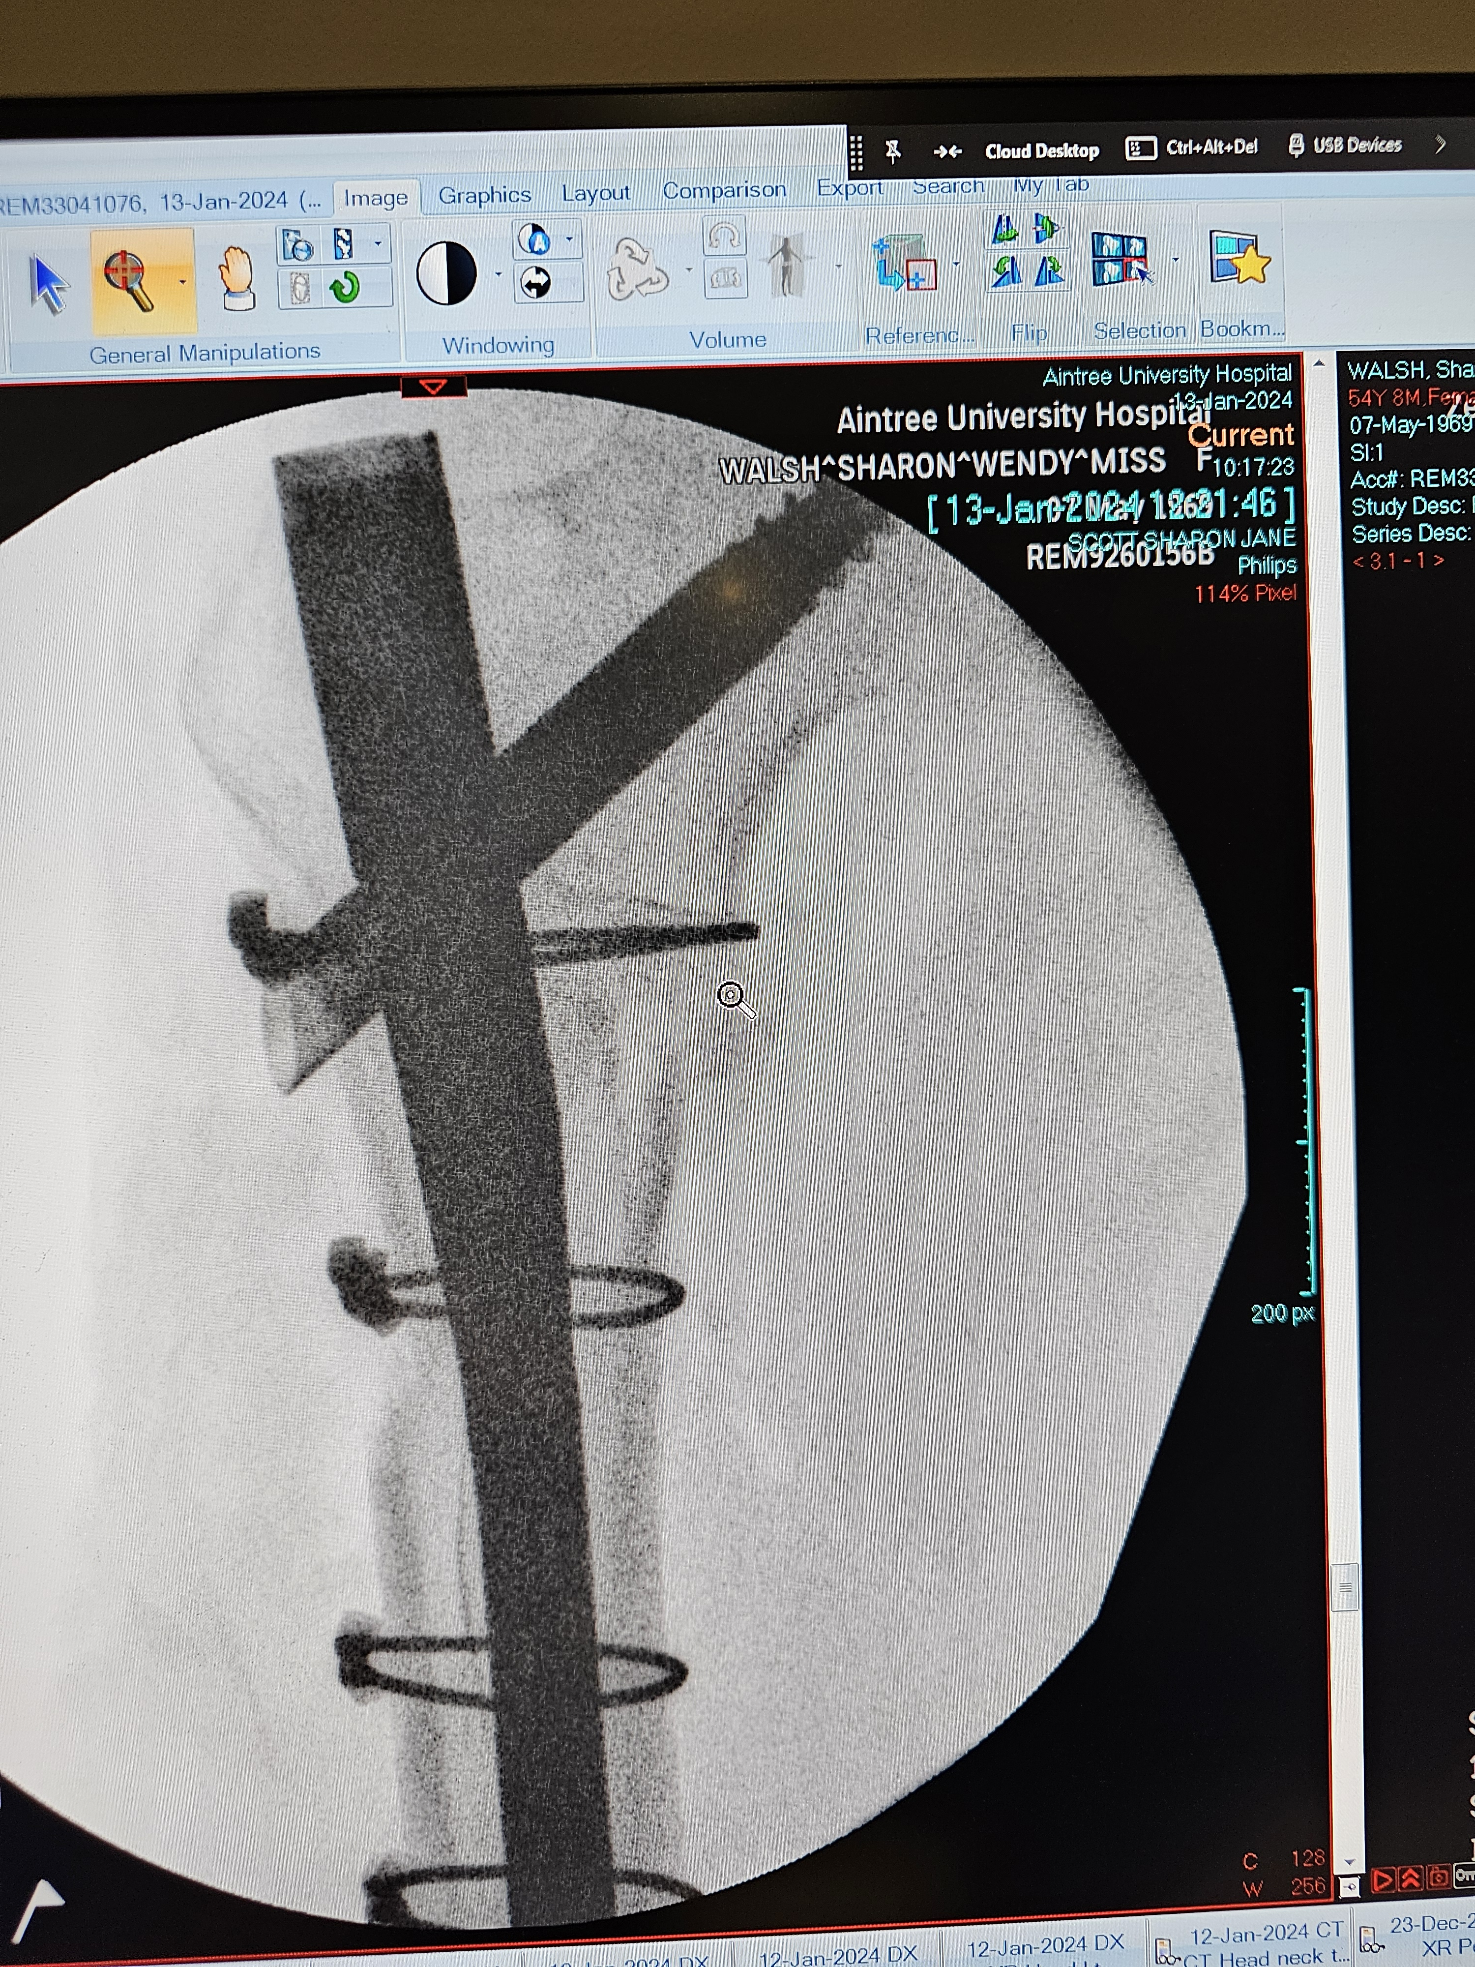
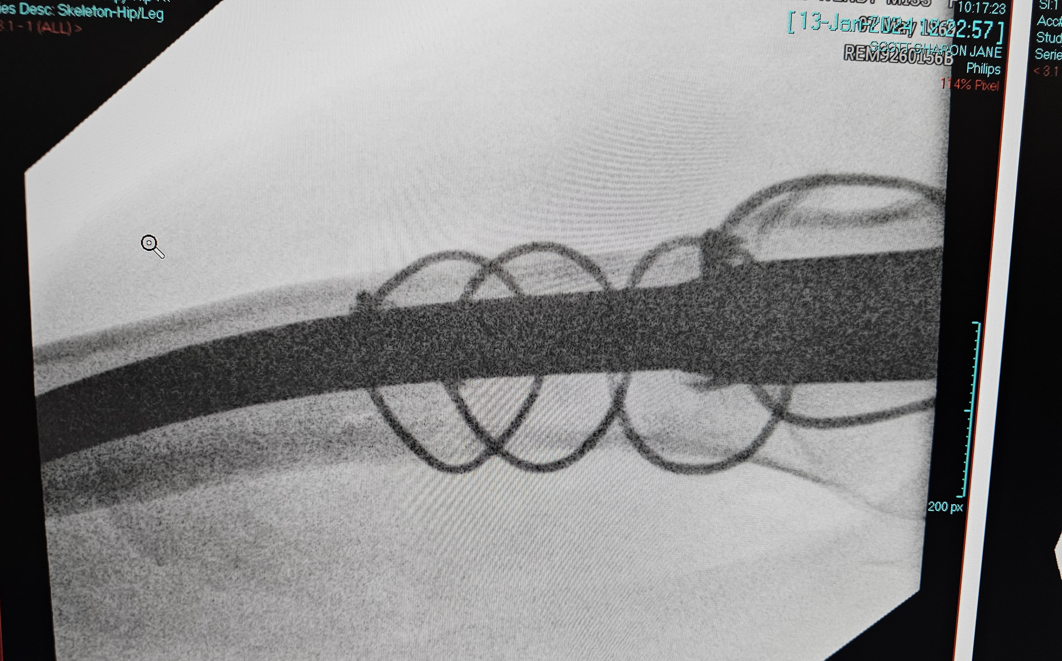

Slide 10
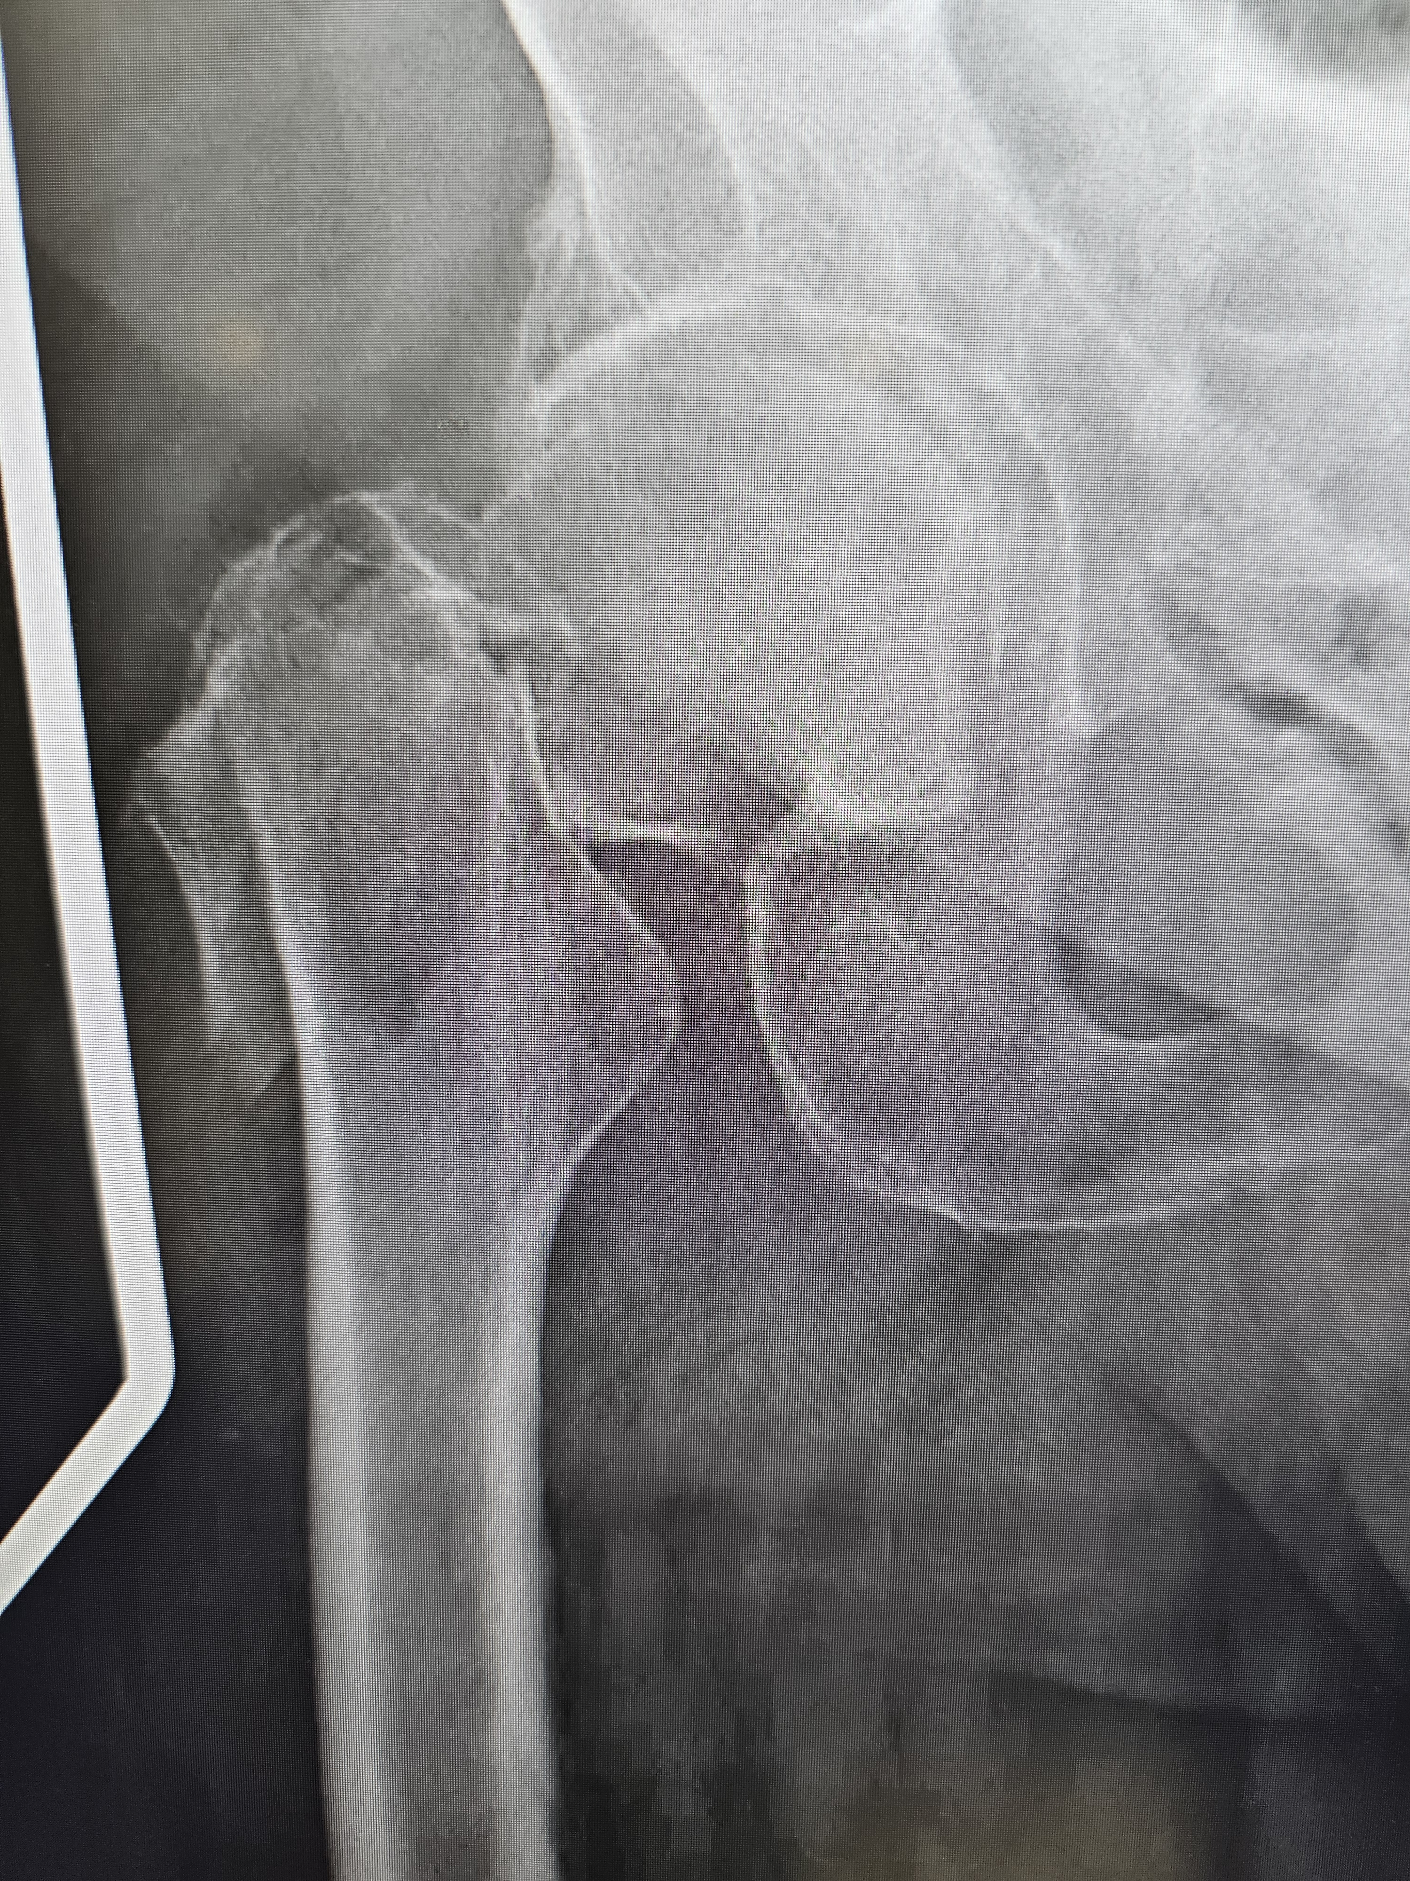
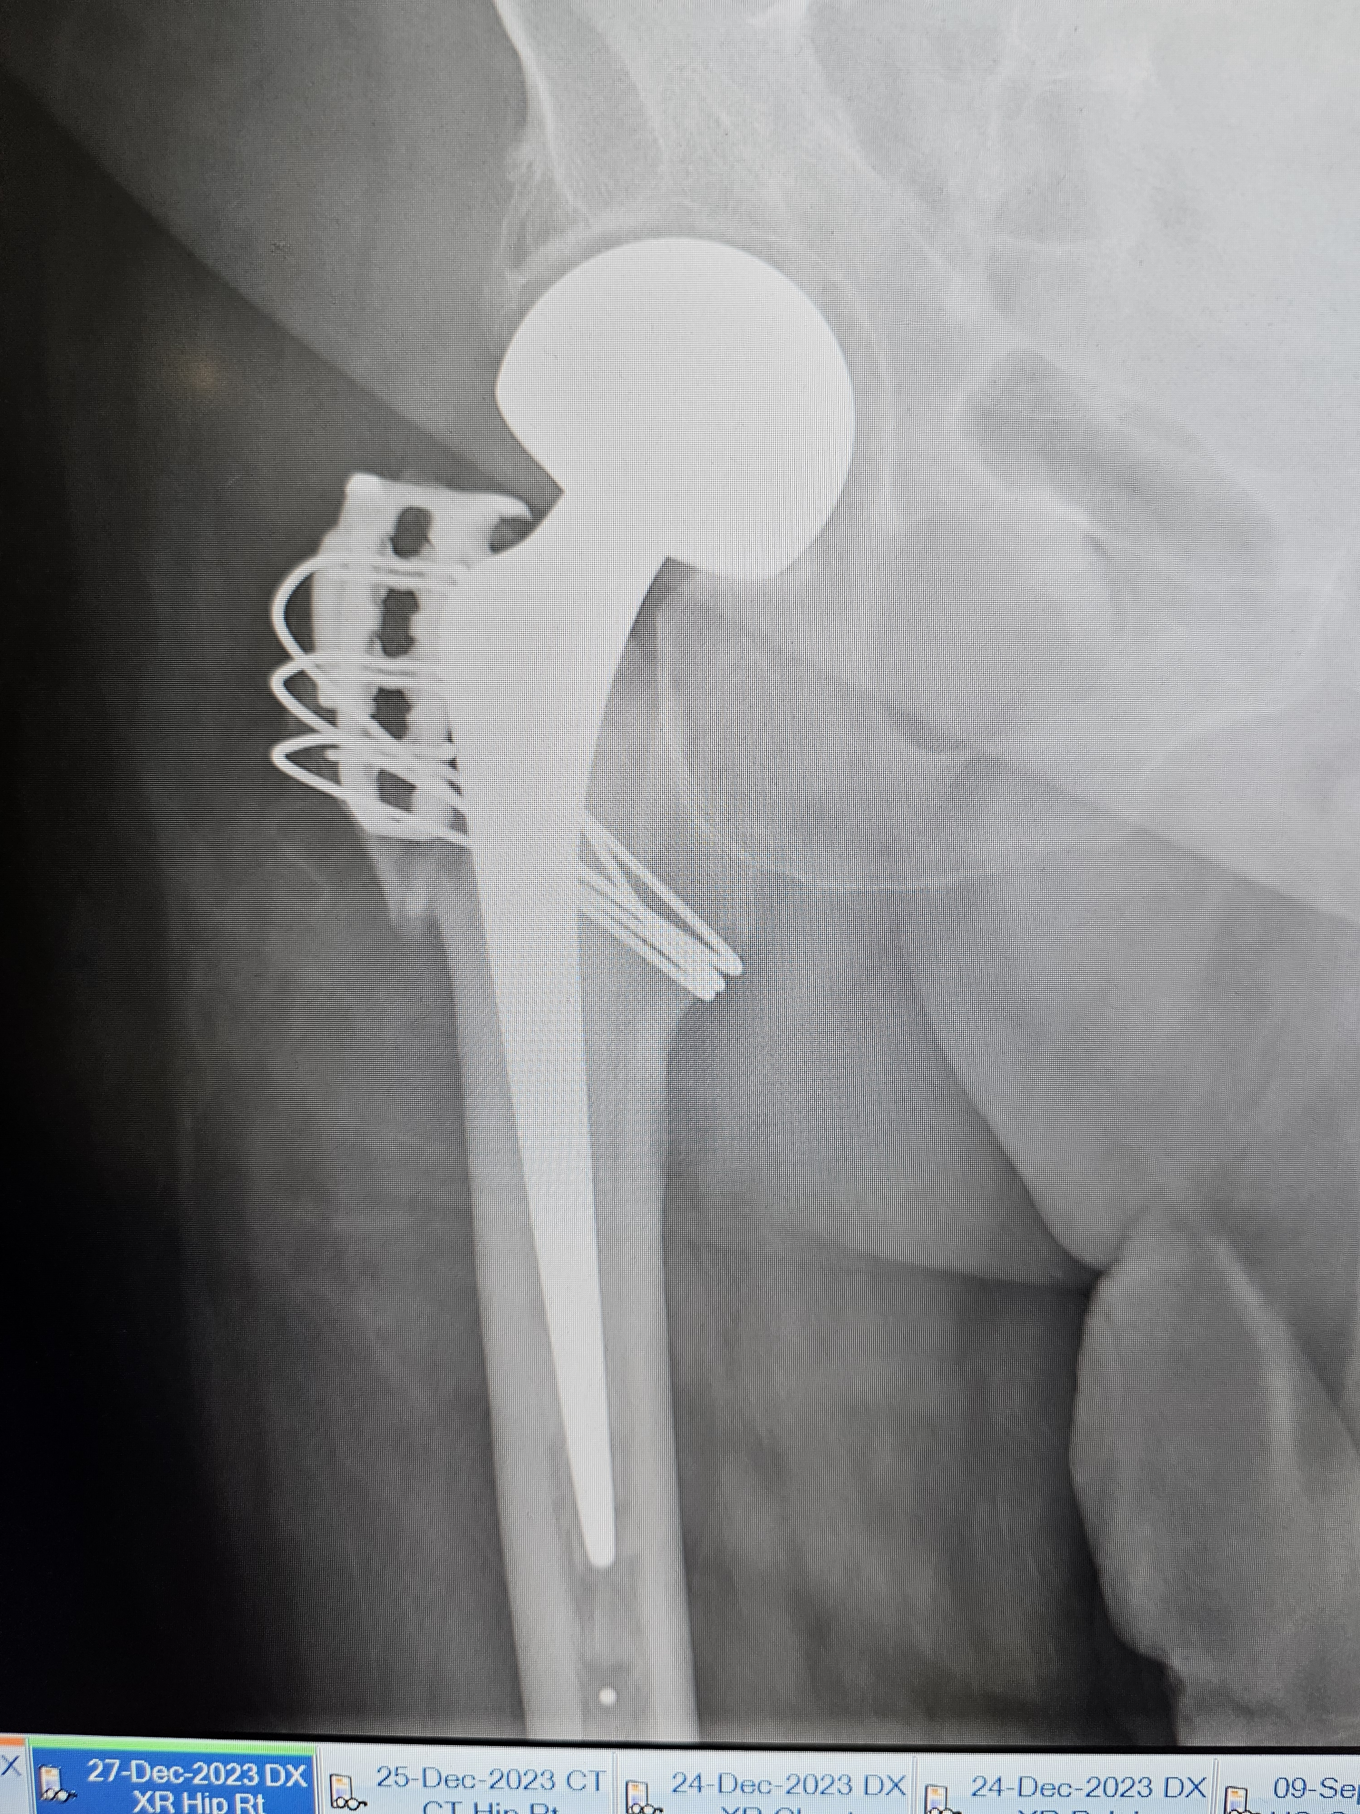
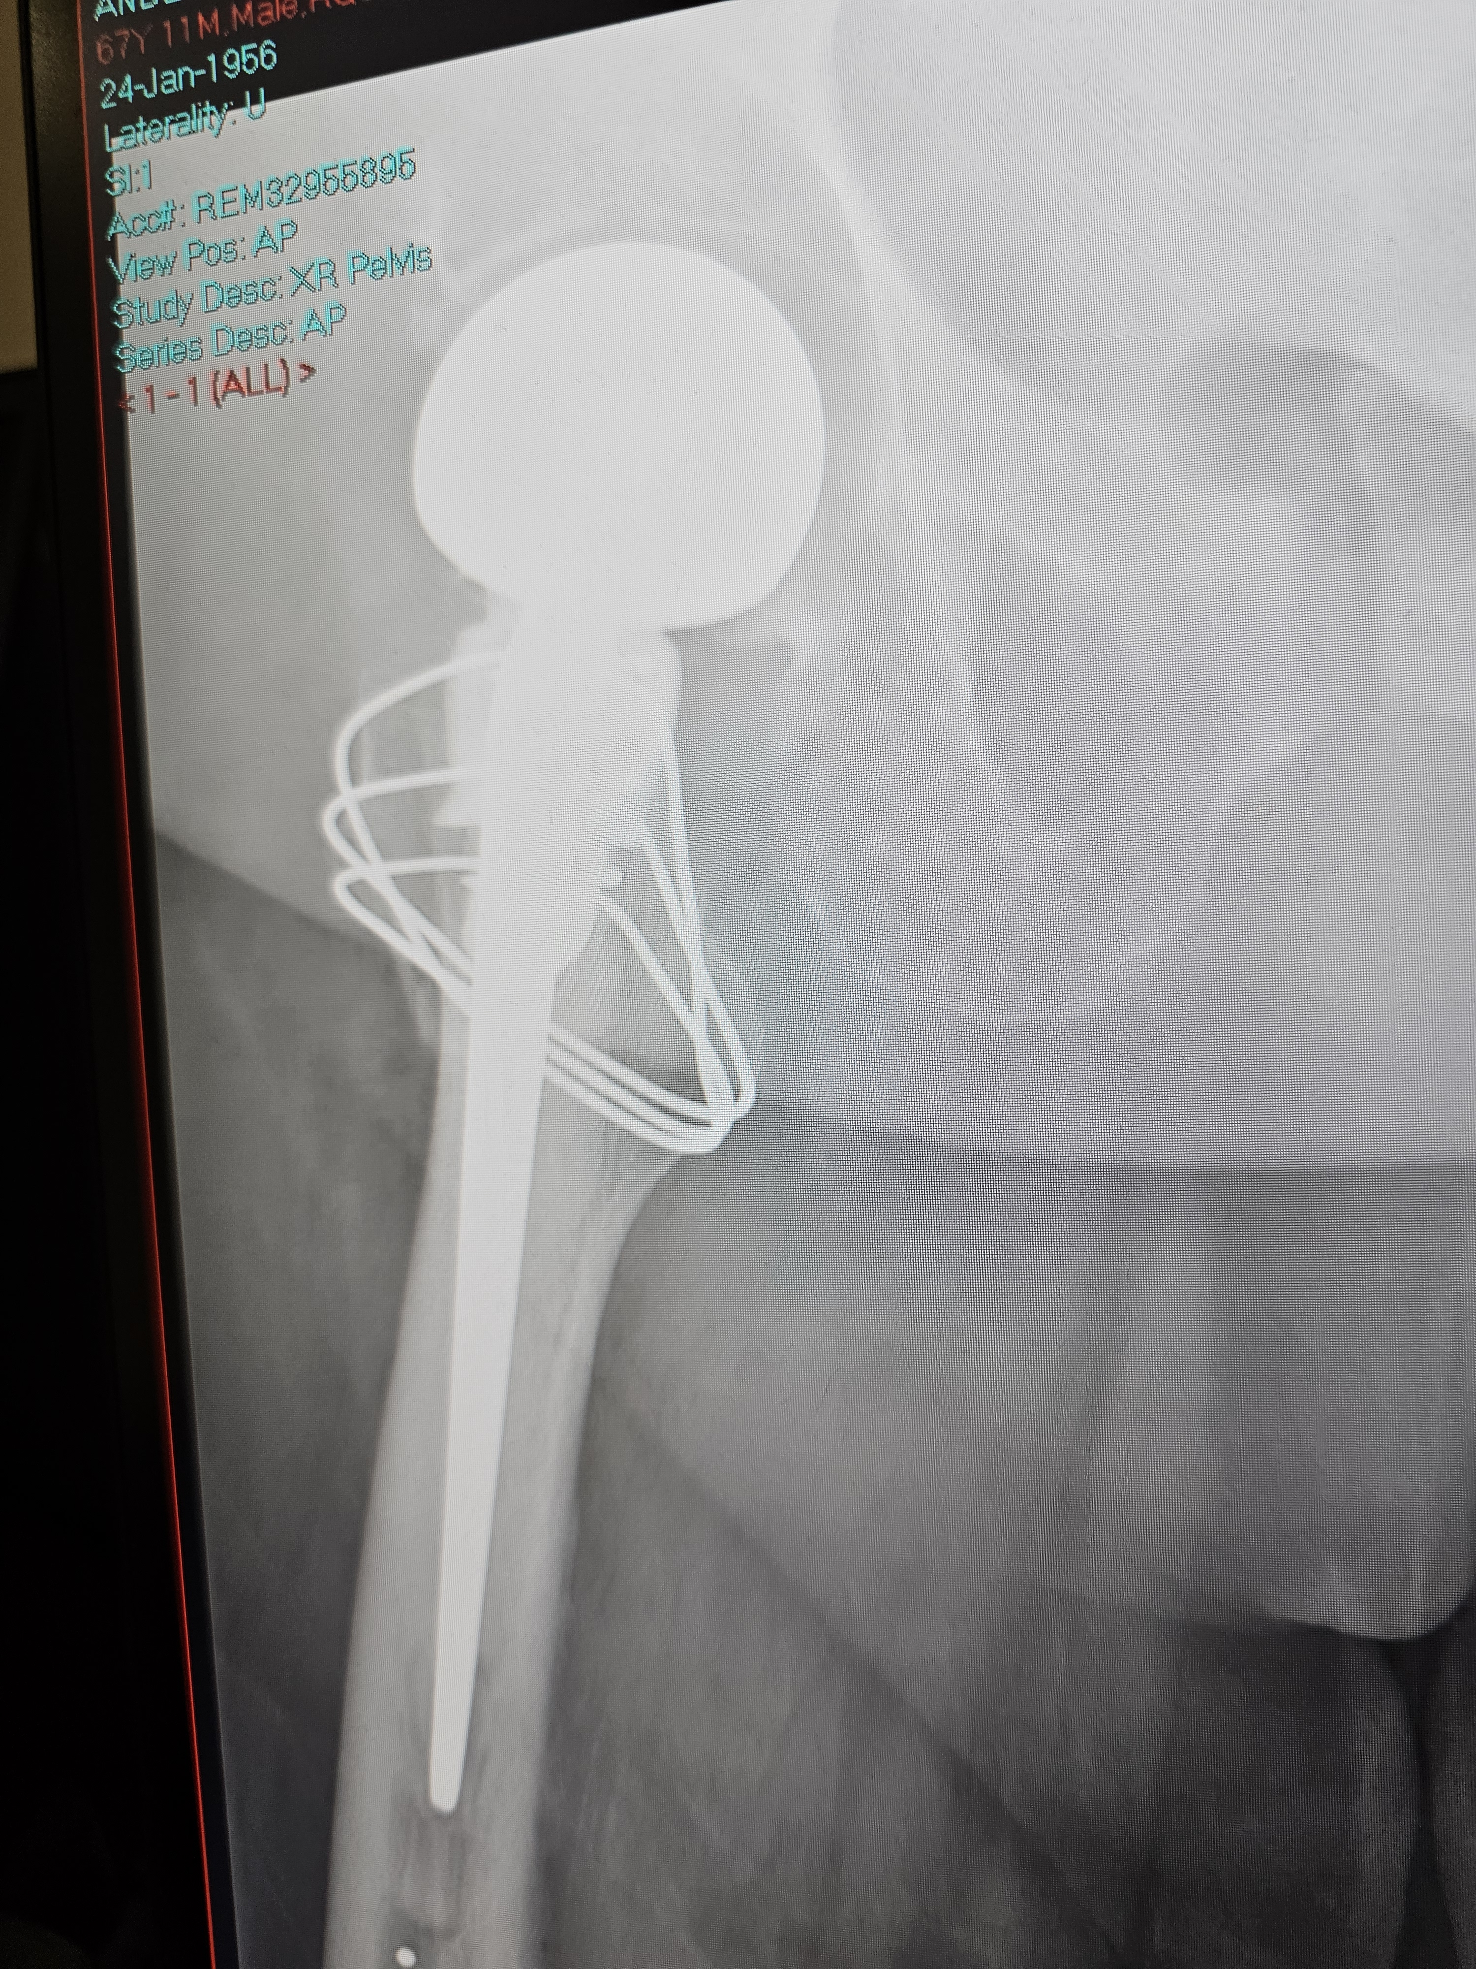

Slide 11
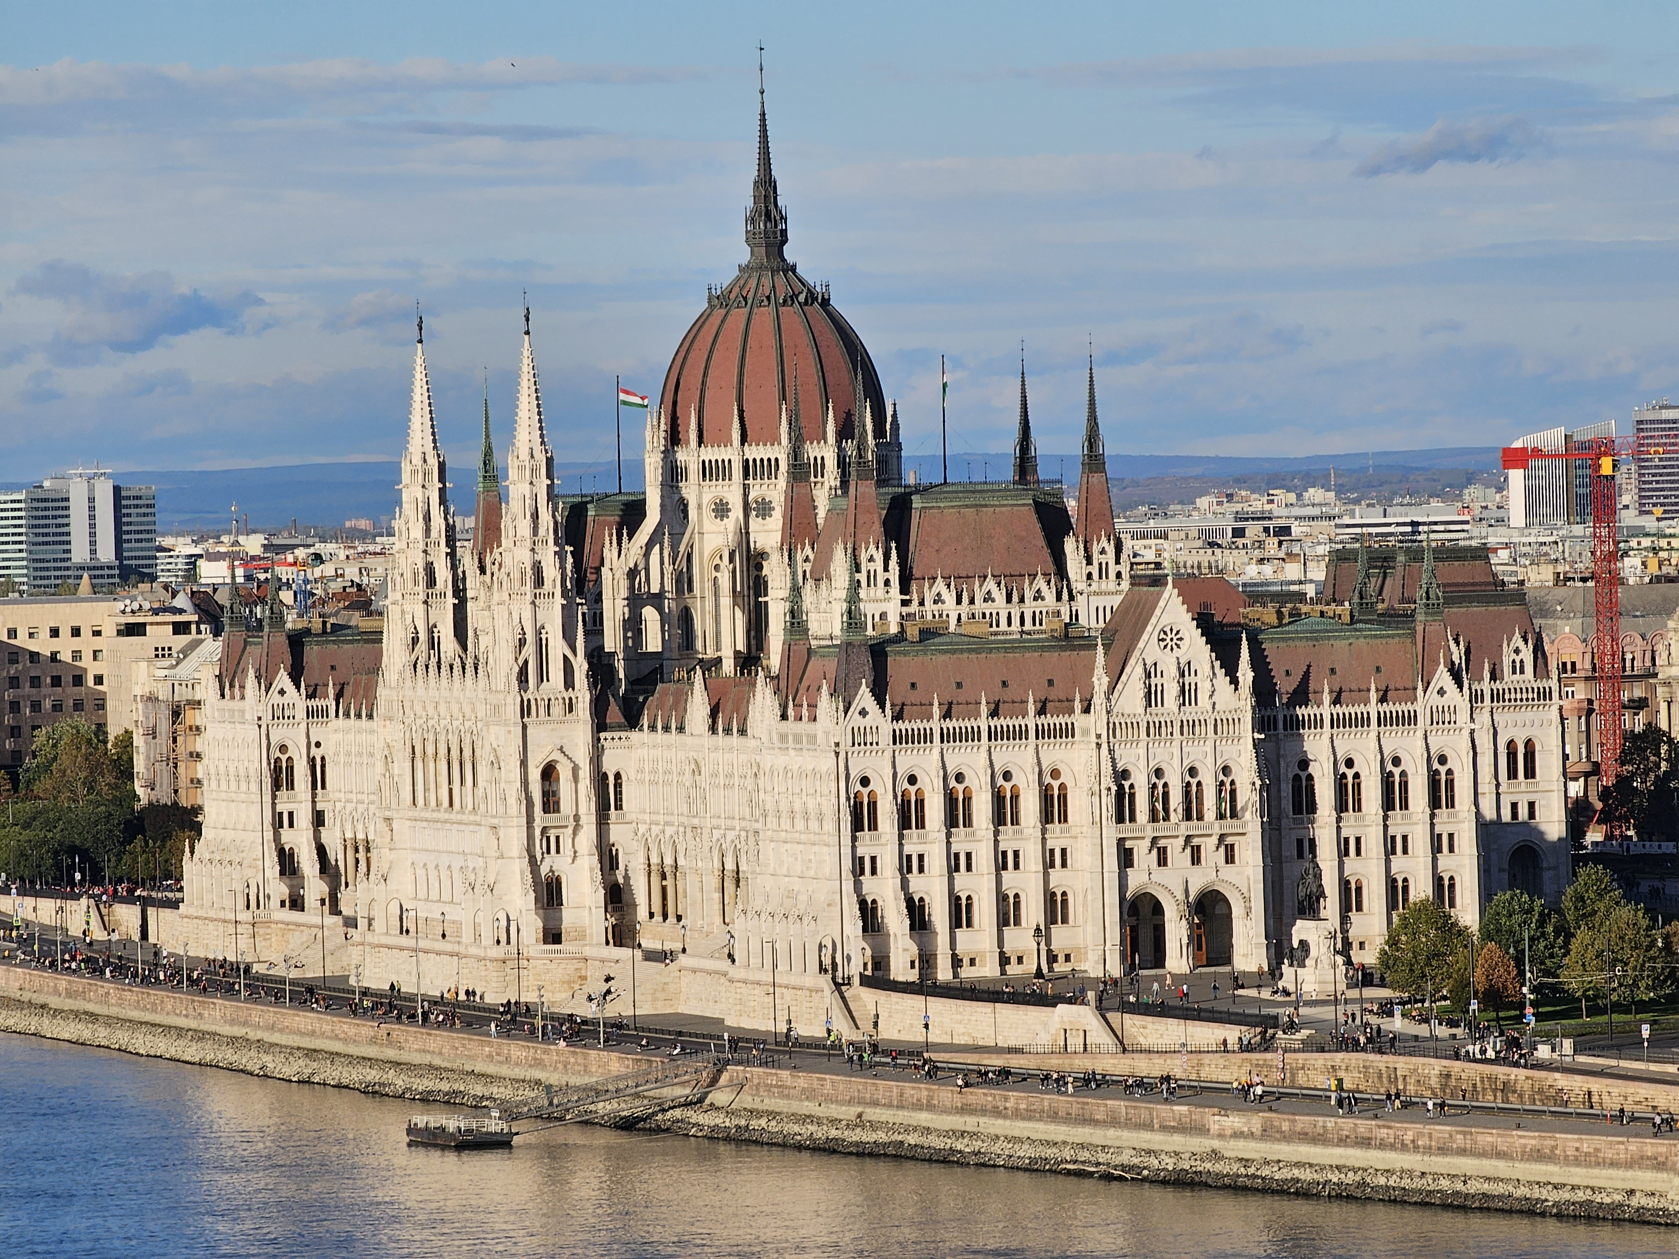

Slide 13
My week
Clinic (1 day a week)
Operating theatre (2-3 days a week)
Admin and research day (1 day)
1 in 10 on-call rota
Long days
Overnight as needed
Weekend in trauma theatre

Slide 14
Why do I like my job?
Massive variety of work
Love the technical aspects of being a surgeon
I get to help people every day!
Sometimes I save people’s life, often I save their profession
Great colleagues – friendly, intelligent, supportive
Relatively well paid

Slide 15
Why don’t I like my job
Can be stressful
Weekend and evening shifts
Loads of extra work at home
NHS beauracracy
Relatively poor pay

Slide 16
Lifestyle and wages
Training is difficult
Highly variable across different medical specialties
Most specialties have on-calls
Weekend shifts
Night shifts
Continuous professional development (CPD), annual appraisal, and revalidation
The best doctors normally love what they do
Consultant salary £100,000 to £120,000 for 4 day week
Private practice can be double, triple or even more

Slide 17
Questions?

