Slide 1
Years 7 – 11 Careers Research Using Xello
Learning objectives:
Understand how to access XELLO using the school intranet to research career routes.

Slide 2
Planning your career
identify your skills and interests
explore career ideas
make a decision

Slide 3
1. Identify your skills and interests
What am I good at?
What are my interests, motivations and values?
What do I most enjoy in school?
What kind of lifestyle do I want?
What do I want from my career?
What is important to me?

Slide 4
2. Explore career ideas
There are three job sectors:
Private - sole traders, partnerships and limited companies
Public - local and national governments, plus their agencies and chartered bodies
Not-for-profit - often referred to as the third sector, or the charity and voluntary work sector.

Slide 5
3. make a decision
Will I enjoy doing the job every day?
Does it meet most of my preferences?
Do I have the right skills?

Slide 6
HOW TO ACCESS XELLO
Click on the APP launcher.
Click on ALL APPS
Scroll down and select XELLO

Slide 7
I would like you to select CAREERS

Slide 8
Using Xello, investigate FOUR careers you may have an interest in exploring in the future.
NAME:
Career | What skills do you need for this career choice? | What GCSEs do I need? | What A Levels do I need? | What further education do I need? | What do you find appealing about that career?

Slide 9
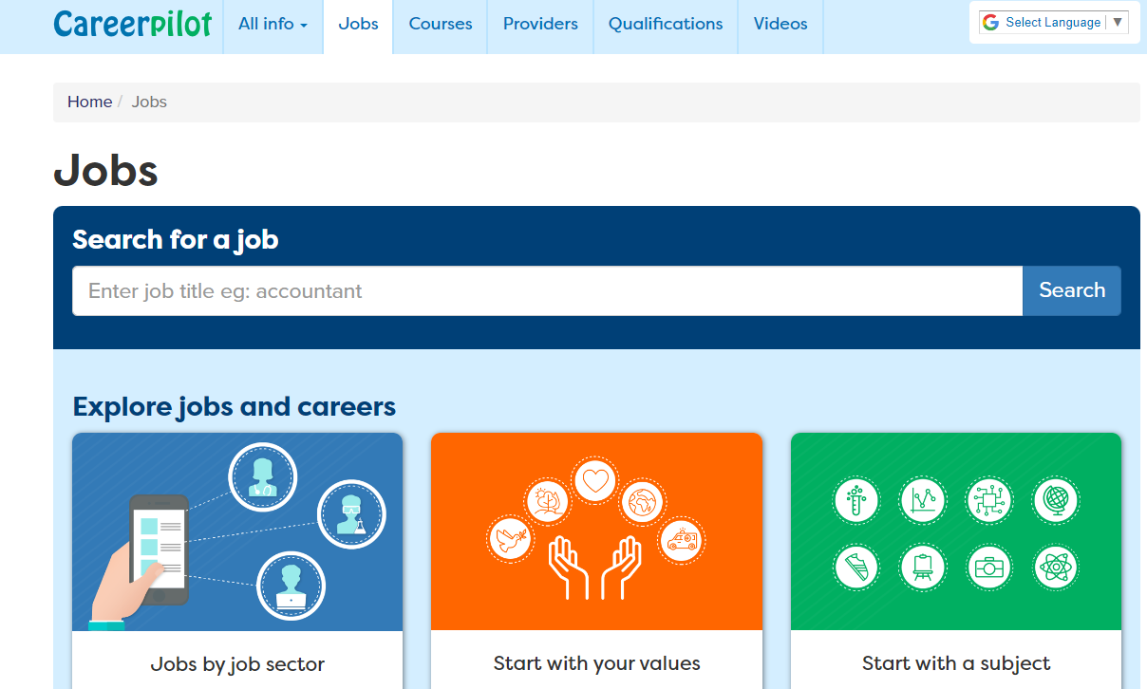
https://www.careerpilot.org.uk/job-sectors

