Slide 1
BMAT
A presentation given by Nechama Giffen

Slide 2
What will be covered in this powerpoint
What is the ‘BMAT’?
Differences between BMAT and UCAT
Why BMAT?
Which universities require BMAT?
Where BMAT?
When BMAT?
Test STATS

Slide 3
What?
BMAT stands for the BioMedical Admissions Test. It is used as part of the admissions process for medicine, dentistry, and biomedical sciences.
For further info https://www.admissionstesting.org/for-test-takers/bmat/
It consists of three sections:
The first section is a problem solving section- very much like quantitative reasoning, verbal reasoning, and abstract reasoning in UCAT.
The second section is scientific knowledge- GCSE maths, biology, chemistry, and physics.
The third section is an essay, choice of three to do.

Slide 4
Ucat vs bmat
Both are 2 hours exams.
UCAT has 5 sections, and BMAT has 3.
UCAT is an online computer exam in a center, BMAT is a written exam in school.
BMAT sections 2 and 3 enable you to demonstrate your knowledge. UCAT is more an aptitude test where preparing and not revision is key.
More UCAT universities
Personally, I found them roughly equally difficult. The consensus is that the BMAT is ‘harder’.

Slide 5
Why BMAT?
I would advise applying to 2 UCAT and 2 BMAT universities.
Since if you don’t do well in the UCAT you have another opportunity.
Don’t apply to all BMAT as you only get results after you have sent your application
2 of the most prestigious universities in the UK- Oxford and Cambridge- require BMAT.

Slide 6
Universities THAt require bmat in the uk
Brighton and Sussex Medical School
Imperial College School Of Medicine
Lancaster University
University College of London (UCL)
University of Cambridge
University of Leeds
University of Oxford

Slide 7
Where and when?
King David High School is an official exam center that can invigilate BMAT.
Typically BMAT is in October, after UCAS deadline for early applicants.

Slide 8
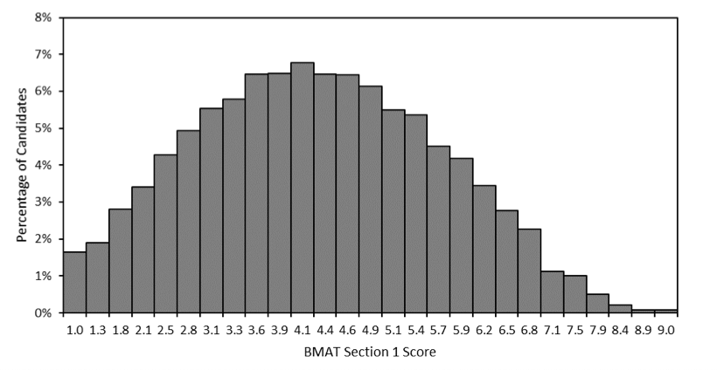
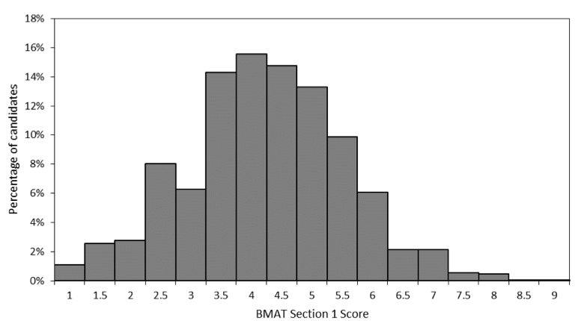
2022 Section 1
2019 Section1

Slide 9
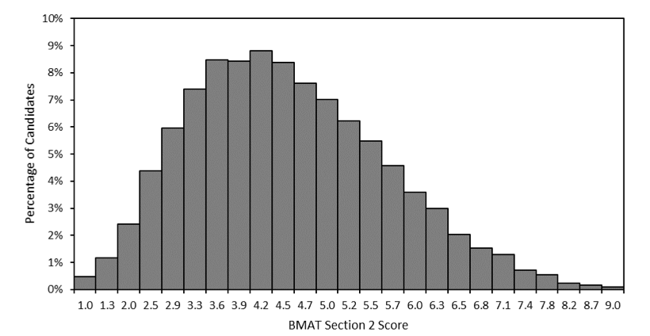
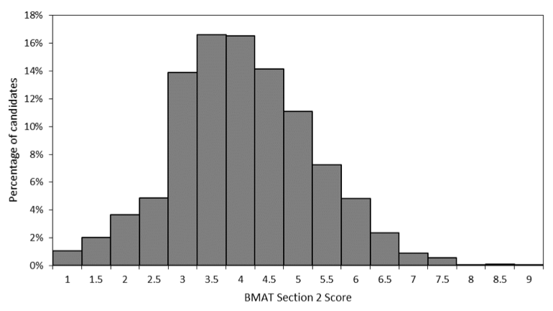
2022 Section 2
2019 Section 2

Slide 10
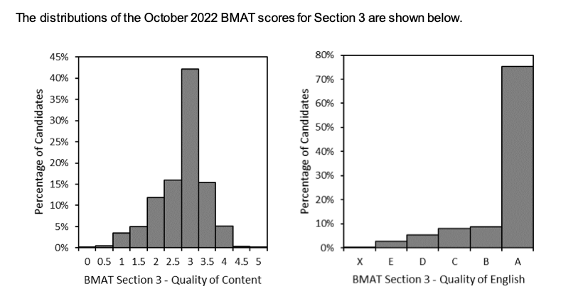
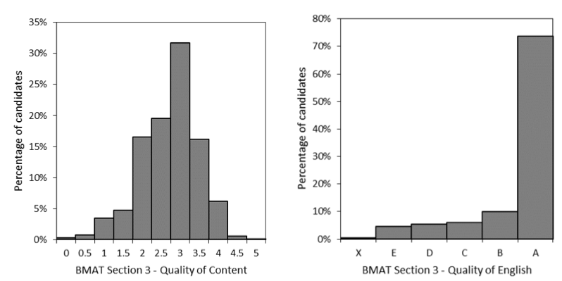
2022 Section 3
2019 Section 3

